Slide 1
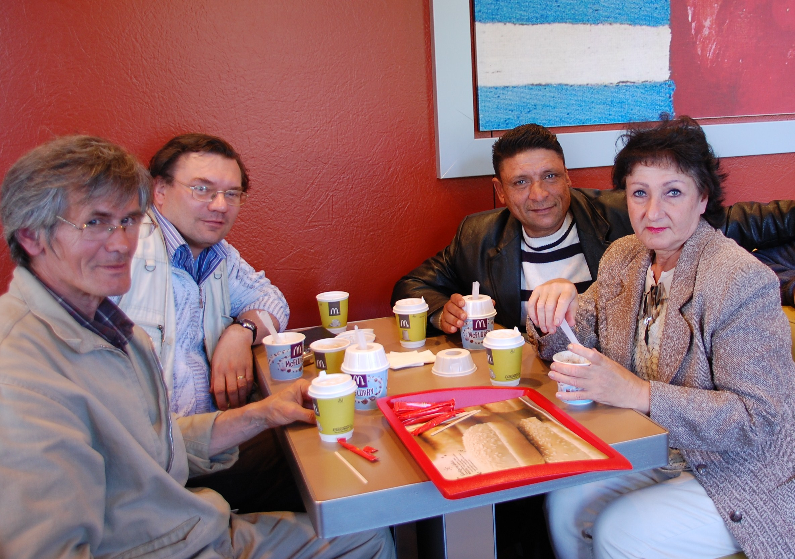
Notes:
Thank you for giving us the opportunity to tell you about Carelinks.
I hope that this will enable you to see what is happening and to consider the amazing response there has been to the work done, centred on brother Duncan Heaster
We start with a providential meeting in a cafe in Riga with 3 Jews who were regular attendees at the Riga Bible Centre-- 2 baptised already, which led to a commitment by Rita to be baptised the following weekend. For those of you who don’t know him, that’s Duncan 2nd left.

Slide 2
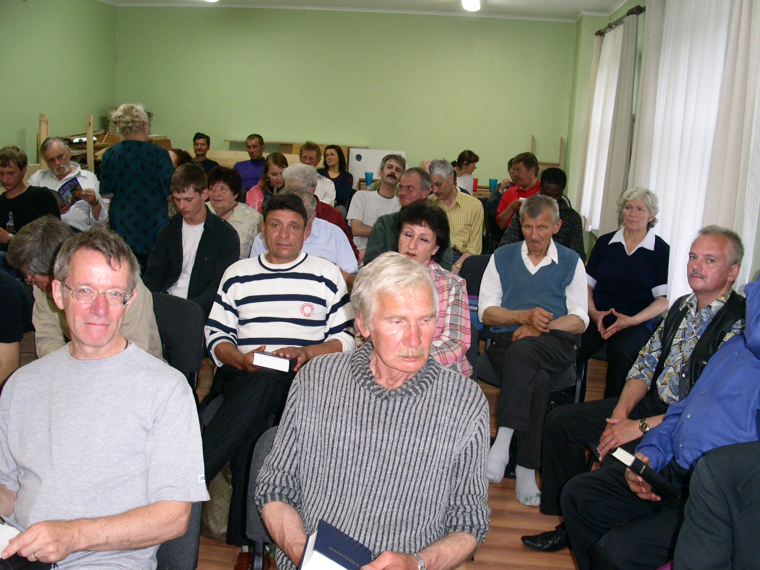
Notes:
A typical Bible School in the north of Latvia – studying the subject of forgiving each other led to 4 baptisms – the result of months of teaching and attendance.

Slide 3
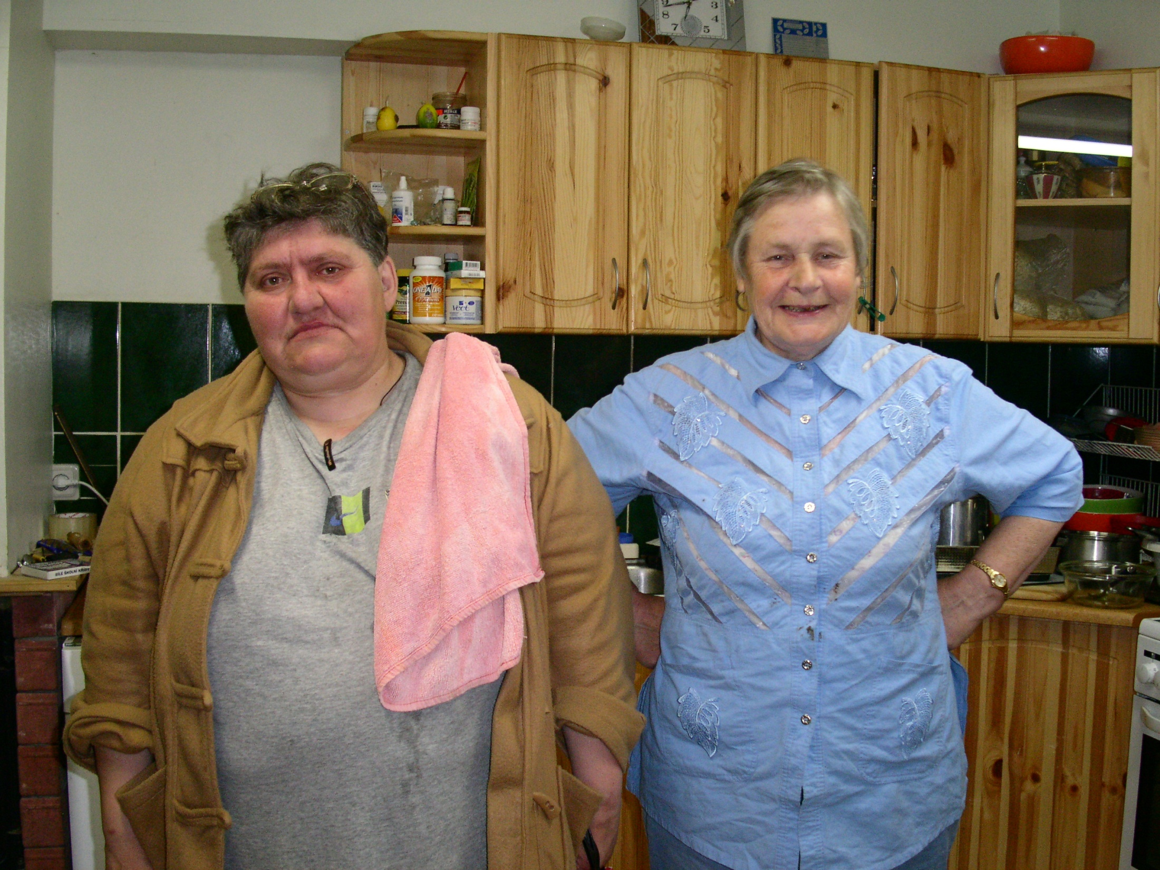
Notes:
The seemingly unlikely fellowship between an Azerbaijani sister Lilya and a former Latvian anti-Communist Resistance leader sister Vija, both now committed to the Truth and ardent teachers and preachers.

Slide 4
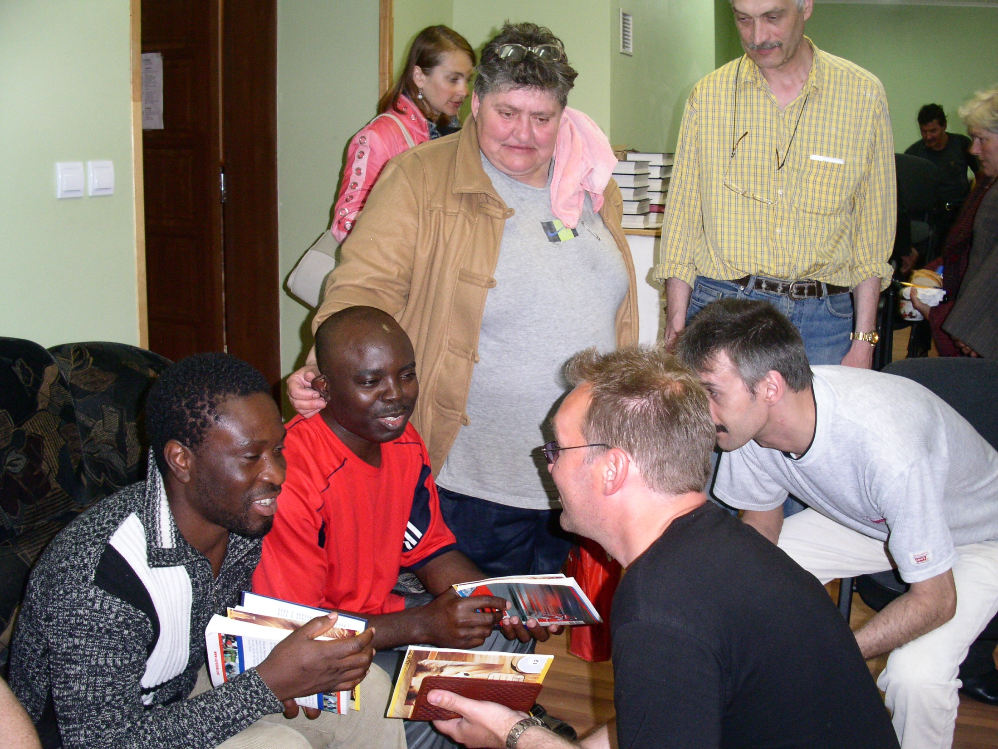
Notes:
The first of many international meetings – Charles from Nigeria & Robert from Sierra Leone – who learnt the gospel whilst in a Latvian Refugee centre.

Slide 5
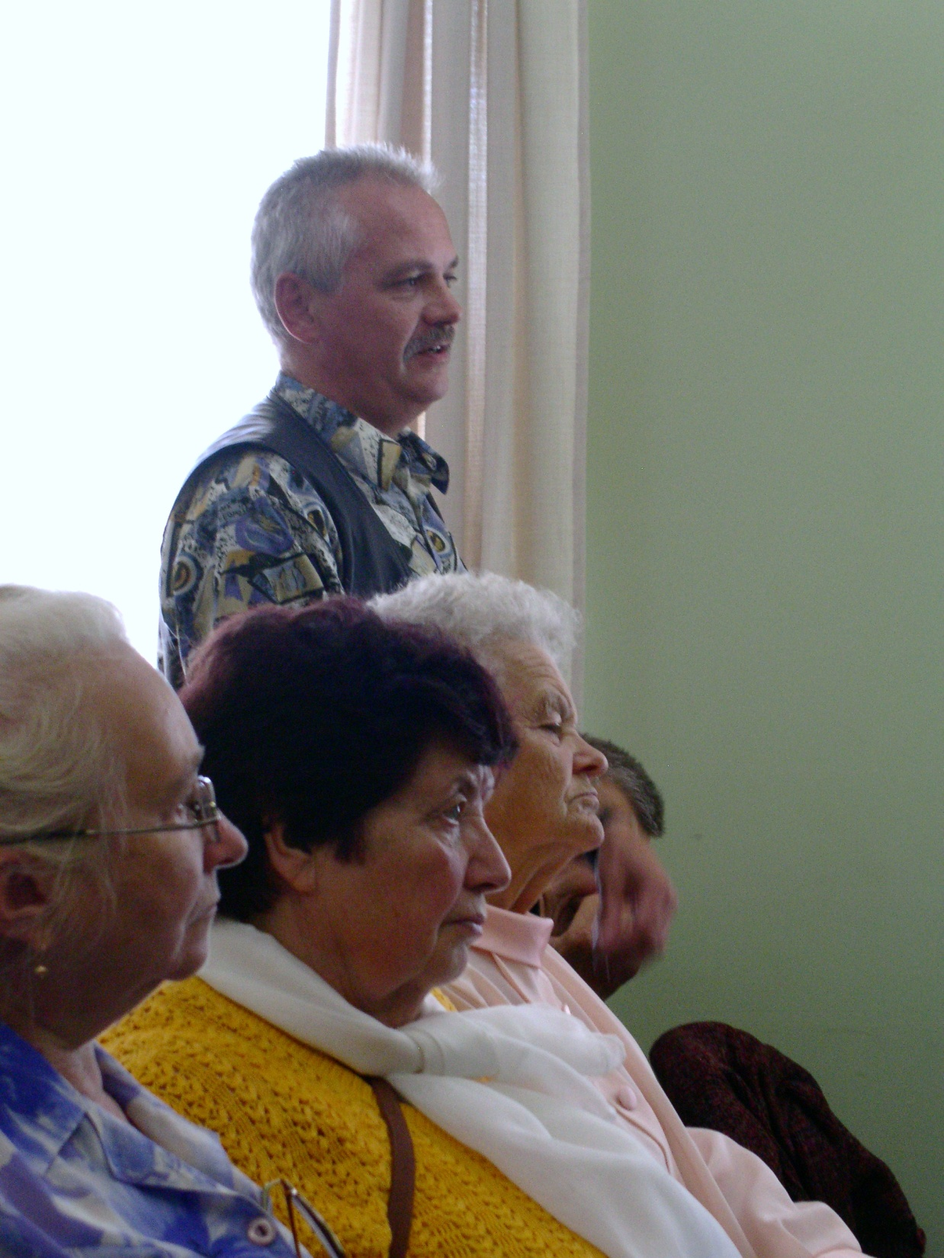
Notes:
Brother Armands – a former businessman who had lost everything that life had to offer. Here he is standing and spontaneously giving his confession of faith. He was baptised later that day. You will see him again as he started working in teaching at the Riga ecclesia.

Slide 6
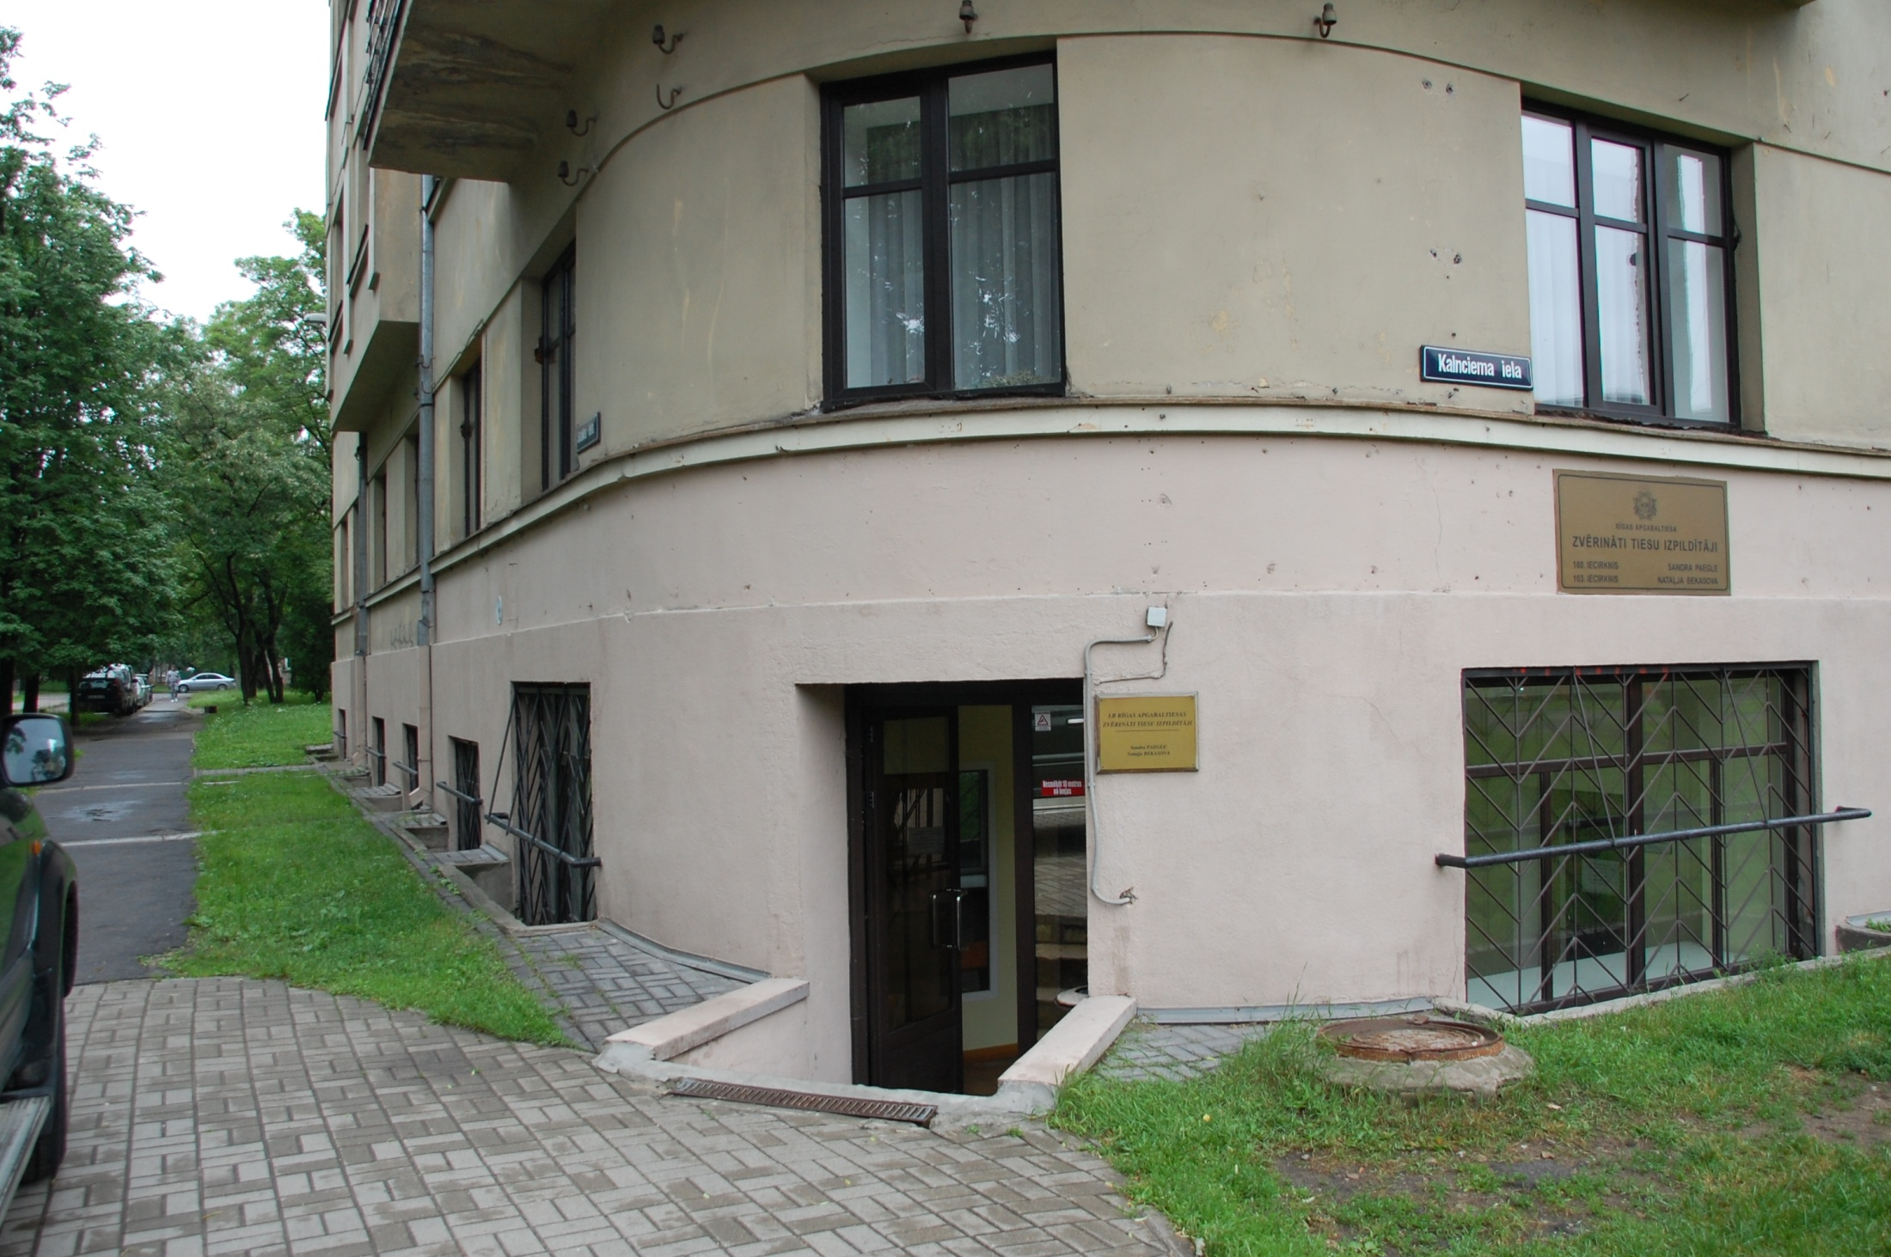
Notes:
When the group in Riga grew to more than 15 people they obtained the ground floor offices in this building for meetings. It proved to be a good centre and soon it was overcrowded.

Slide 7
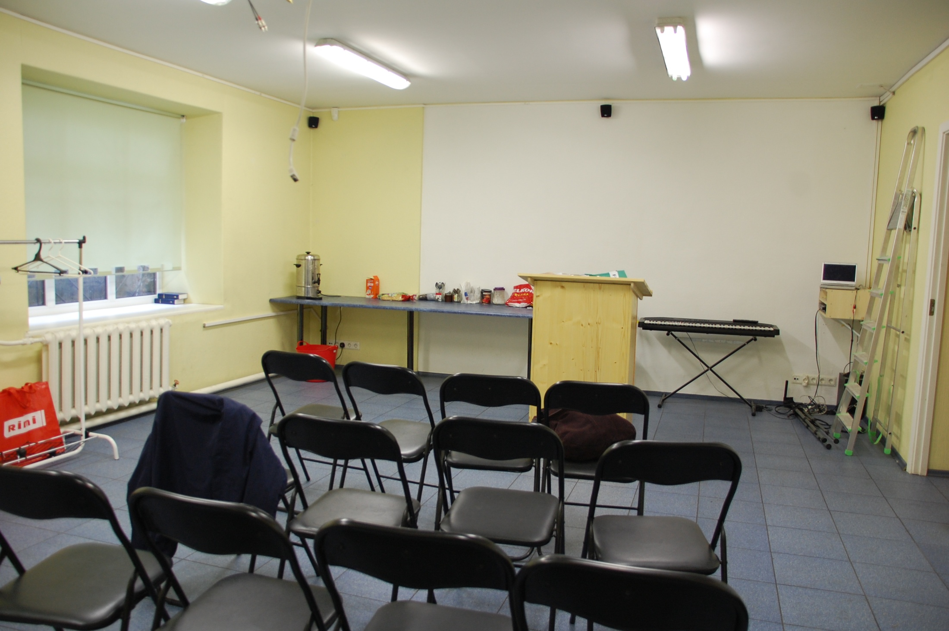
Notes:
This room was fine for 30,but when 85 started turning up regularly, it was necessary to move.

Slide 8
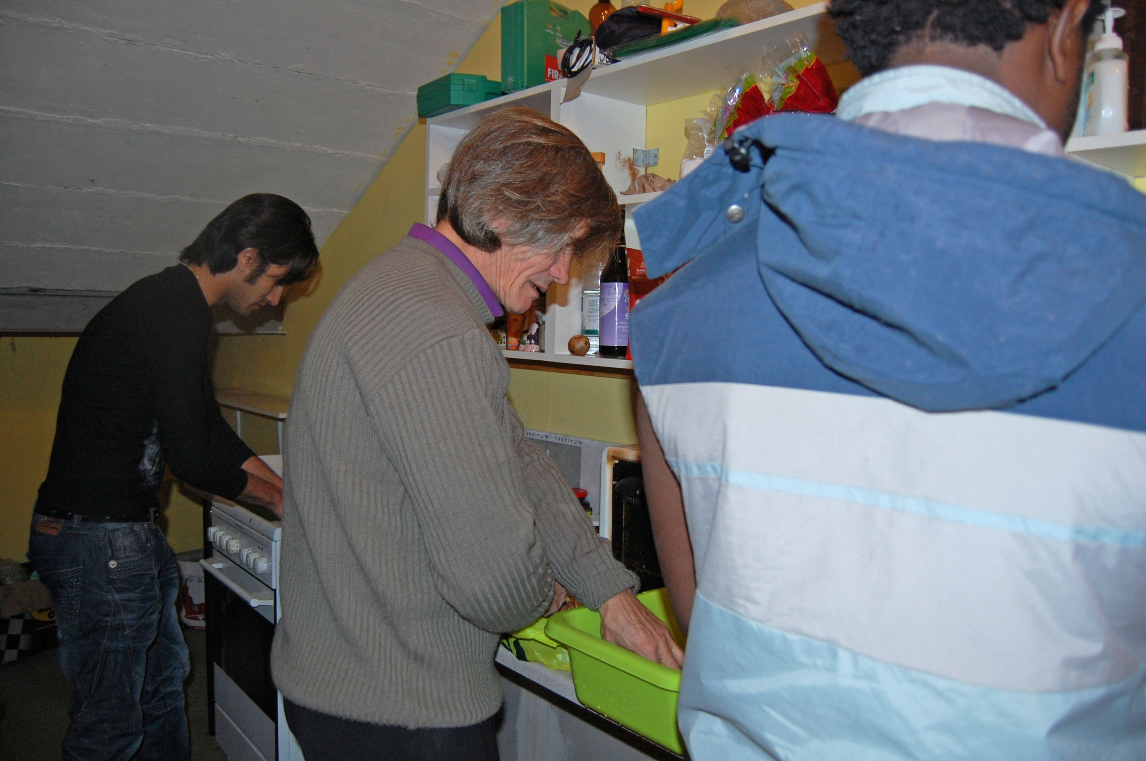
Notes:
In this small kitchen, meals were prepared for up to 100 people. Bashir from Iran, Charles from Nigeria and a Jewish Latvian, Vladimir in the centre are the faithful servants here. They all speak of the privilege of serving the Lord this way.

Slide 9
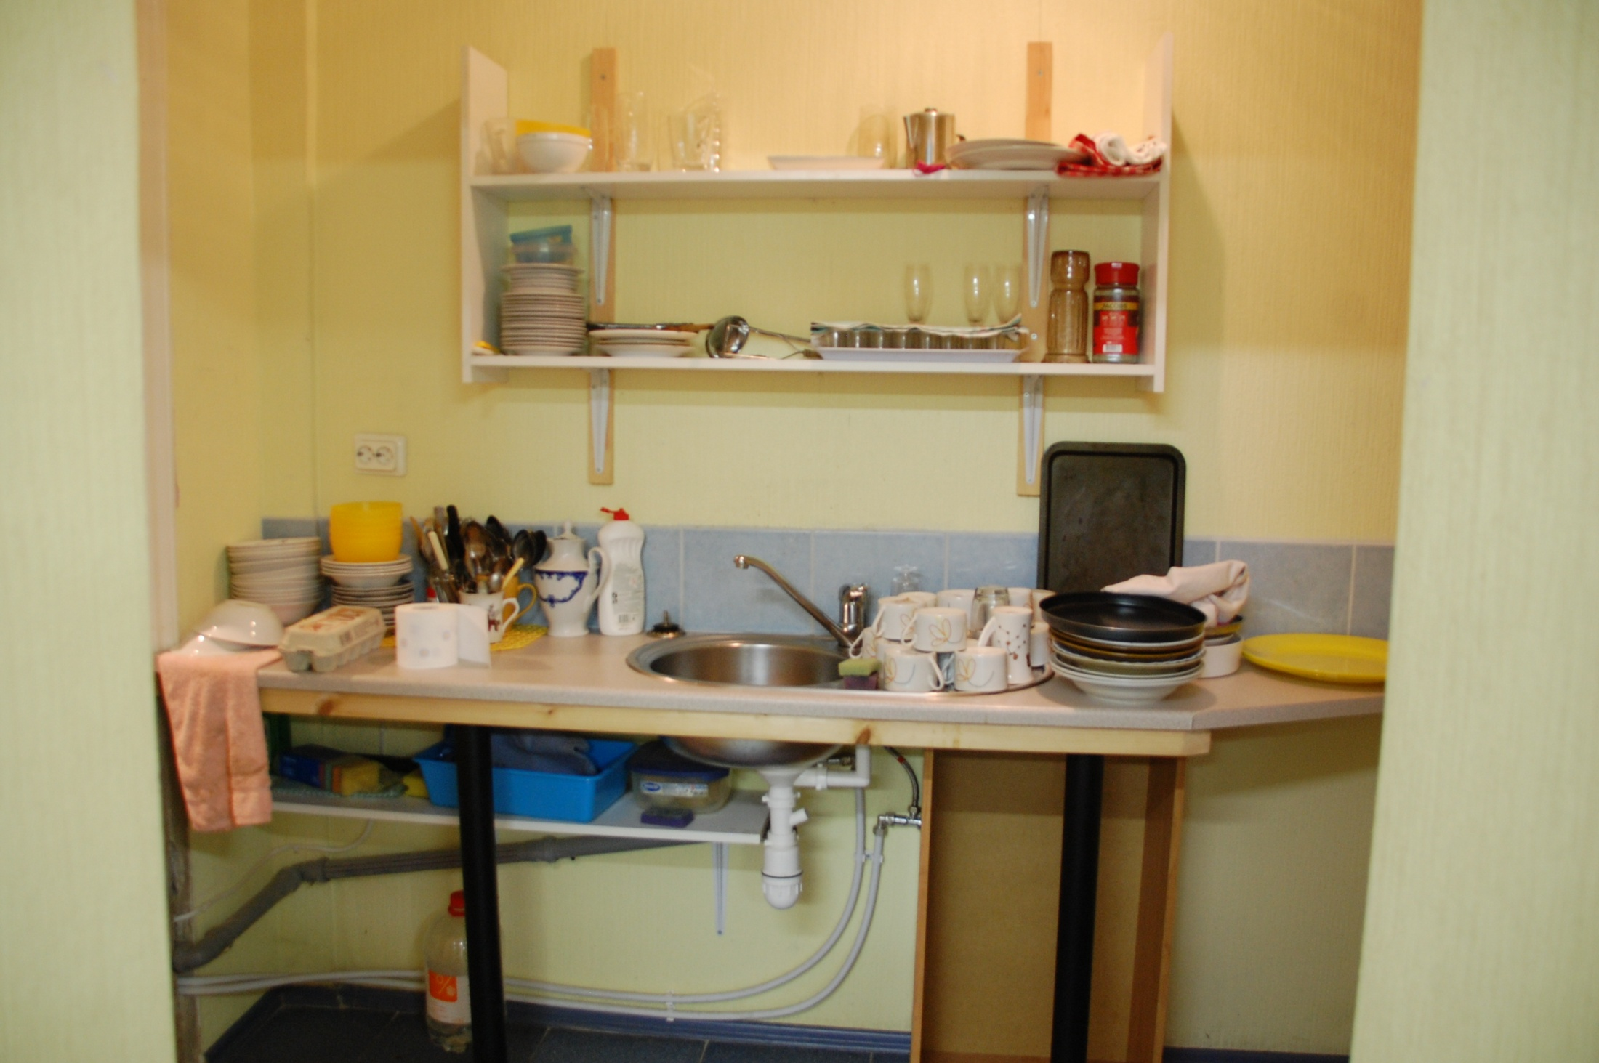
Notes:
And the only sink for all the washing up. It is no exaggeration to say that the bre and sis vie for the job of washing up! As soon as there is a job to be done, they rush forward to help.

Slide 10
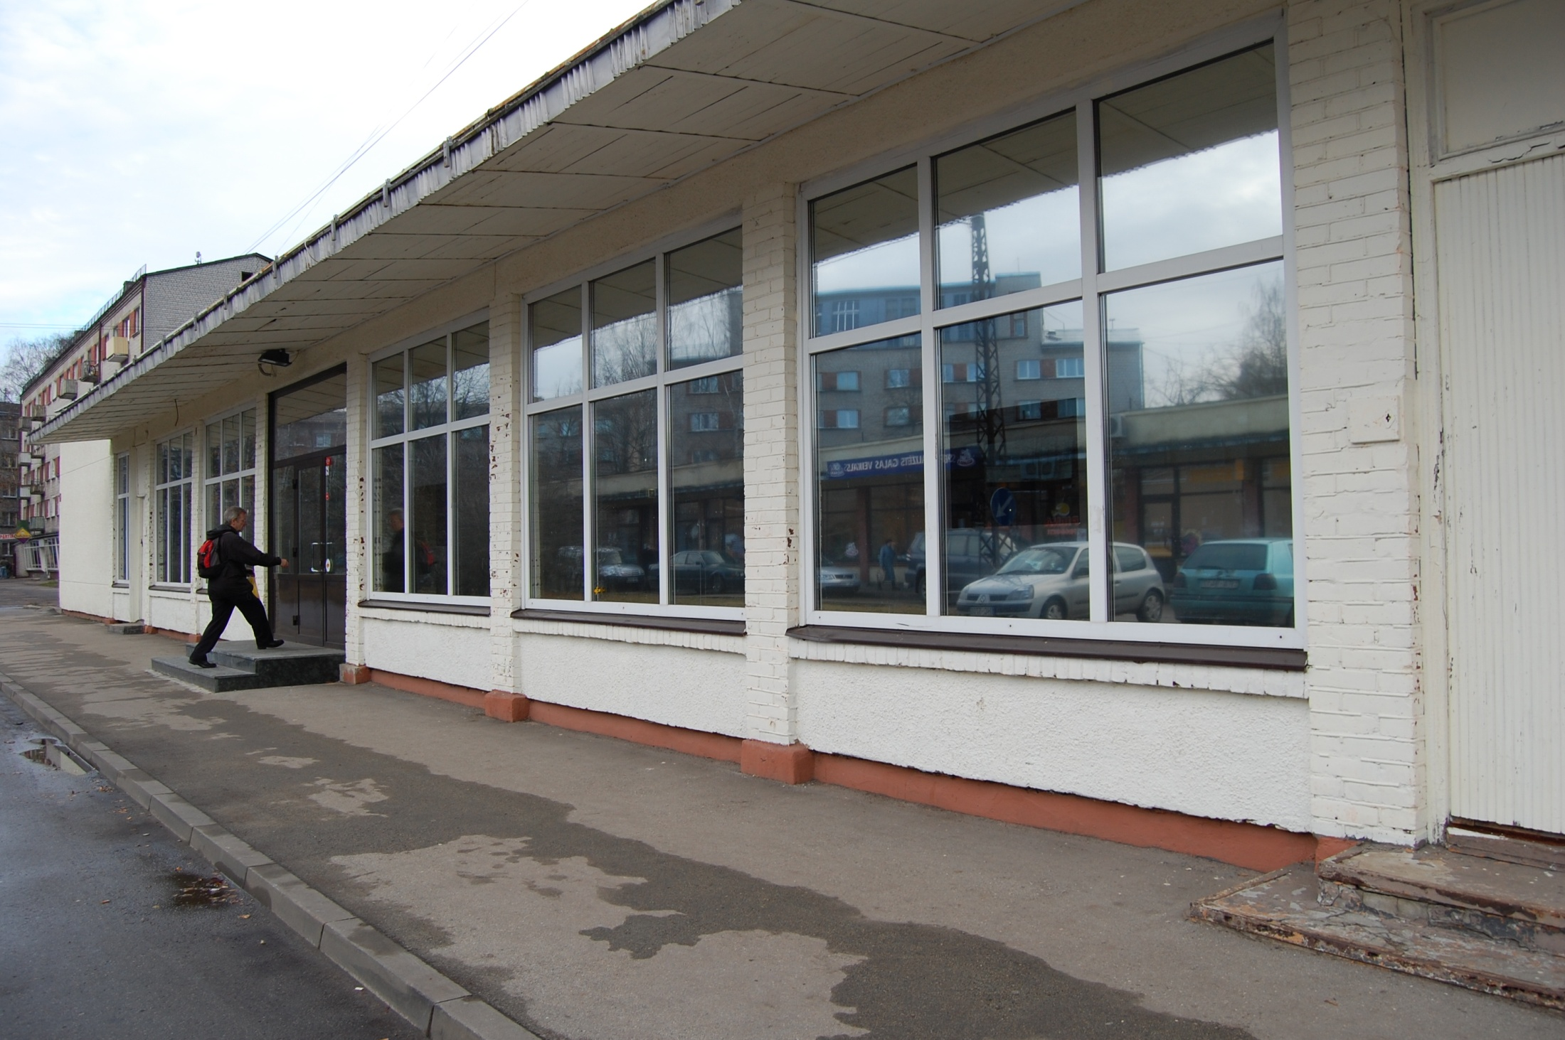
Notes:
And so to the new hall last November. It was a casino in its former life – well placed next to a huge housing area and across the road from shops. Many people walk past and it gives them an opportunity to peer in and see what’s happening, and read the notices in the window.

Slide 11
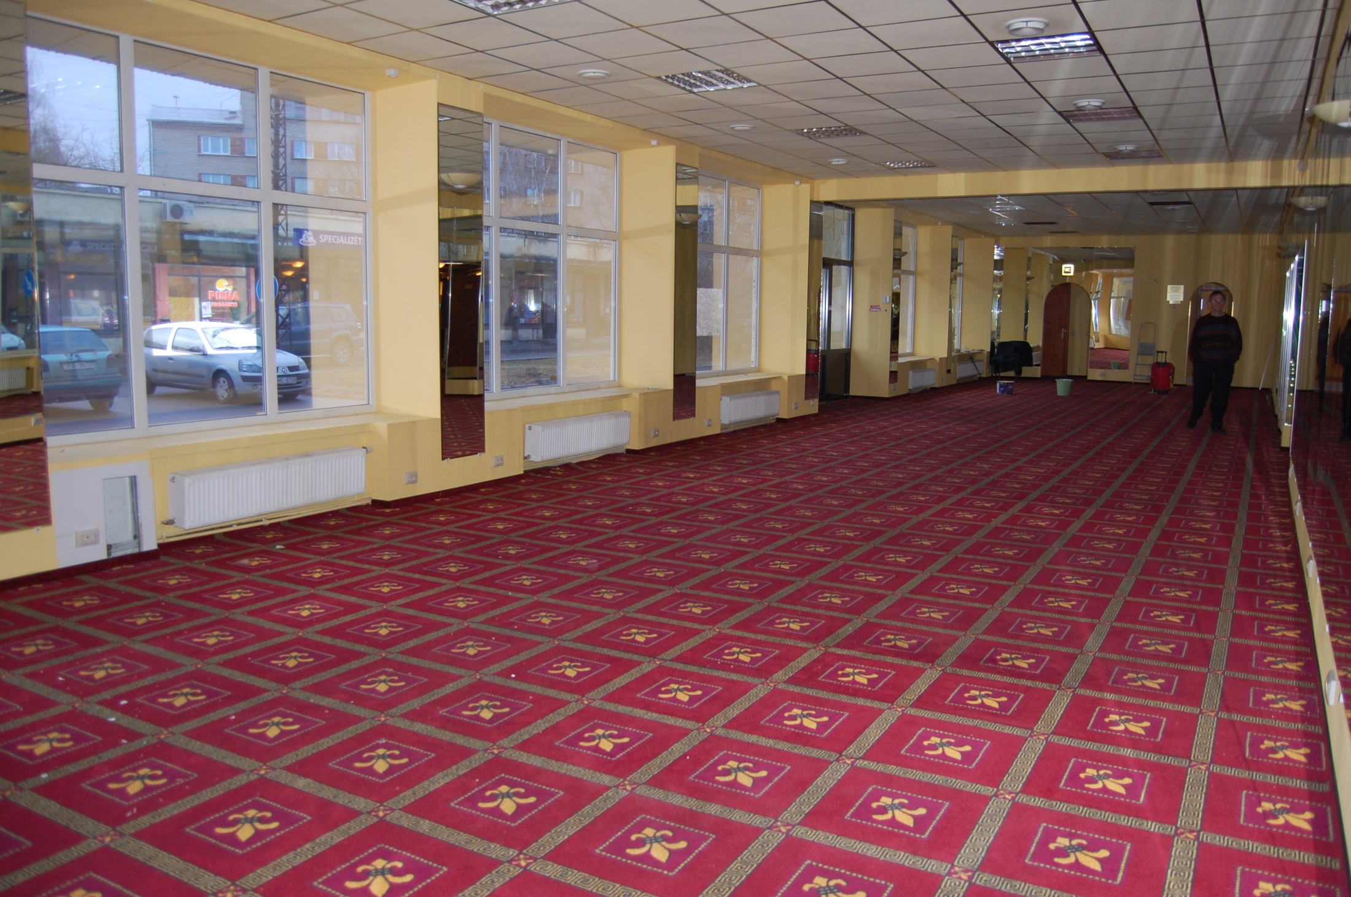
Notes:
Here’s the new hall before the work was undertaken to provide a large kitchen, dining room, some accommodation, and to develop this main room for teaching and worship.

Slide 12
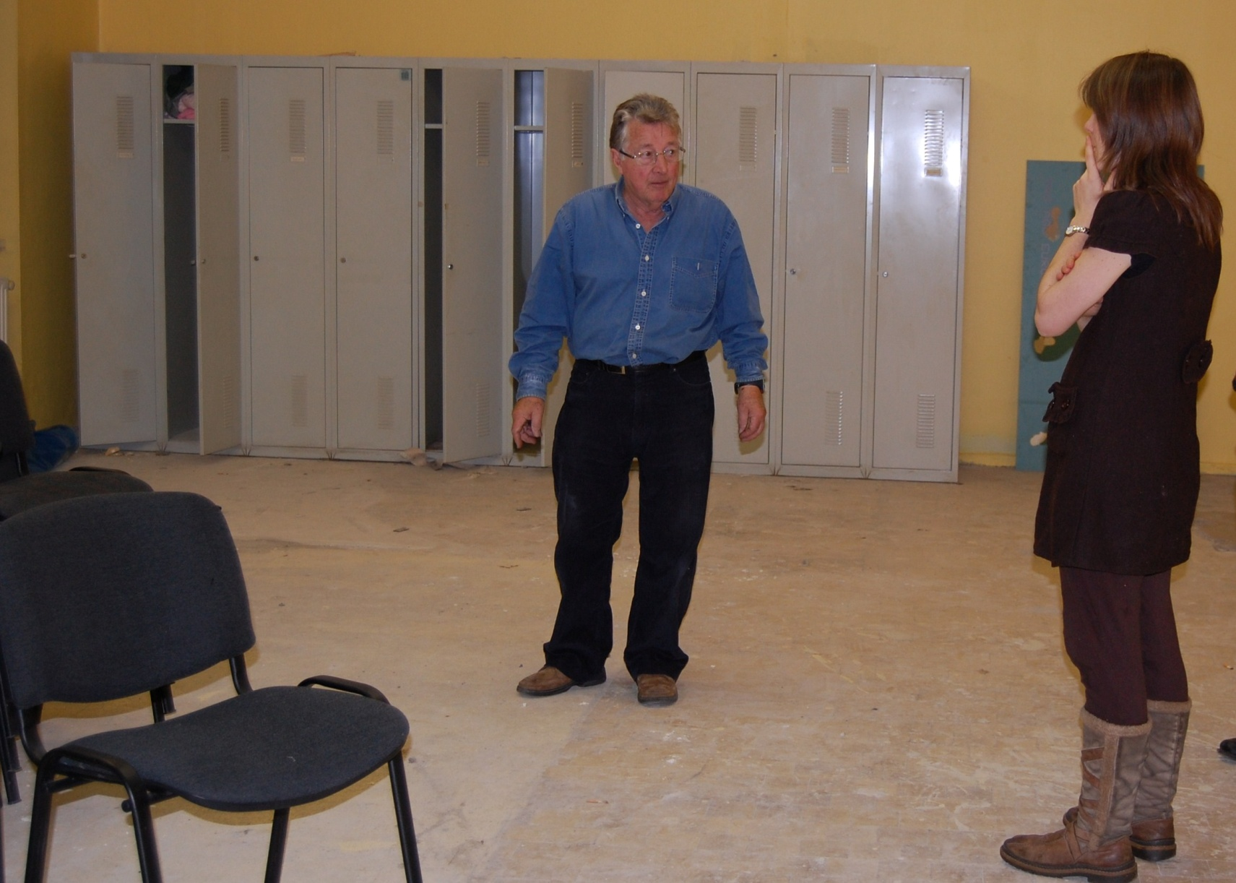
Notes:
This is where the kitchen is to be. Bro Graham Mitchell setting out the plans.

Slide 13
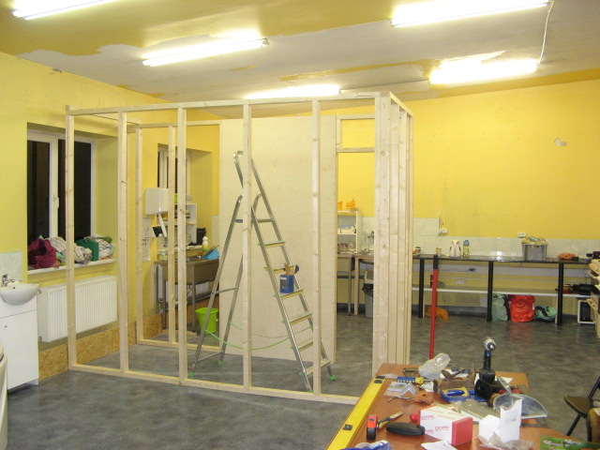
Notes:
And the building work, built by volunteers from the UK and Australia as well as local brethren.

Slide 14
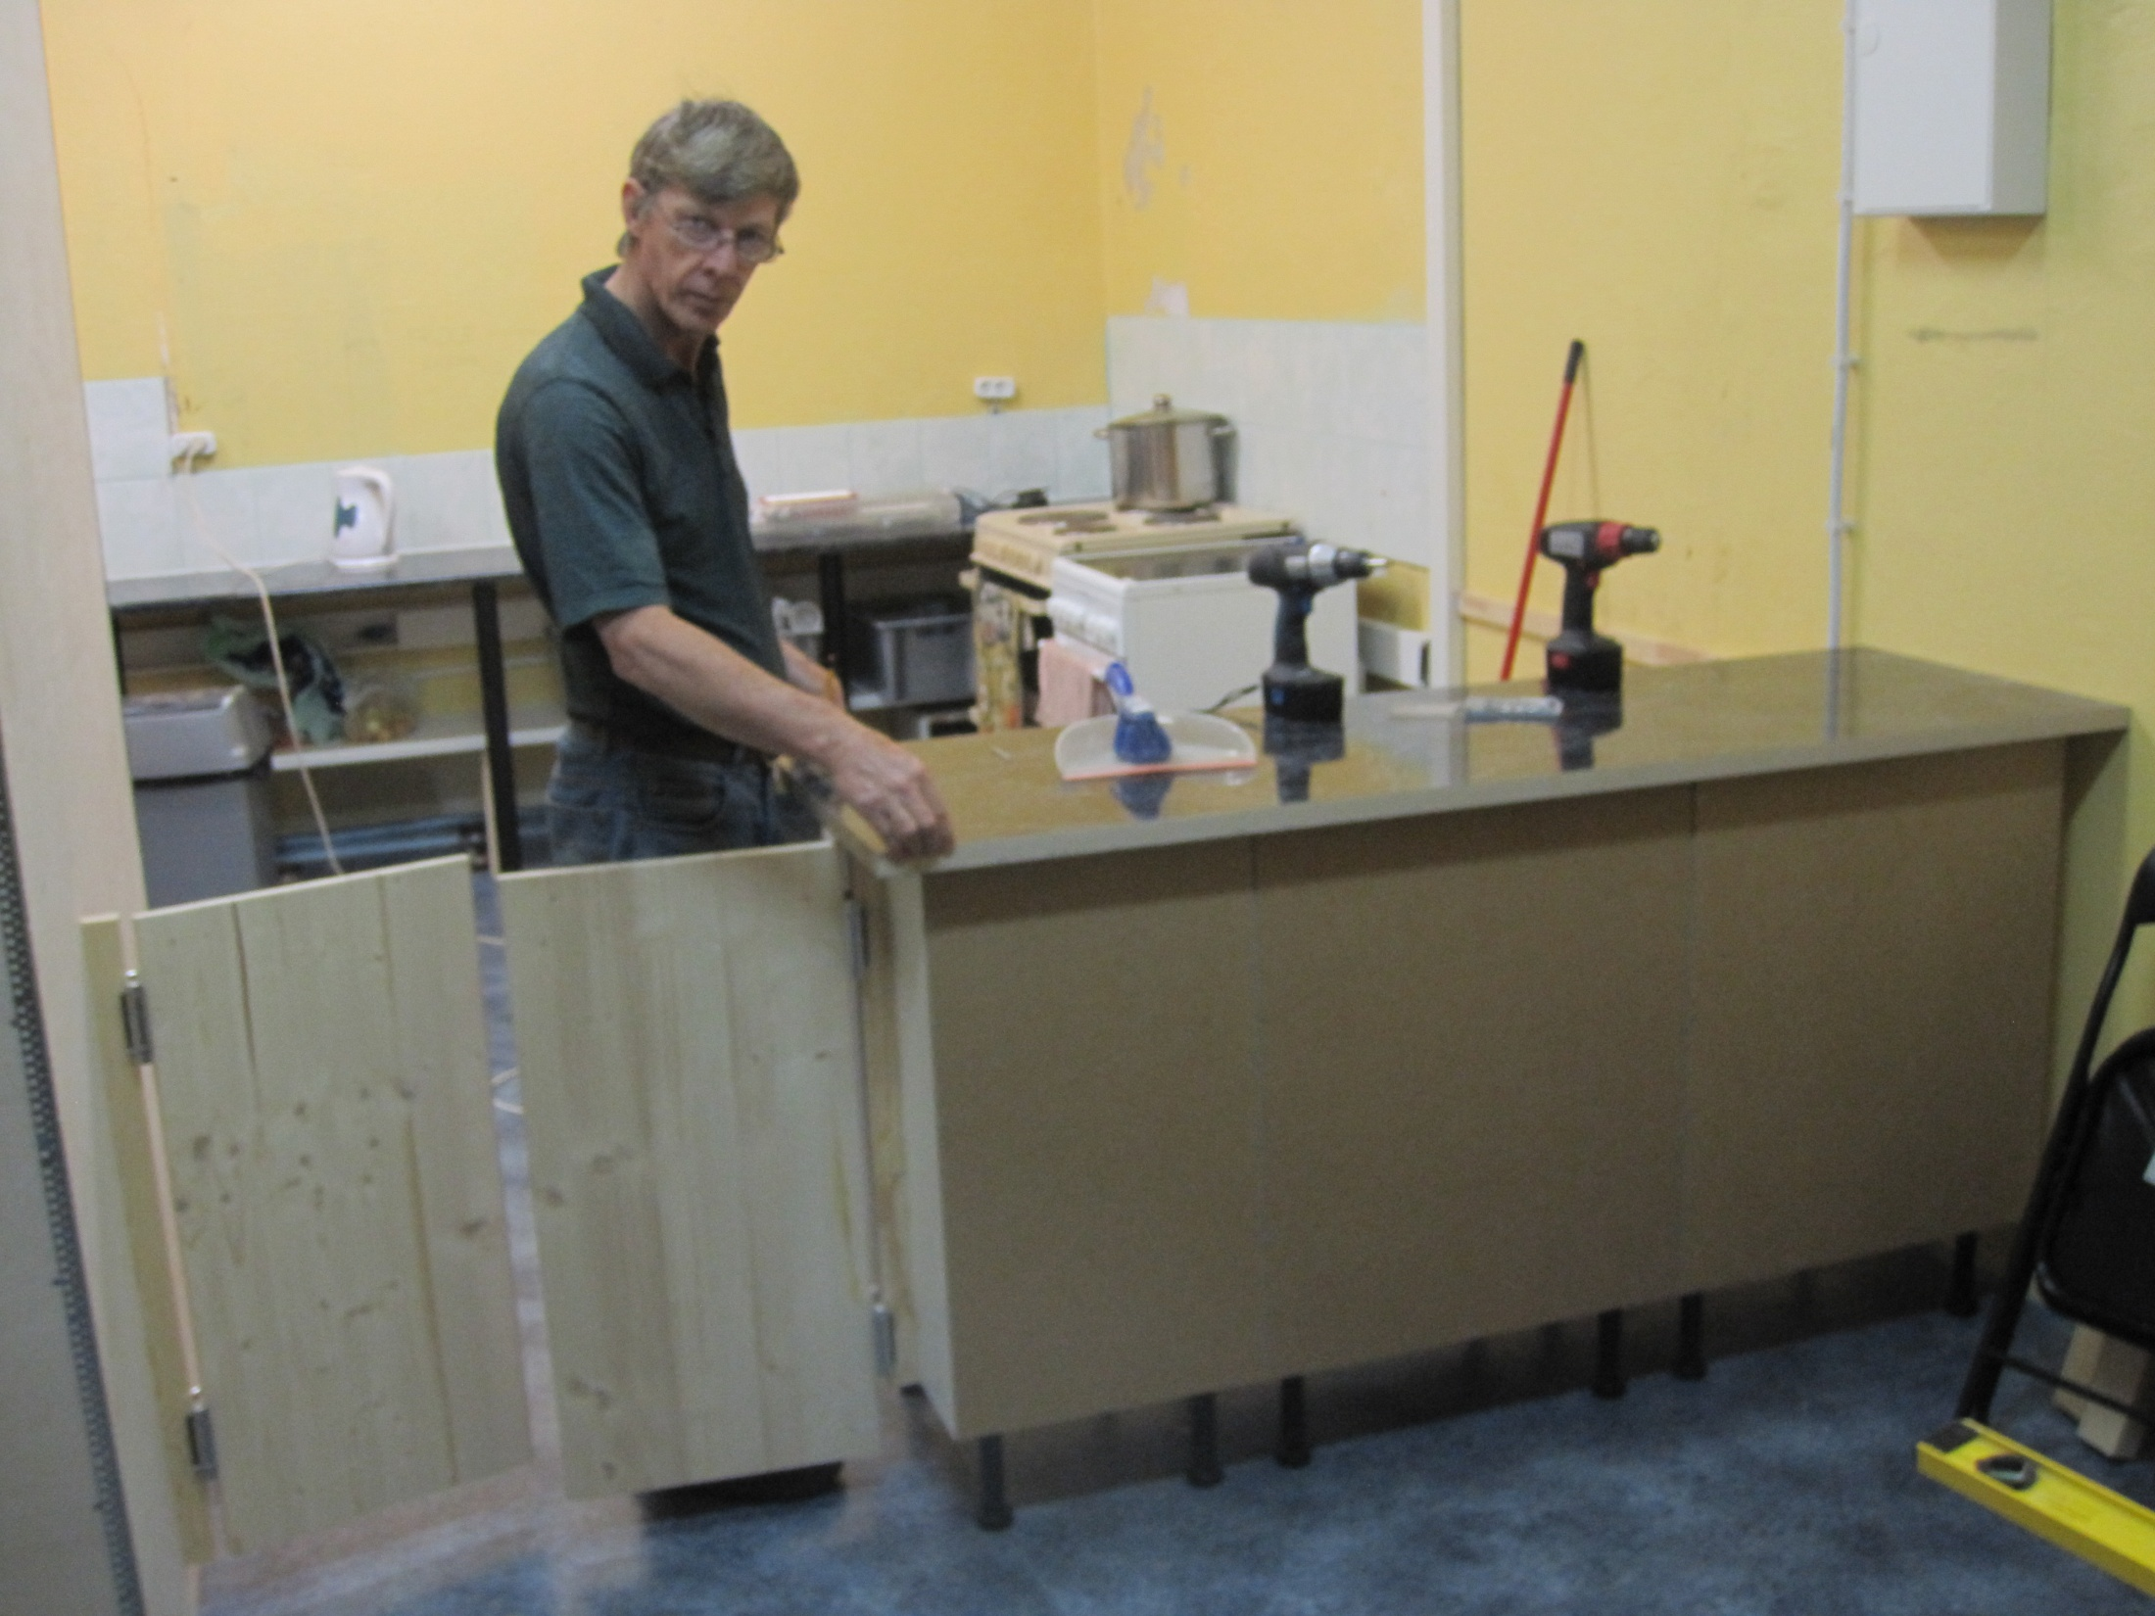
Notes:
Bro Peter Stringer from OZ putting the finishing touches to the worktops

Slide 15
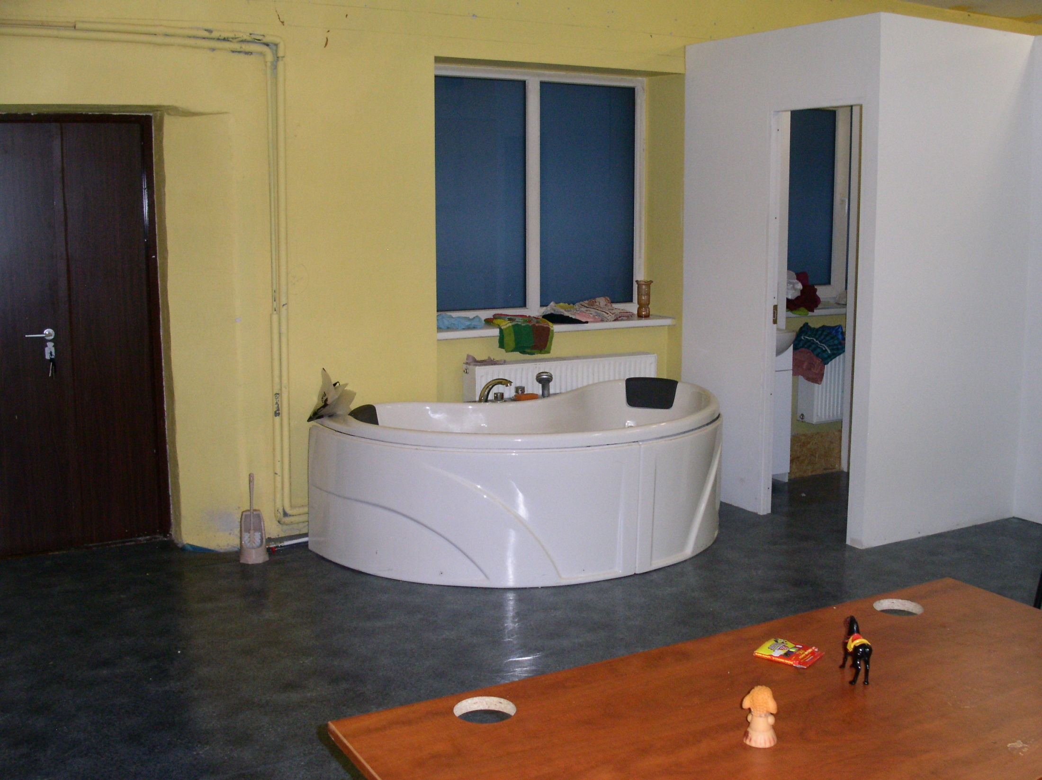
Notes:
The new baptismal bath and a changing room alongside.

Slide 16
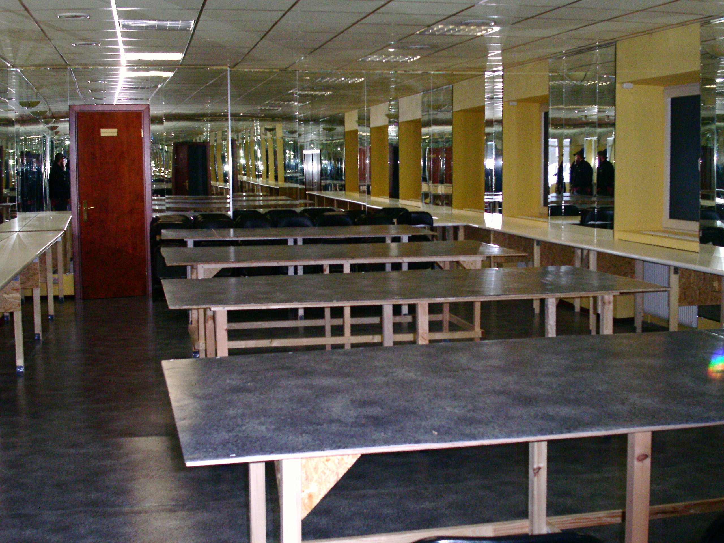
Notes:
The dining room. Many of the tables have been assembled by bro Vladimir although he is almost blind.

Slide 17
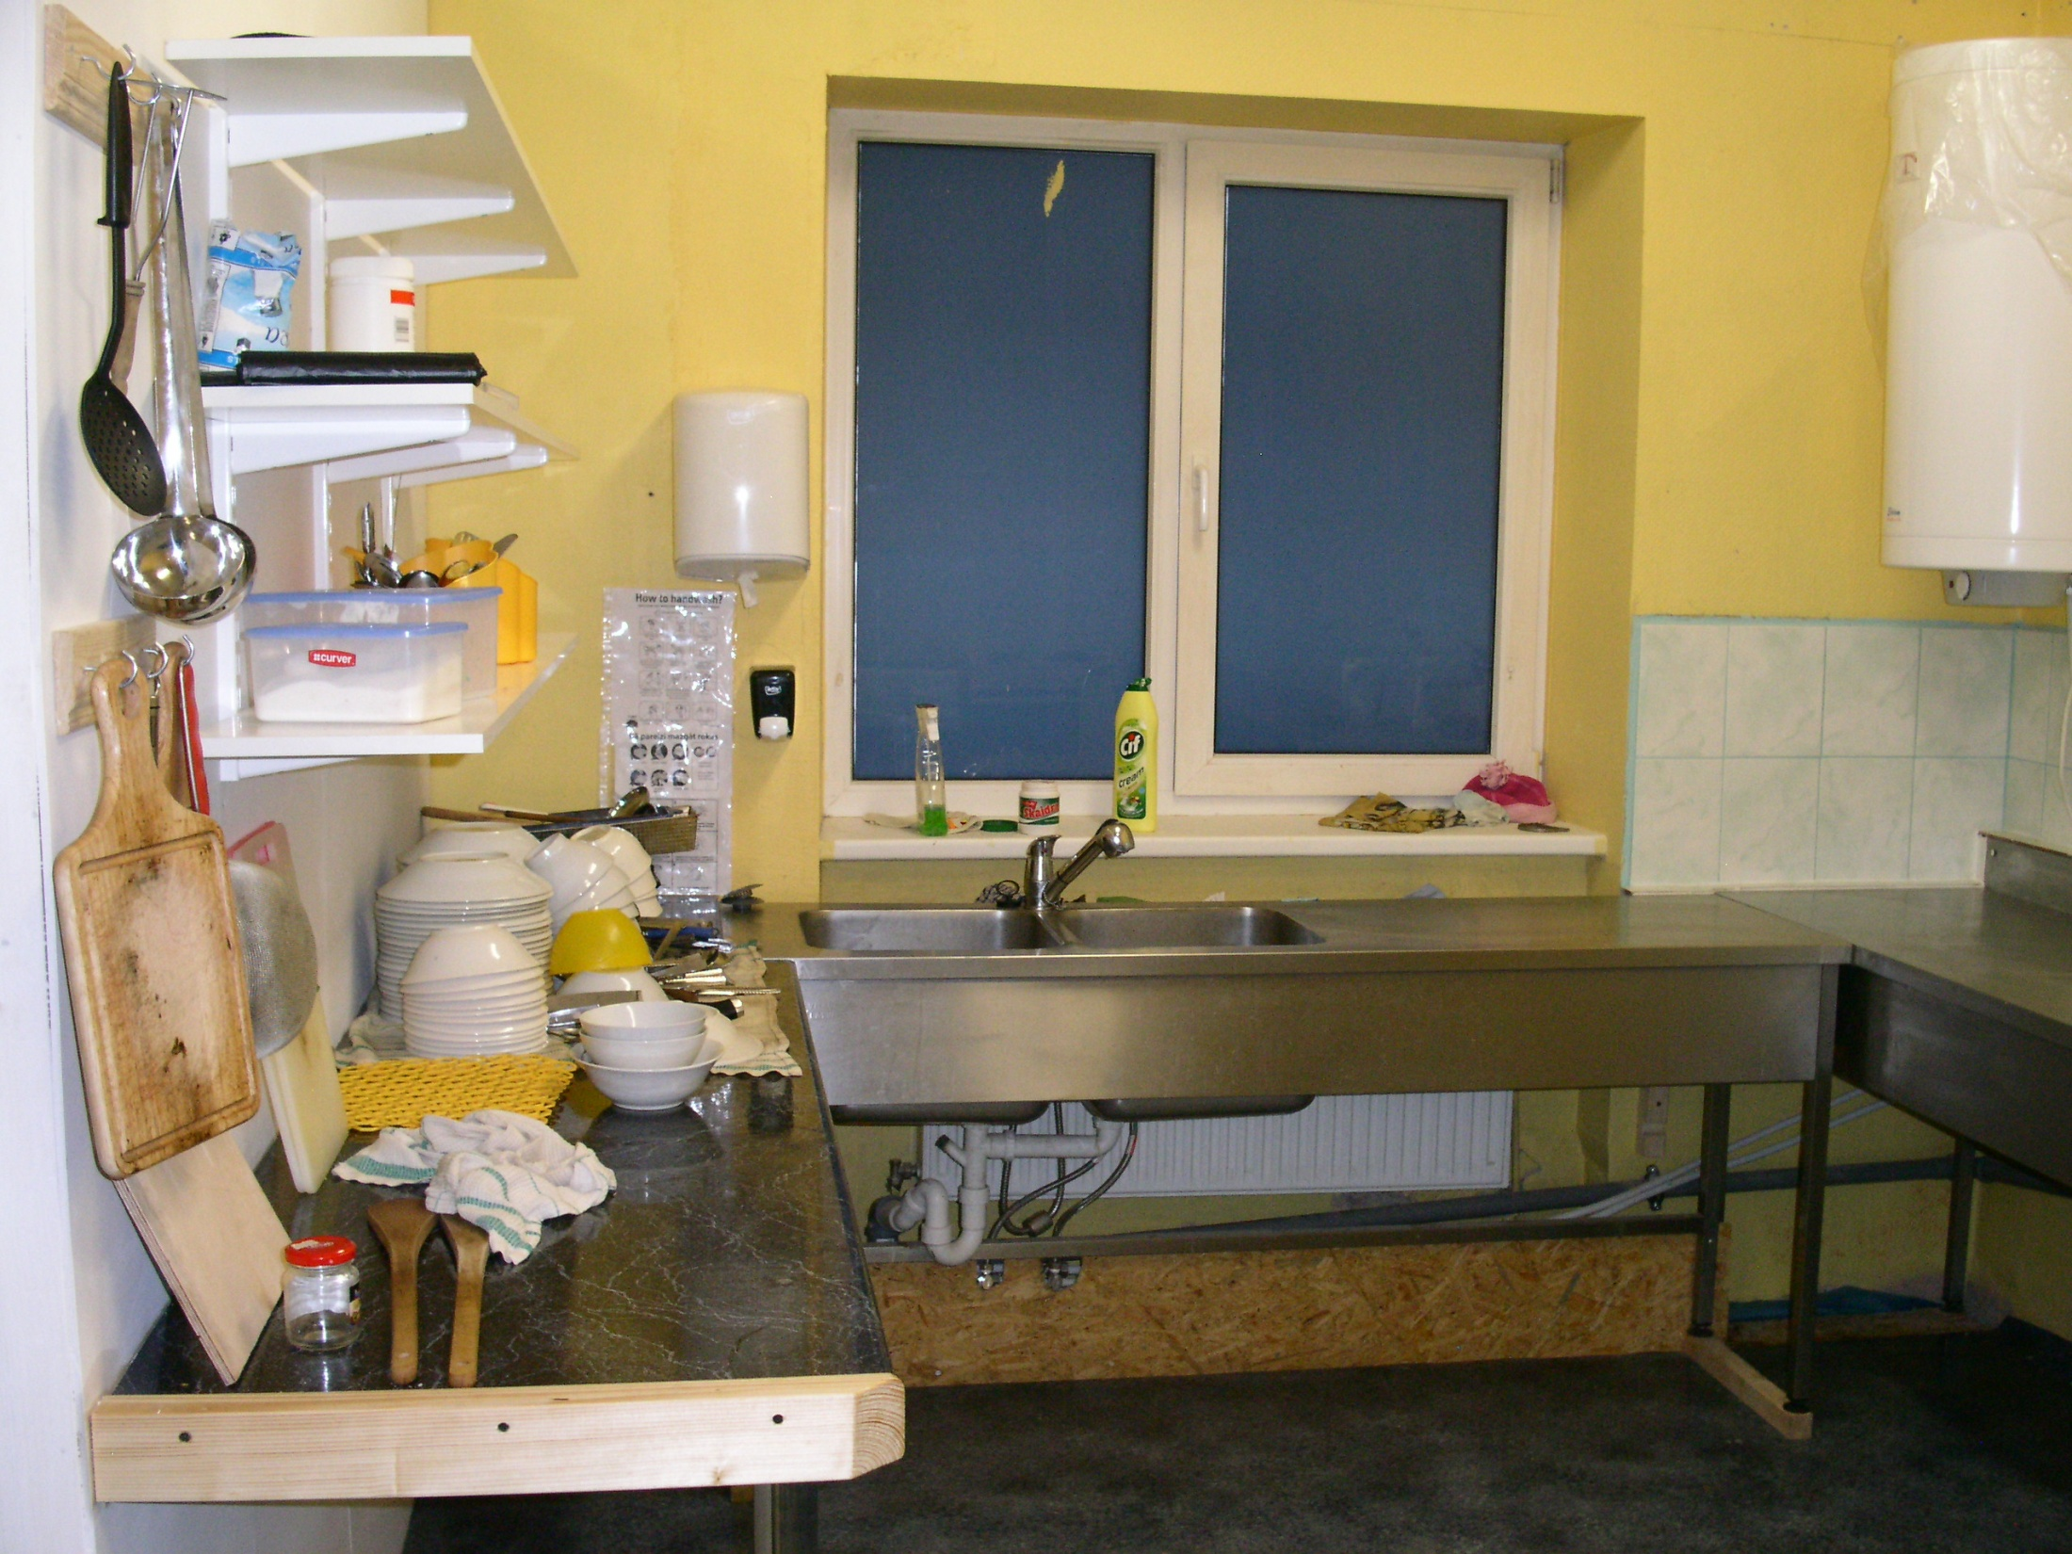
Notes:
And the finished kitchen – up to the necessary health and safety standards required.

Slide 18
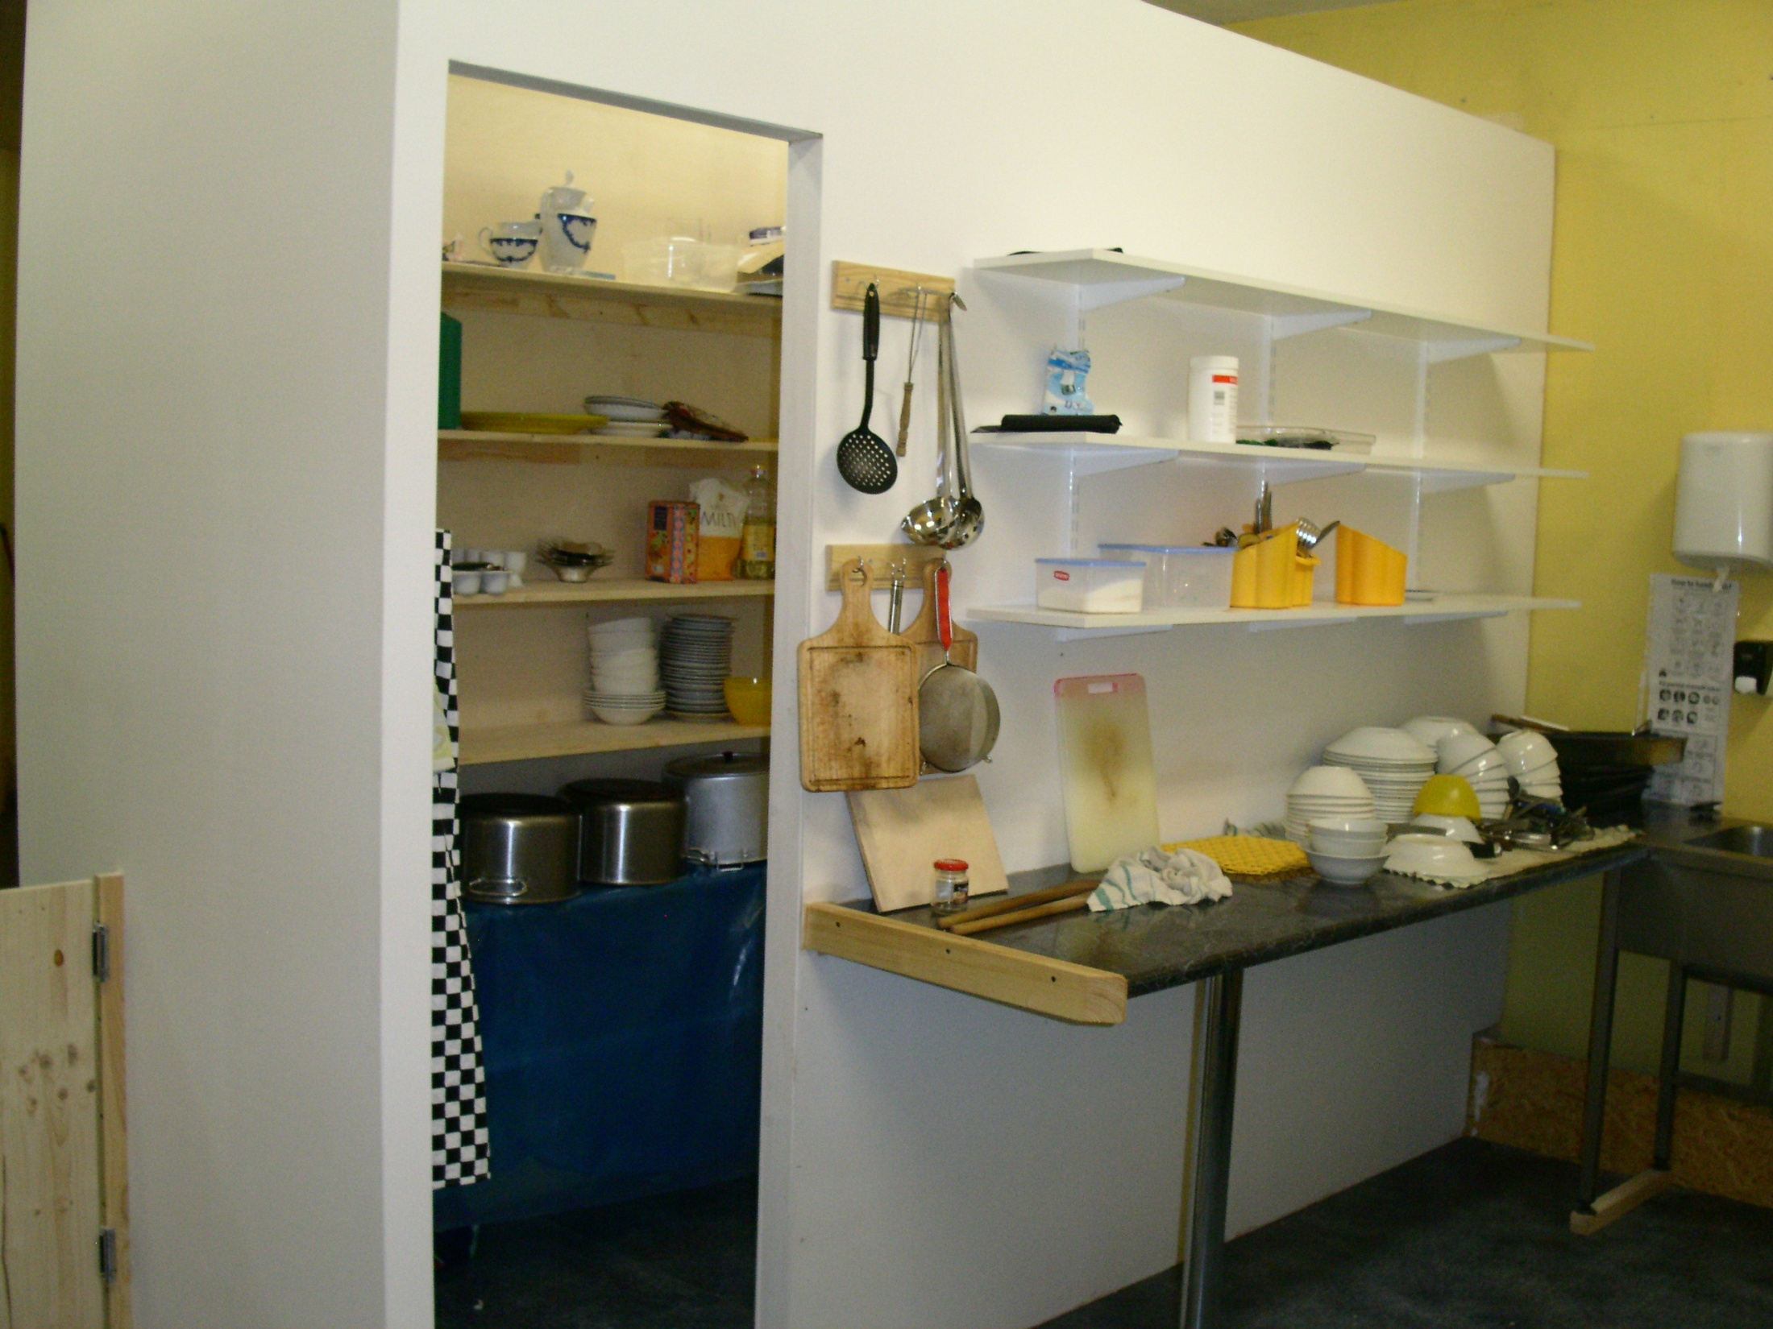
Notes:
The kitchen store. This kitchen facility is large enough to cope with numbers of over 100, usually 2-3 times a week.

Slide 19
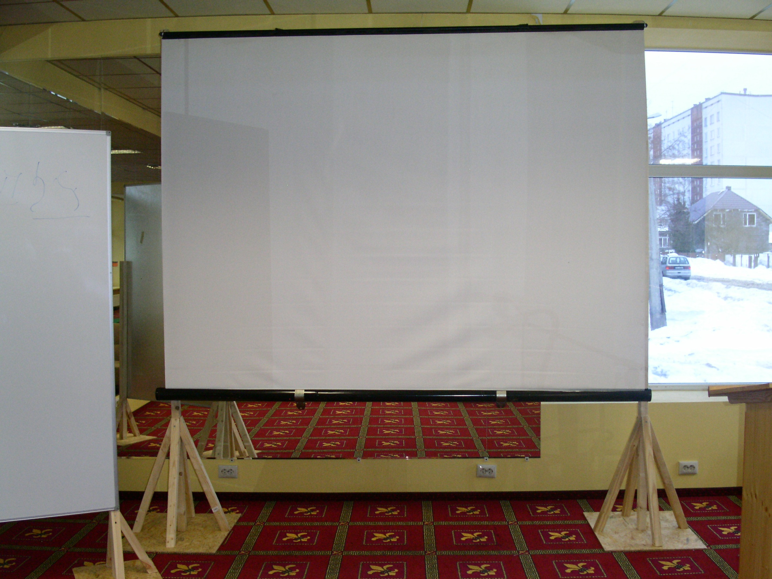
Notes:
As this is a young ecclesia, many of the bre and sis find it easier to read the text of the Bible from the screen. Again the projector is a gift from a brother and sister in the Midlands.

Slide 20
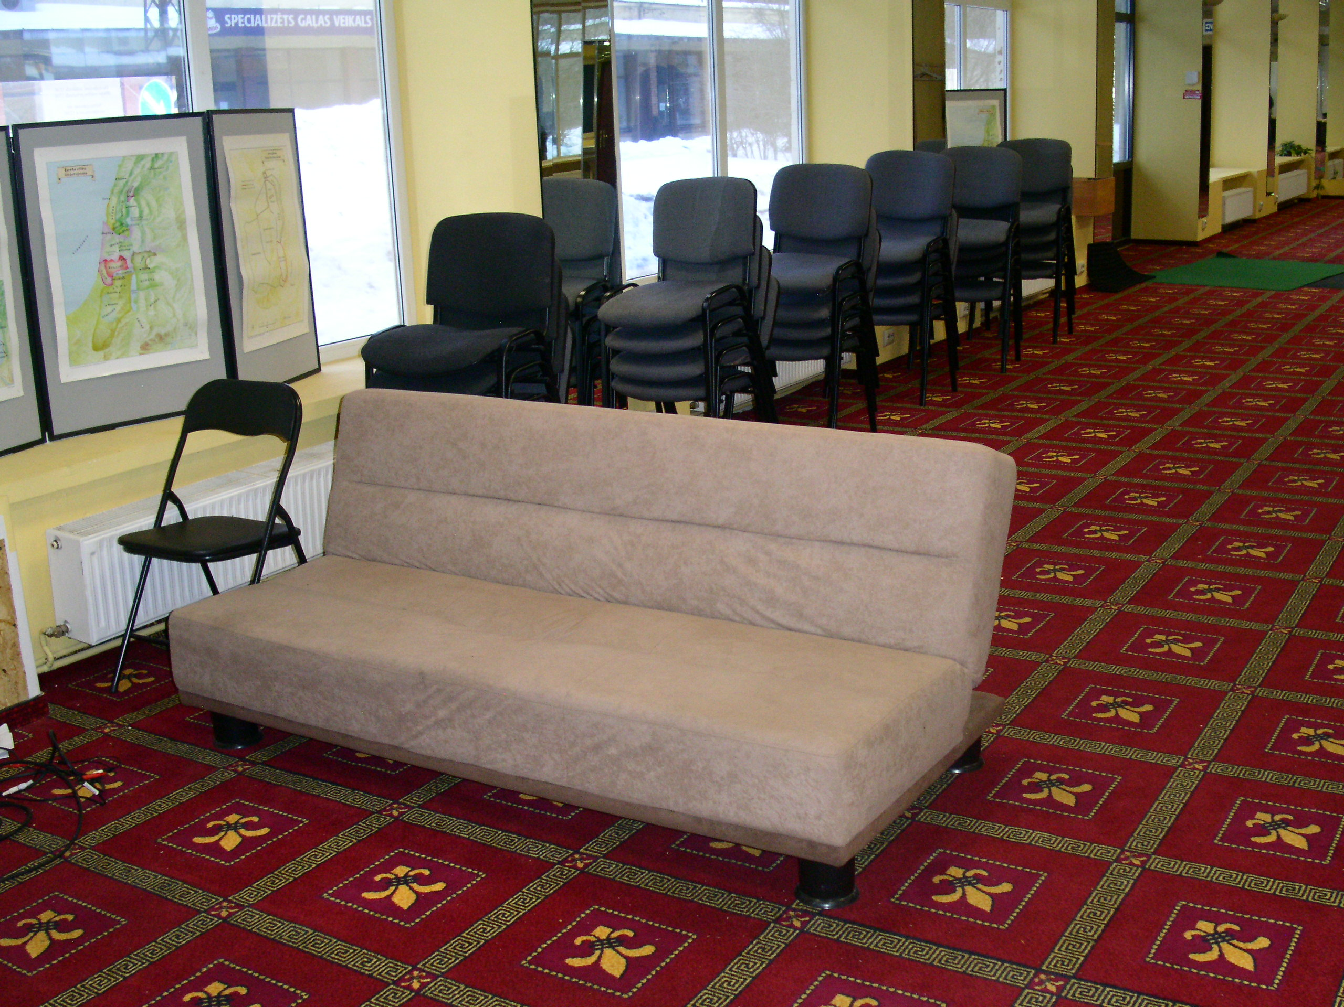
Notes:
And the seats start to arrive for the first services. The sofa is popular so it goes on the front row!!

Slide 21
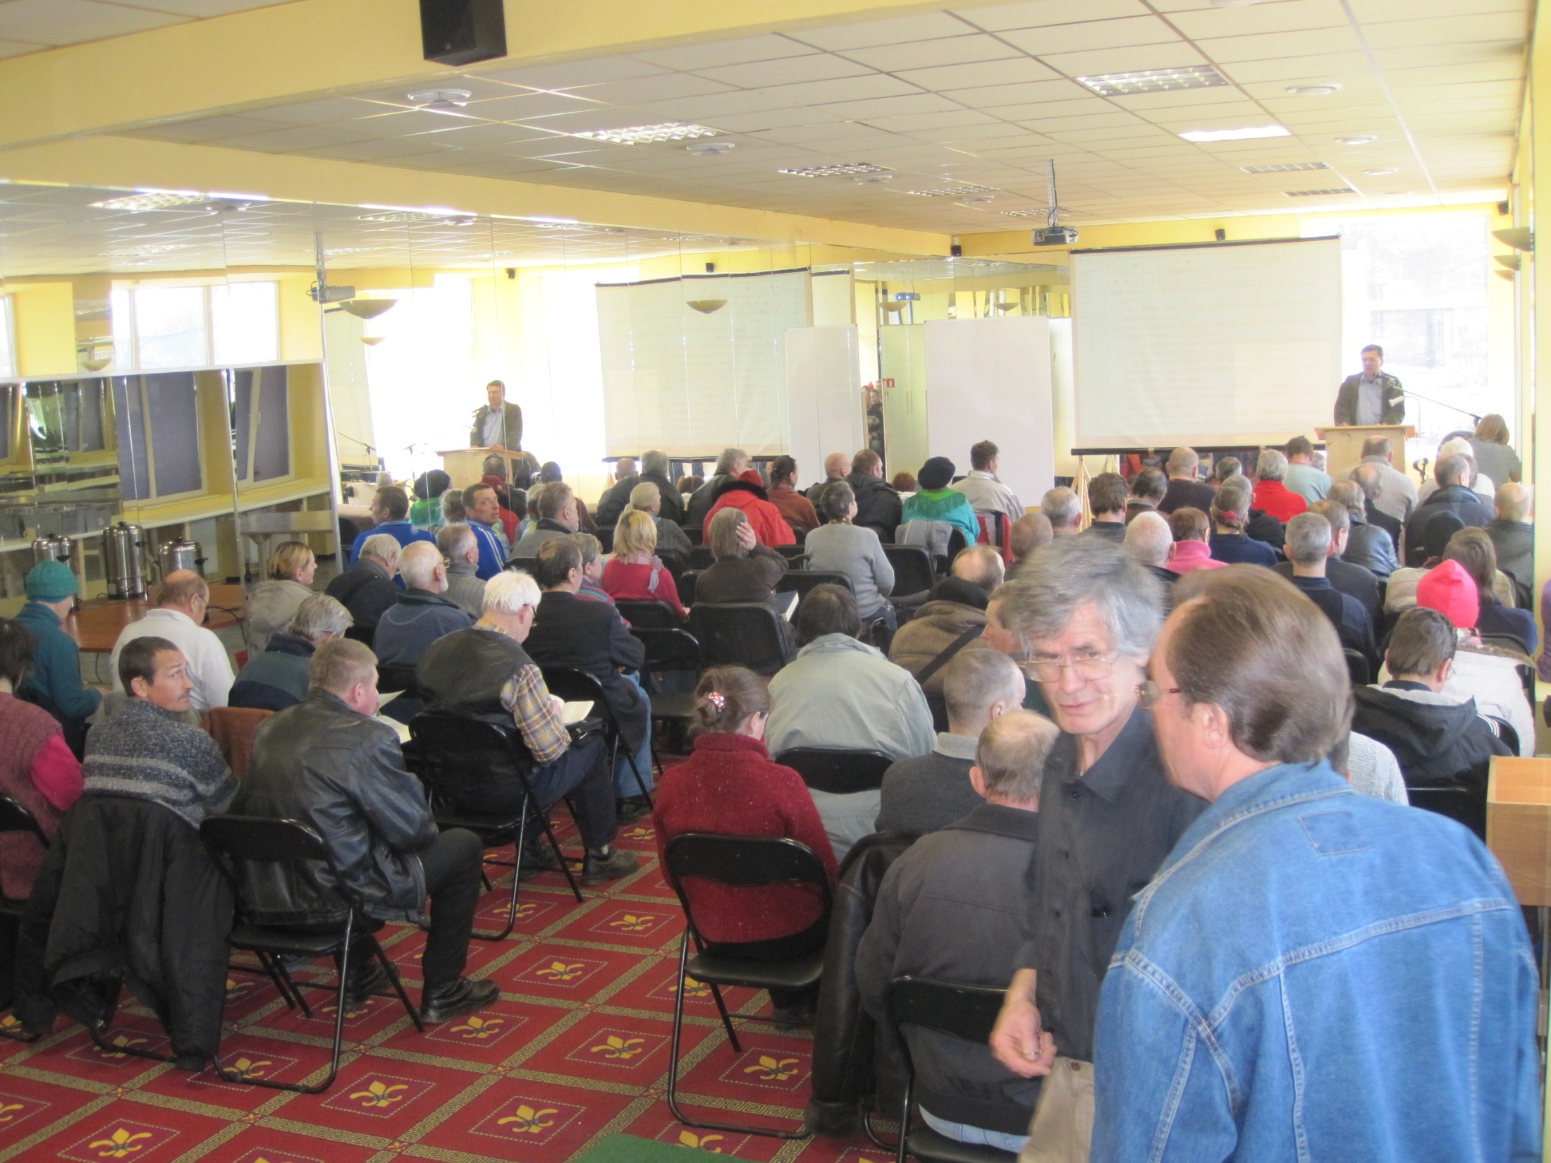
Notes:
But of course, the building is merely the setting for a large, regular group who meet several times a week. Many were brought up as atheists under the communist regime and are hungry to learn the Bible truths – so long denied to them.

Slide 22
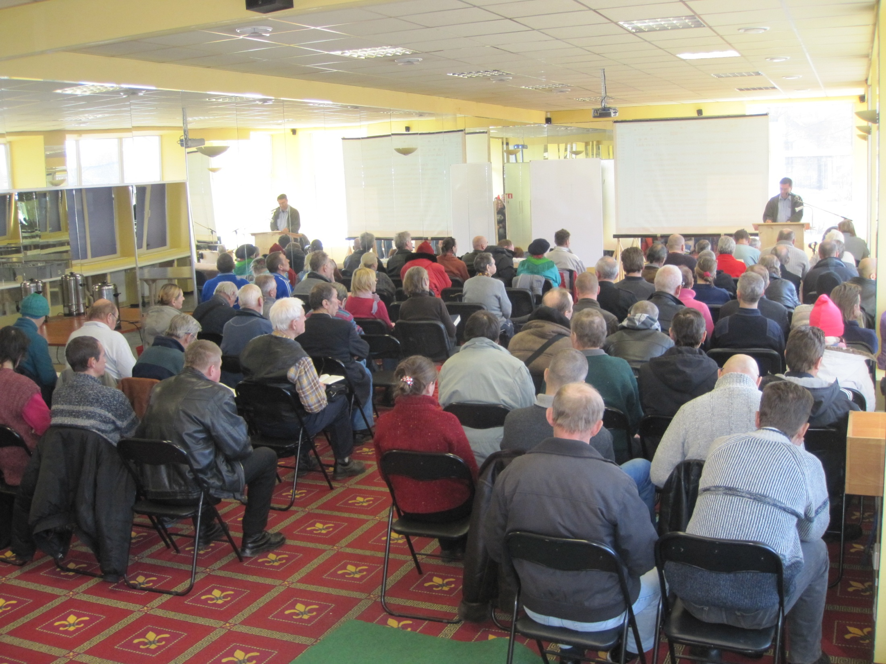
Notes:
The Bible Companion form the basis for the ecclesia reading and teaching. From experience we know that it is not unusual for the reading, teaching and discussion from a single reading can take up to an hour – many taking notes.

Slide 23
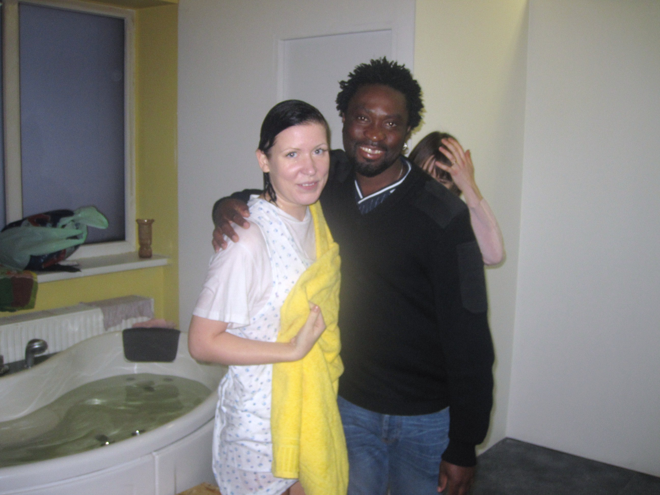
Notes:
And the many baptisms – something like 40 this year in Riga alone.

Slide 24
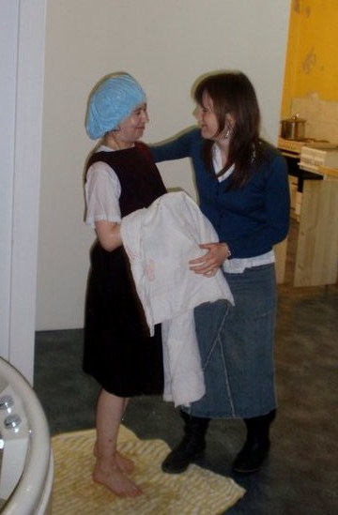
Notes:
Always with great joy. Many of our brothers and sisters are homeless because of pathetic pensions but food prices to match ours and rents which are beyond their means.

Slide 25
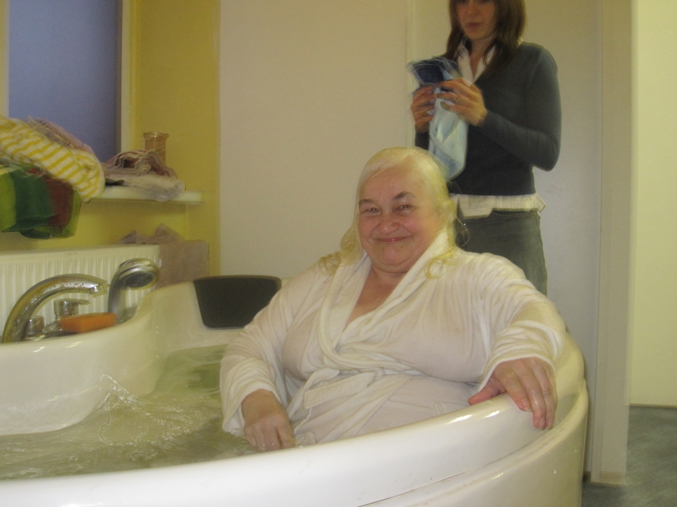
Notes:
Many have lost families. The cohesiveness of the family which we tend to take for granted, is often absent in Latvia and other ex-communist countries. The ecclesia truly becomes a family to many people who have nothing in the world.

Slide 26
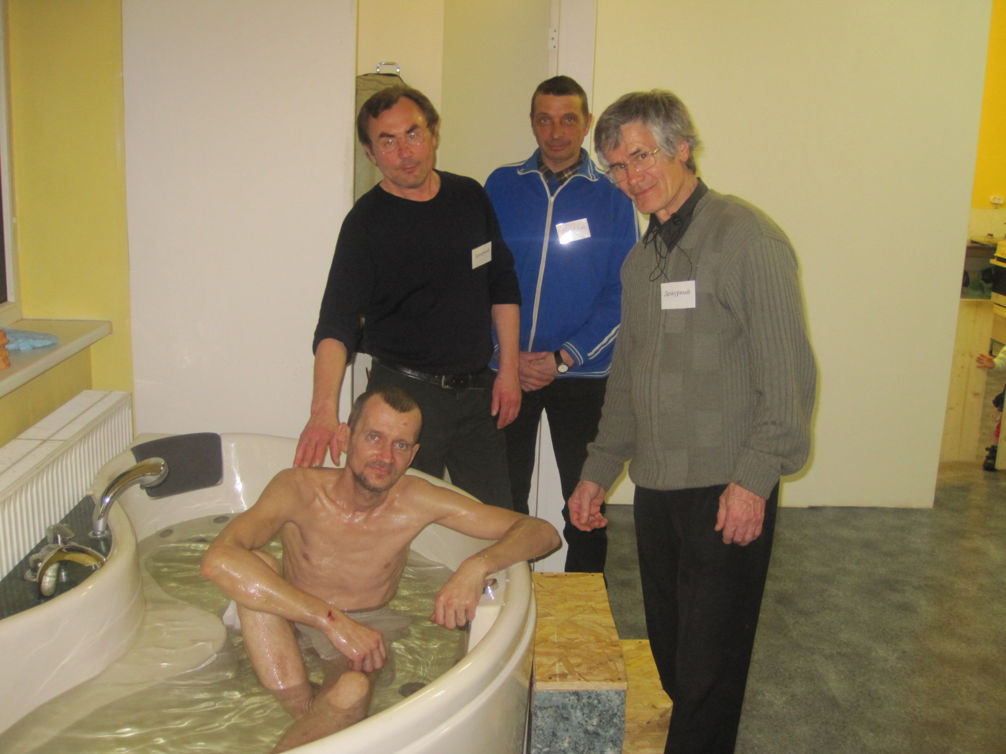
Notes:
Two of the brethren Valerij and Vladimir being trained as elders in the ecclesia and now enthusiastically leading another believer through the water to his new life with them.

Slide 27
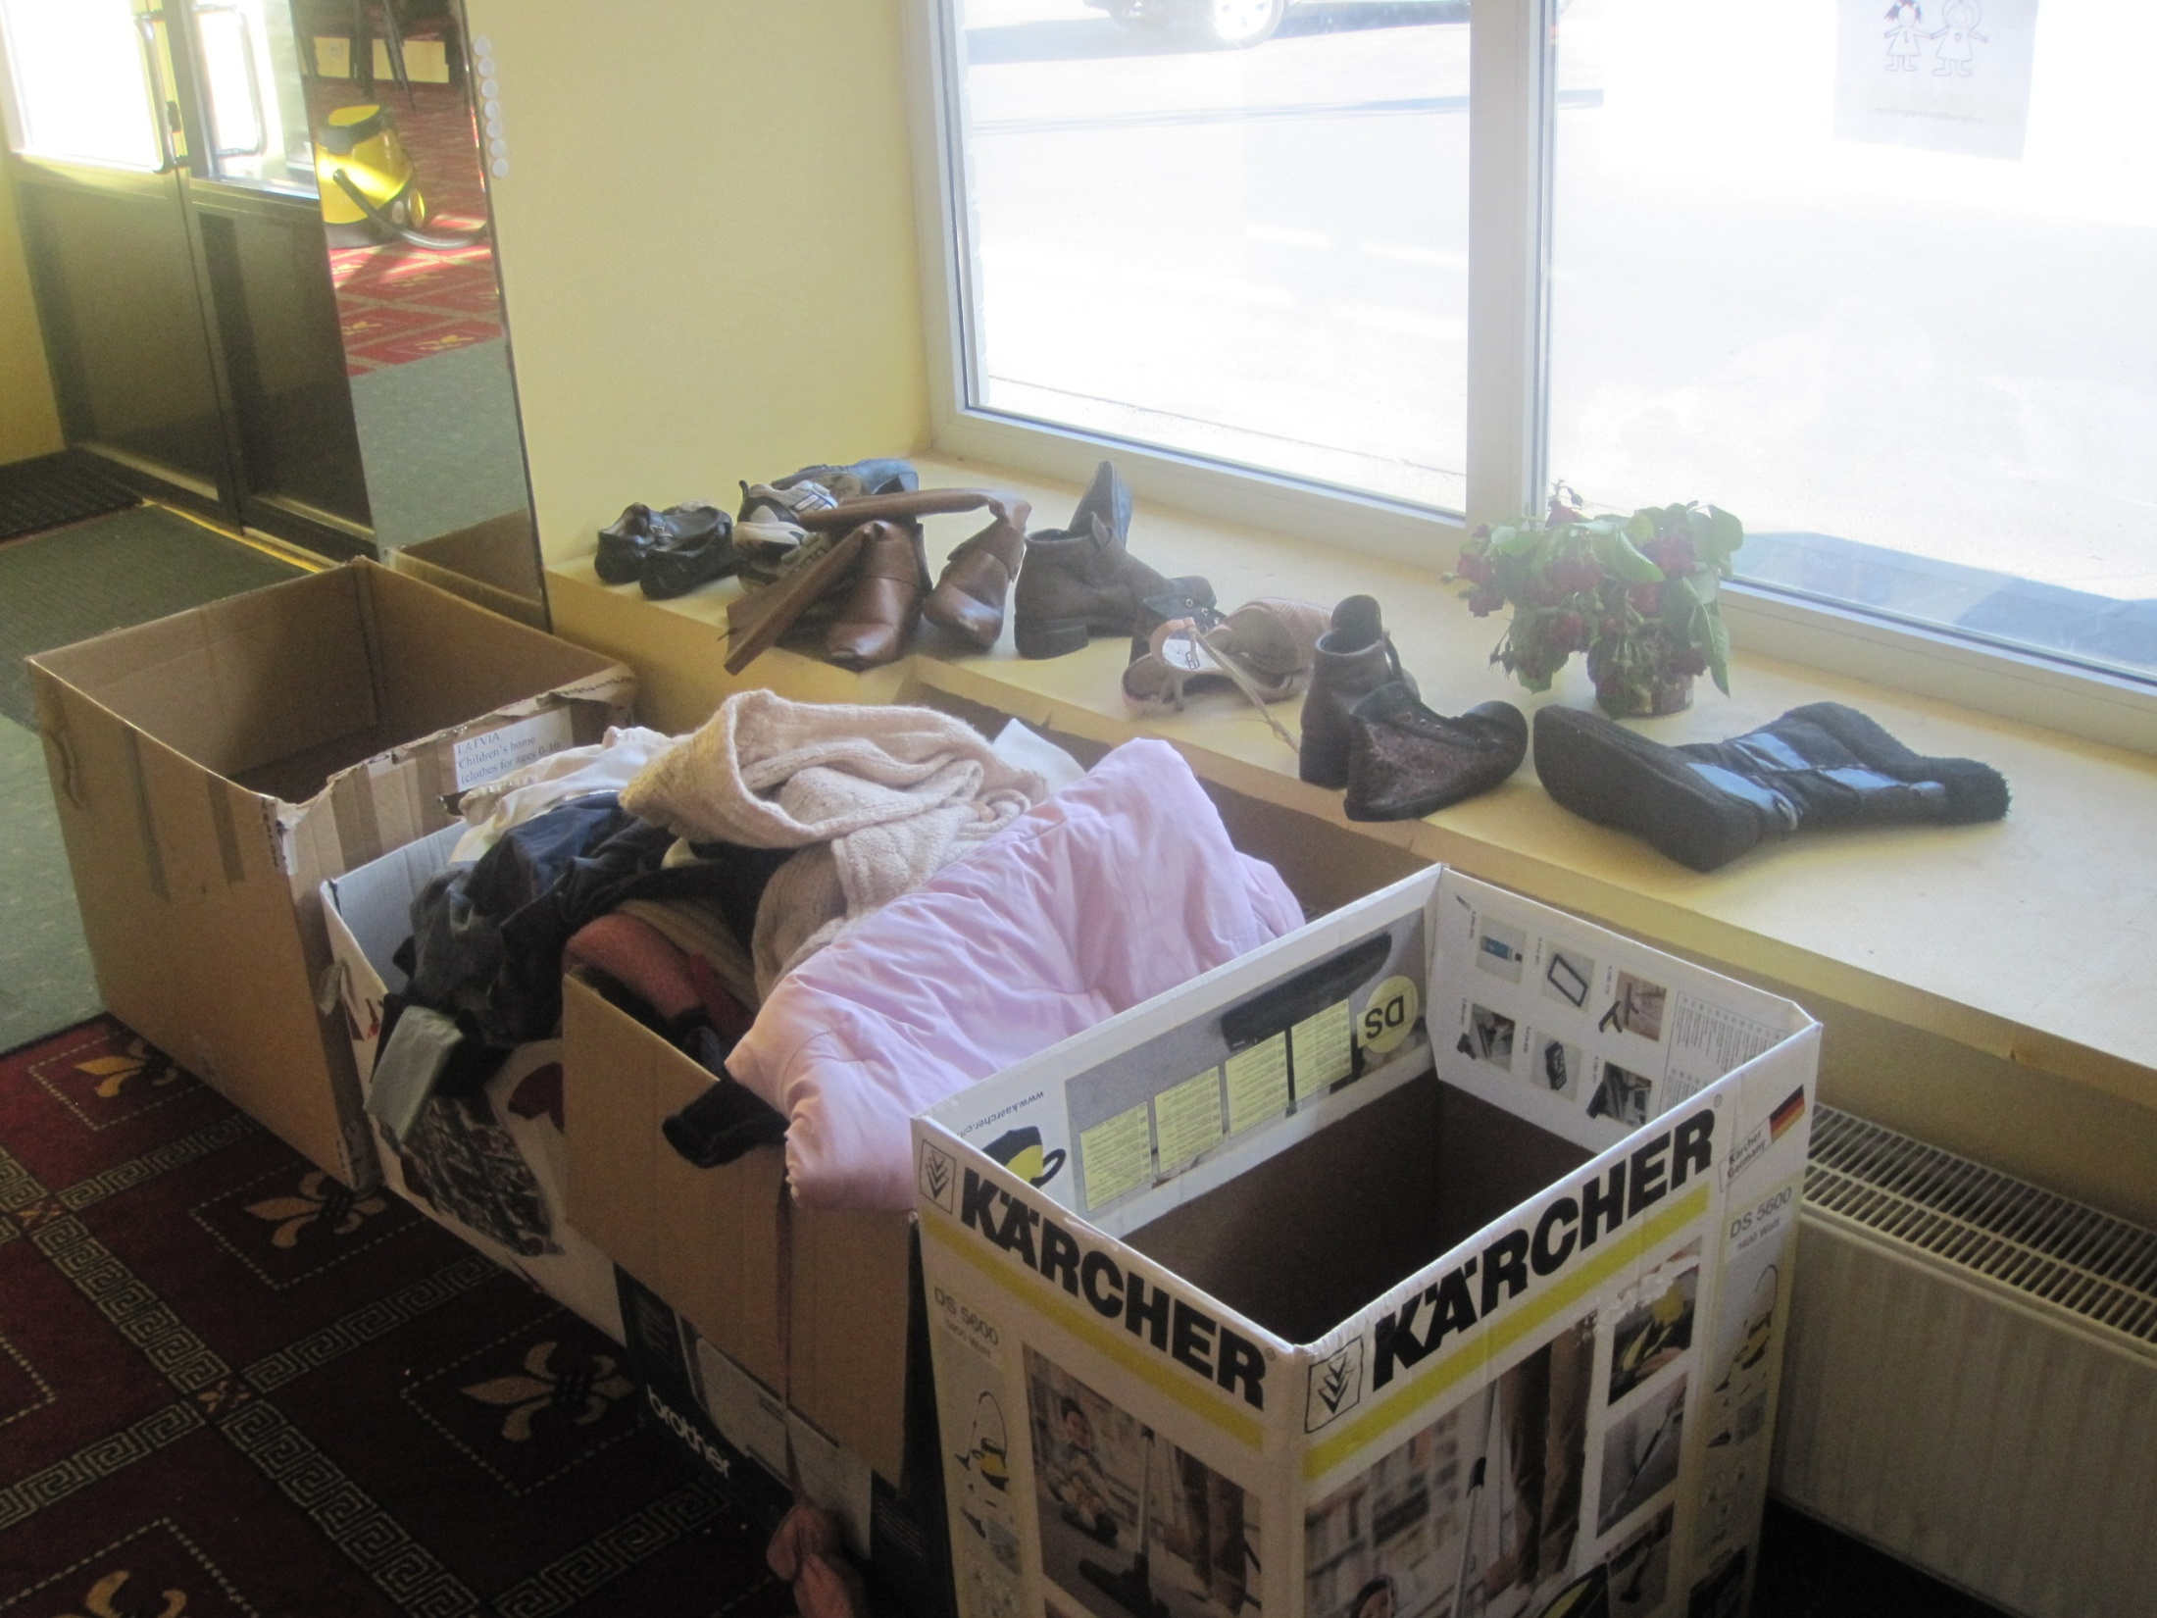
Notes:
As we said, many people are homeless and lack of warm clothing is a major issue. Here is part of a consignment from Canada.

Slide 28
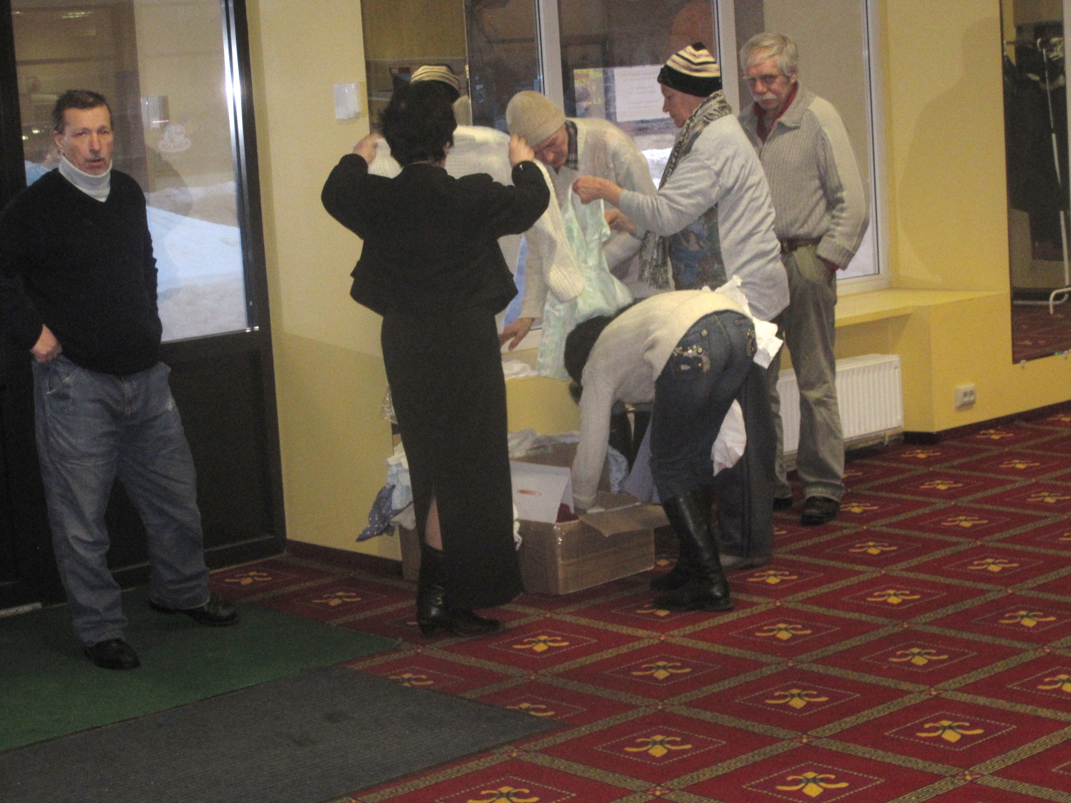
Notes:
Our bre and sis often have to carry all their possessions around with them in 2-3 plastic shopping bags.

Slide 29
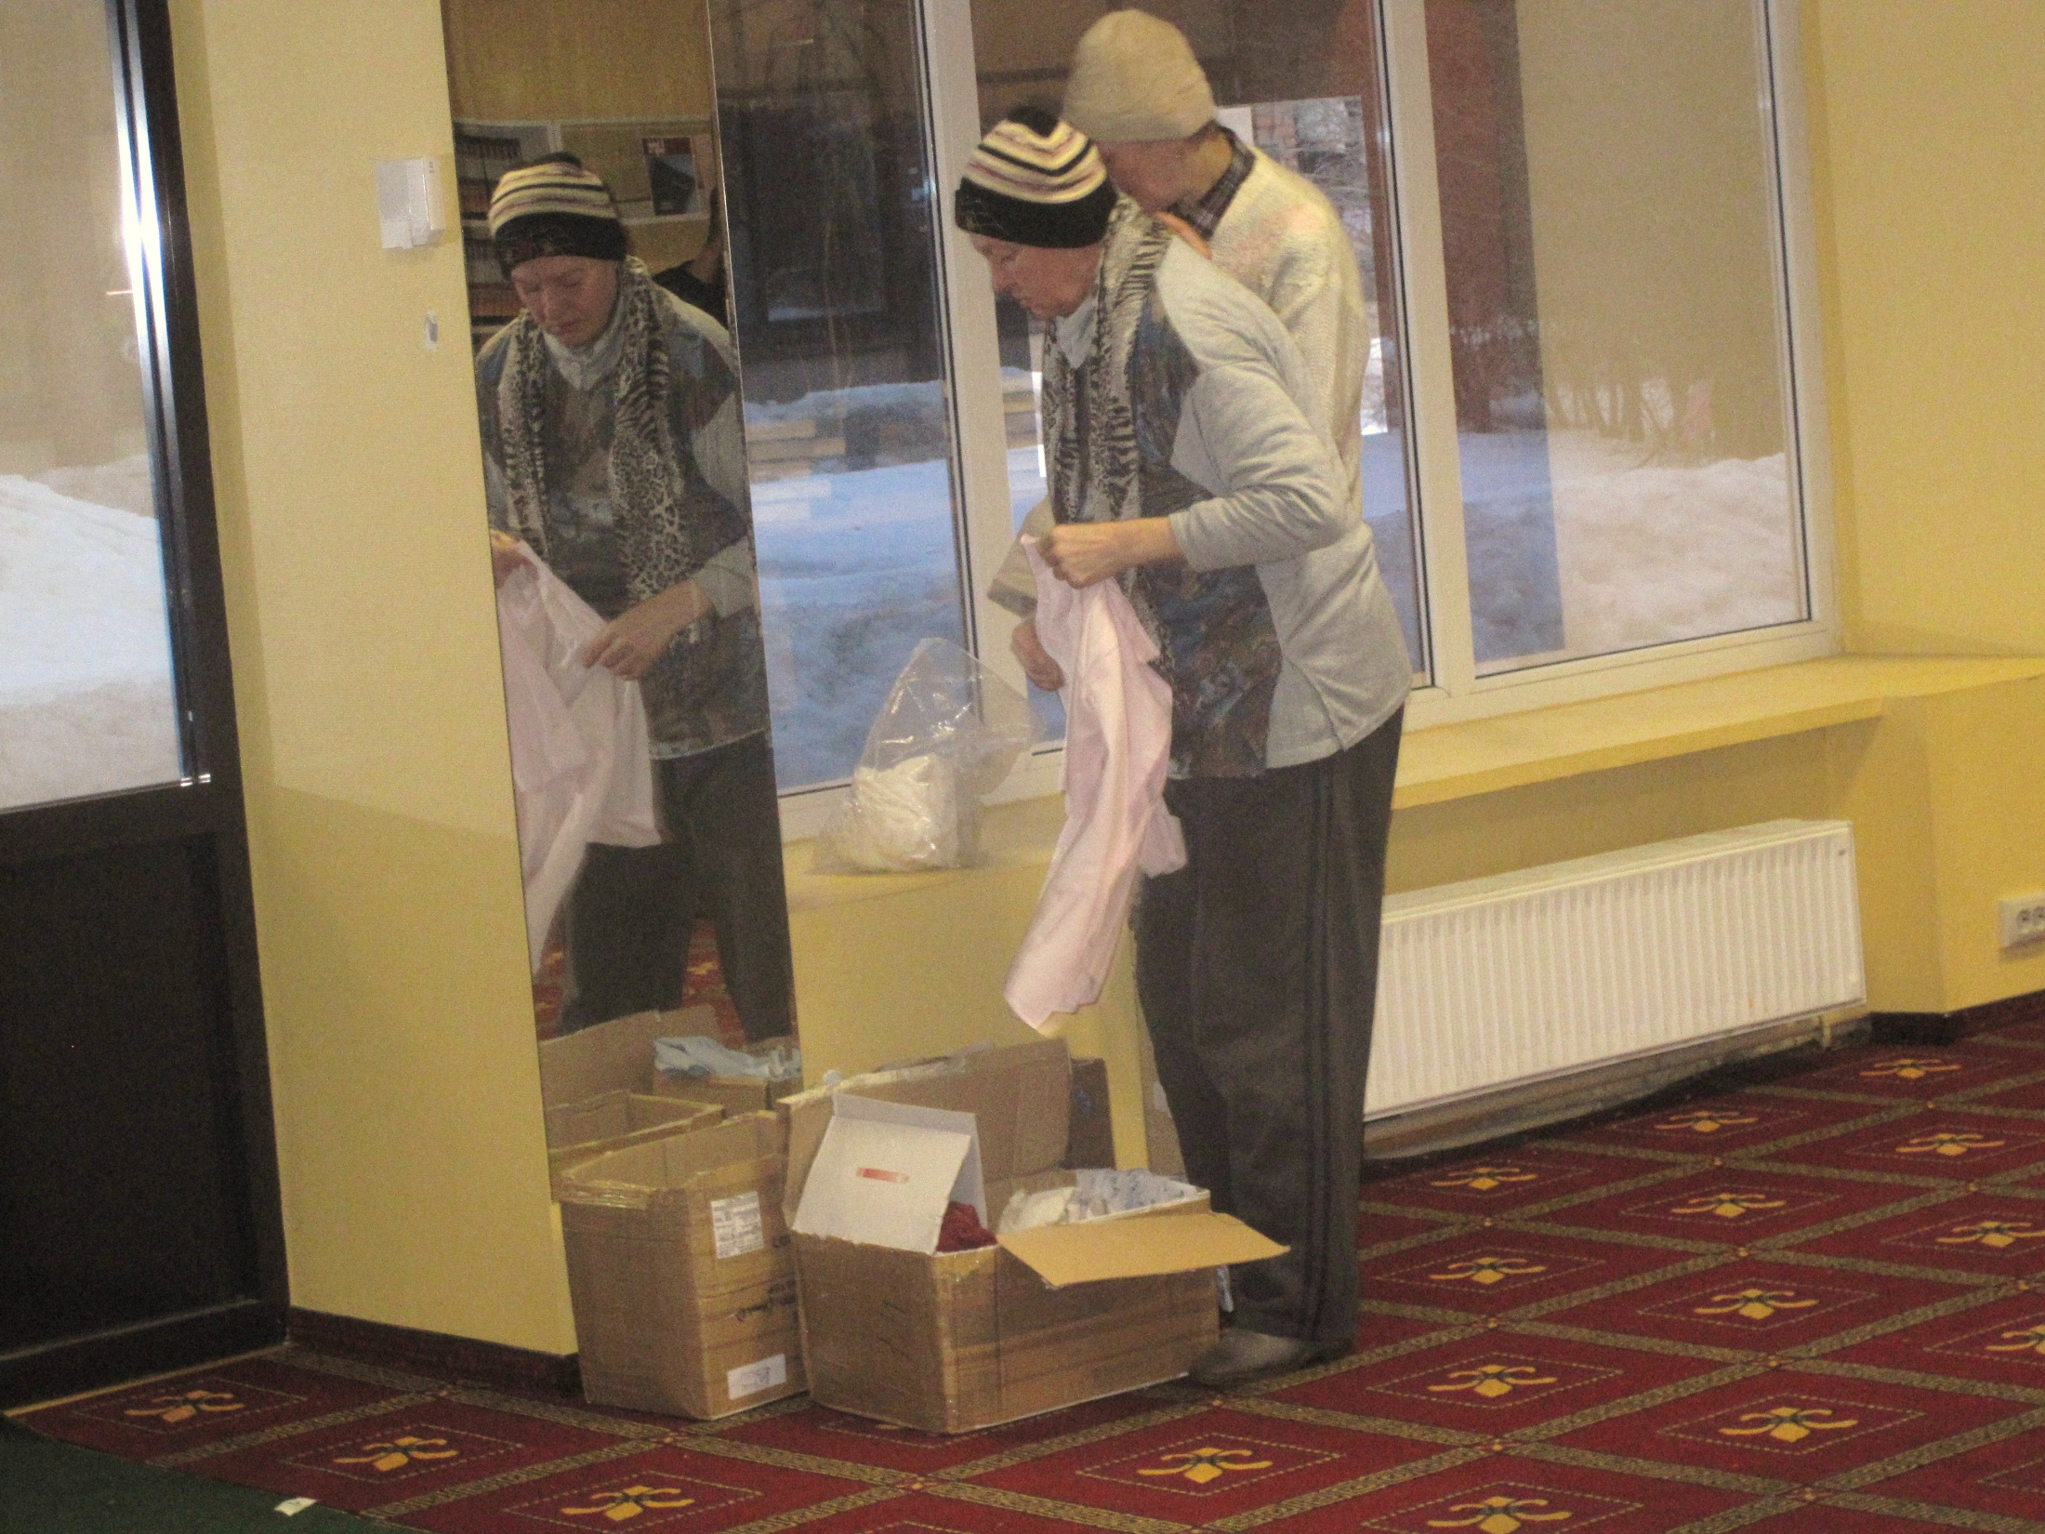
Notes:
The provision of clothes becomes a life line for them. If anyone is interested in helping, there will be a huge demand for warm clothes in the autumn. Temperatures soon drop below freezing from November through to April and last winter it was down to -40 and 10 feet of snow.

Slide 30
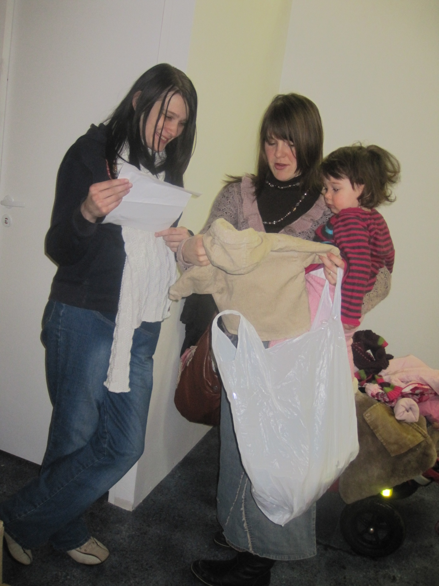
Notes:
This is Cindy and her daughter Evia helping a young pregnant sister who was in a desperately bad situation.

Slide 31
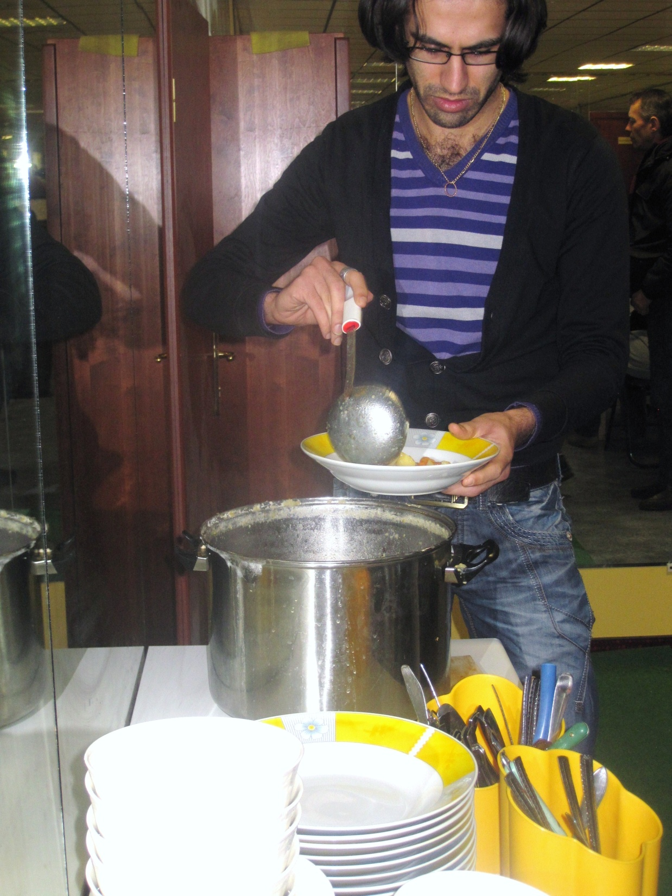
Notes:
The provision of meals has become a major feature of ecclesial meetings. If one or two hot meals can be given, it is probably the best meal many will have that week.

Slide 32
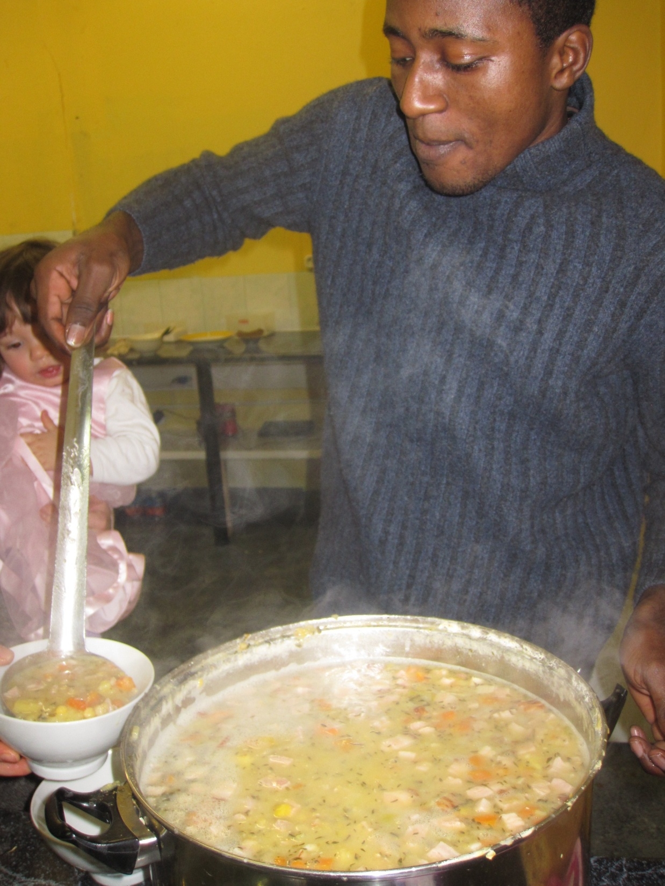
Notes:
Again, it costs a lot to buy even the simplest of meals and cook for 100, so support is always requested for this work. It is difficult for us to imagine living in a hostel, being out on the streets from 8am to 7pm with virtually no money, in the depths of winter.

Slide 33
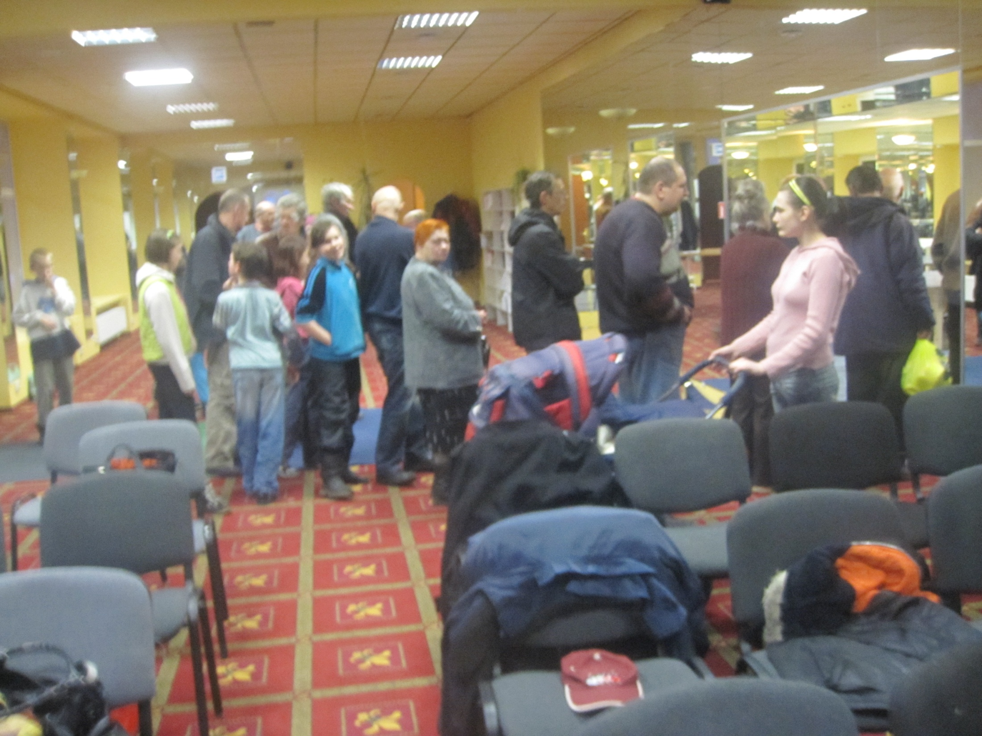
Notes:
So Sunday lunch is always a highlight of the week.

Slide 34
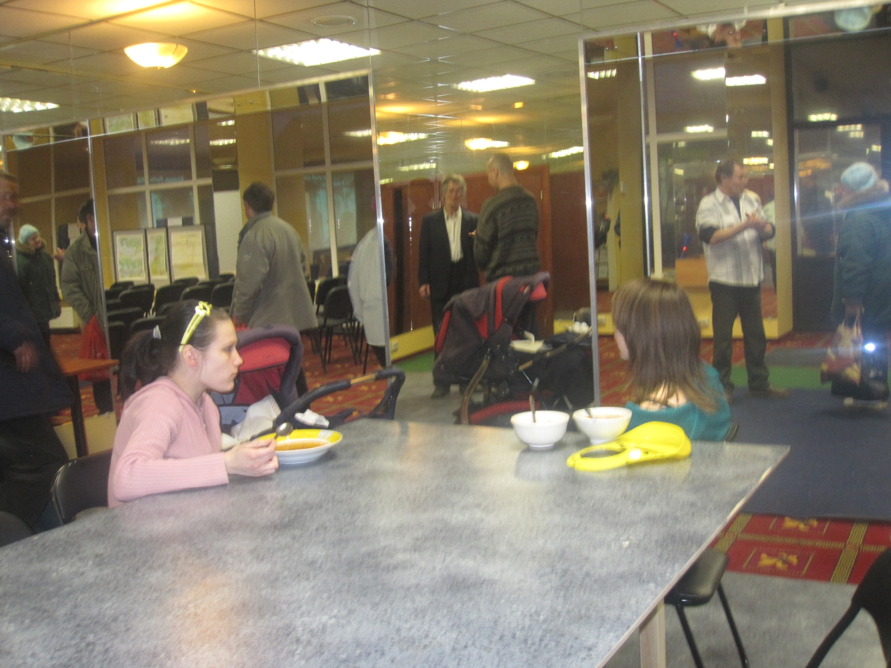
Notes:
But often you will find people with bibles open when they eat together or deep in Bible based conversations..

Slide 35
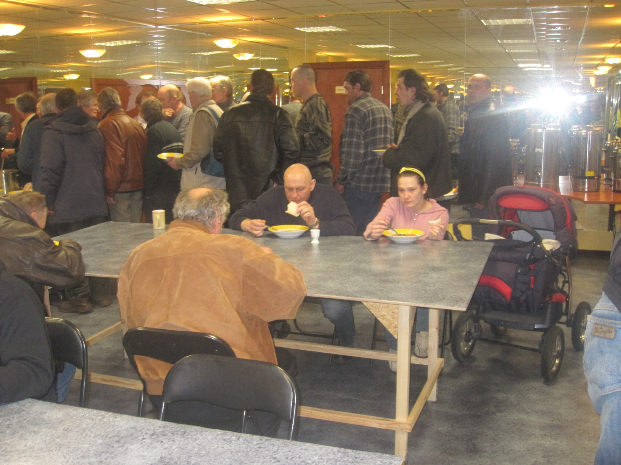
Notes:
Old and young are together caught up in a system which provides virtually no assistance and the ecclesia has to provide a whole welfare system. Those of us who have been out there are astonished at the breadth of support provided by Duncan and Cindy and Carelinks.

Slide 36
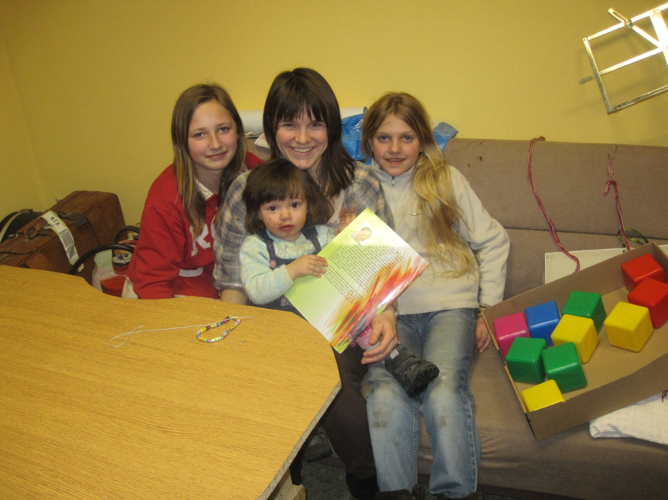
Notes:
Here’s Cindy and Evia and part of a Mothers’ and children group she runs. It was easy to find people to come. Cindy simply handed out leaflets to mothers in the park and they came.

Slide 37
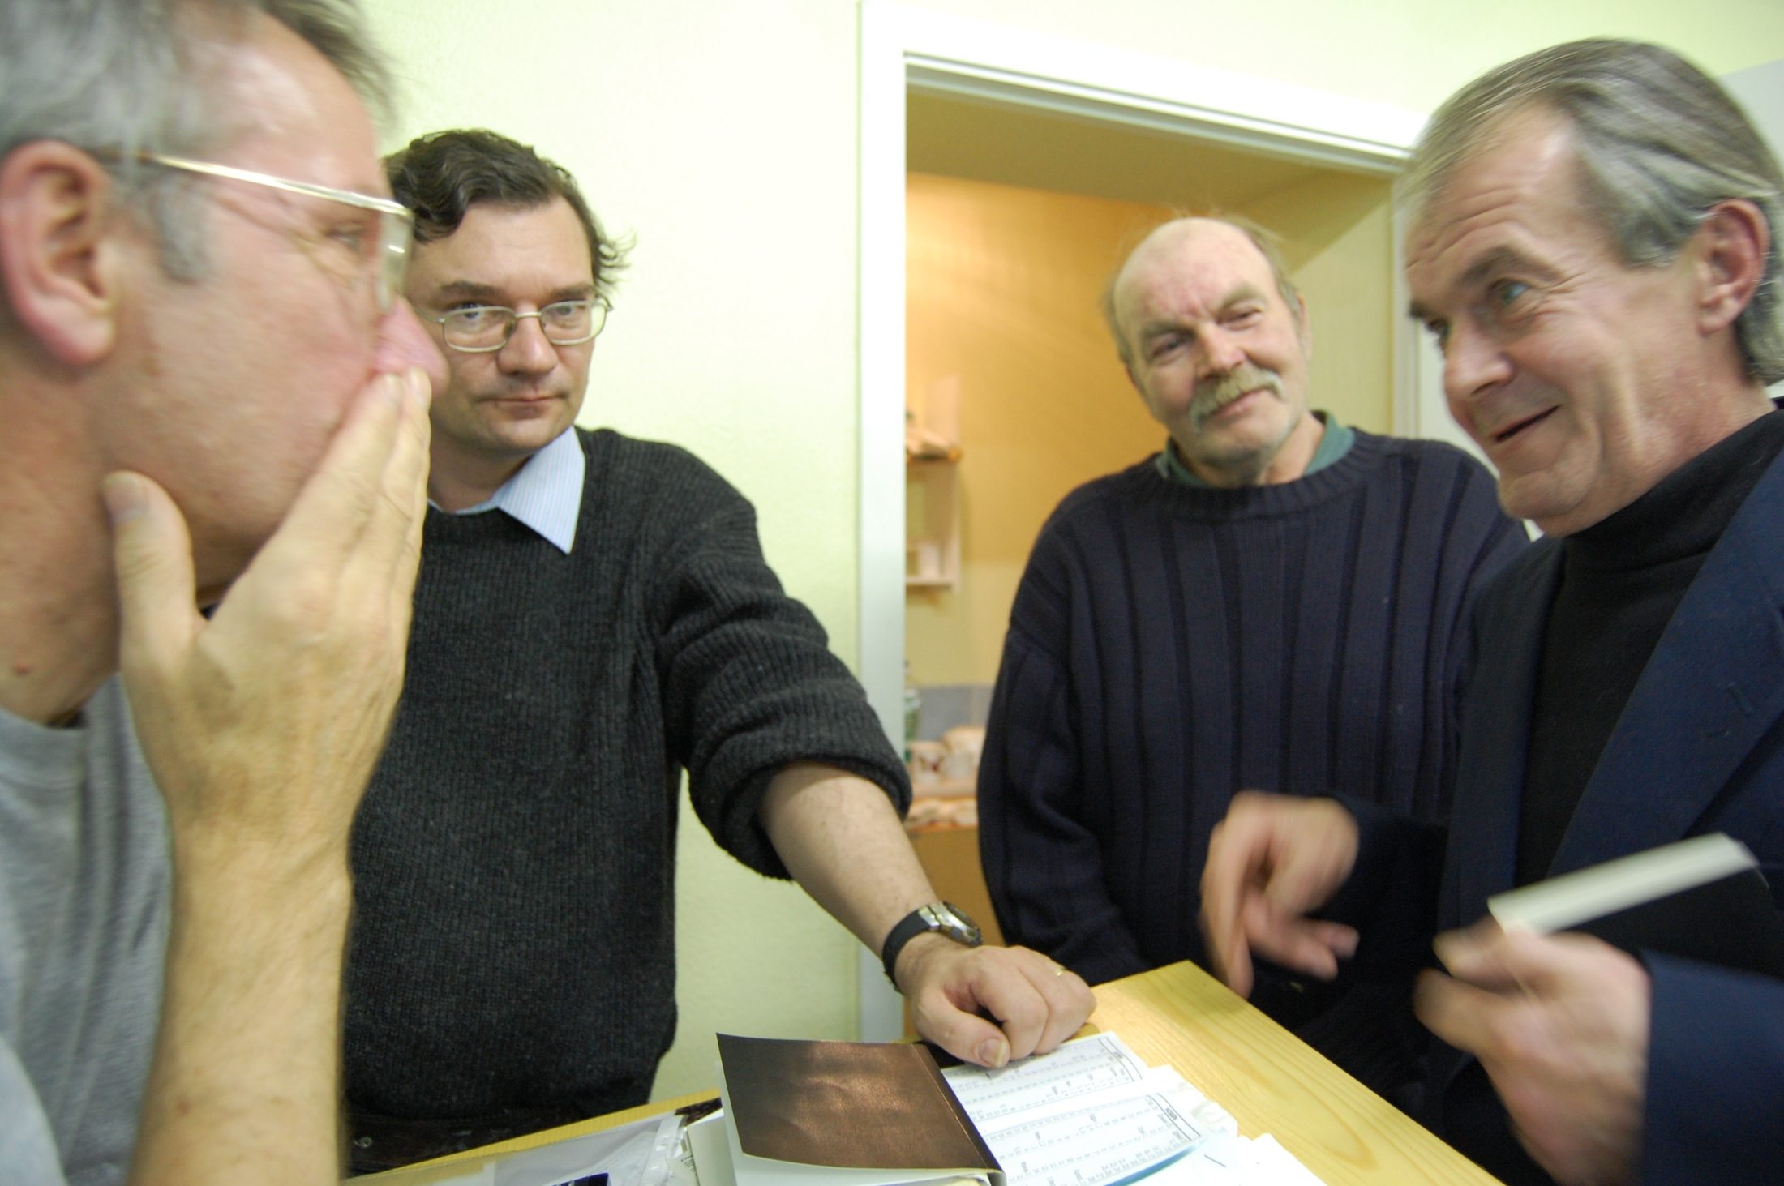
Notes:
The meetings become vital places for passionate discussions. Again translation is the problem and here is Duncan helping with a 2 way discussion of forgiveness and accepting grace to and fro, between English and Russian.

Slide 38
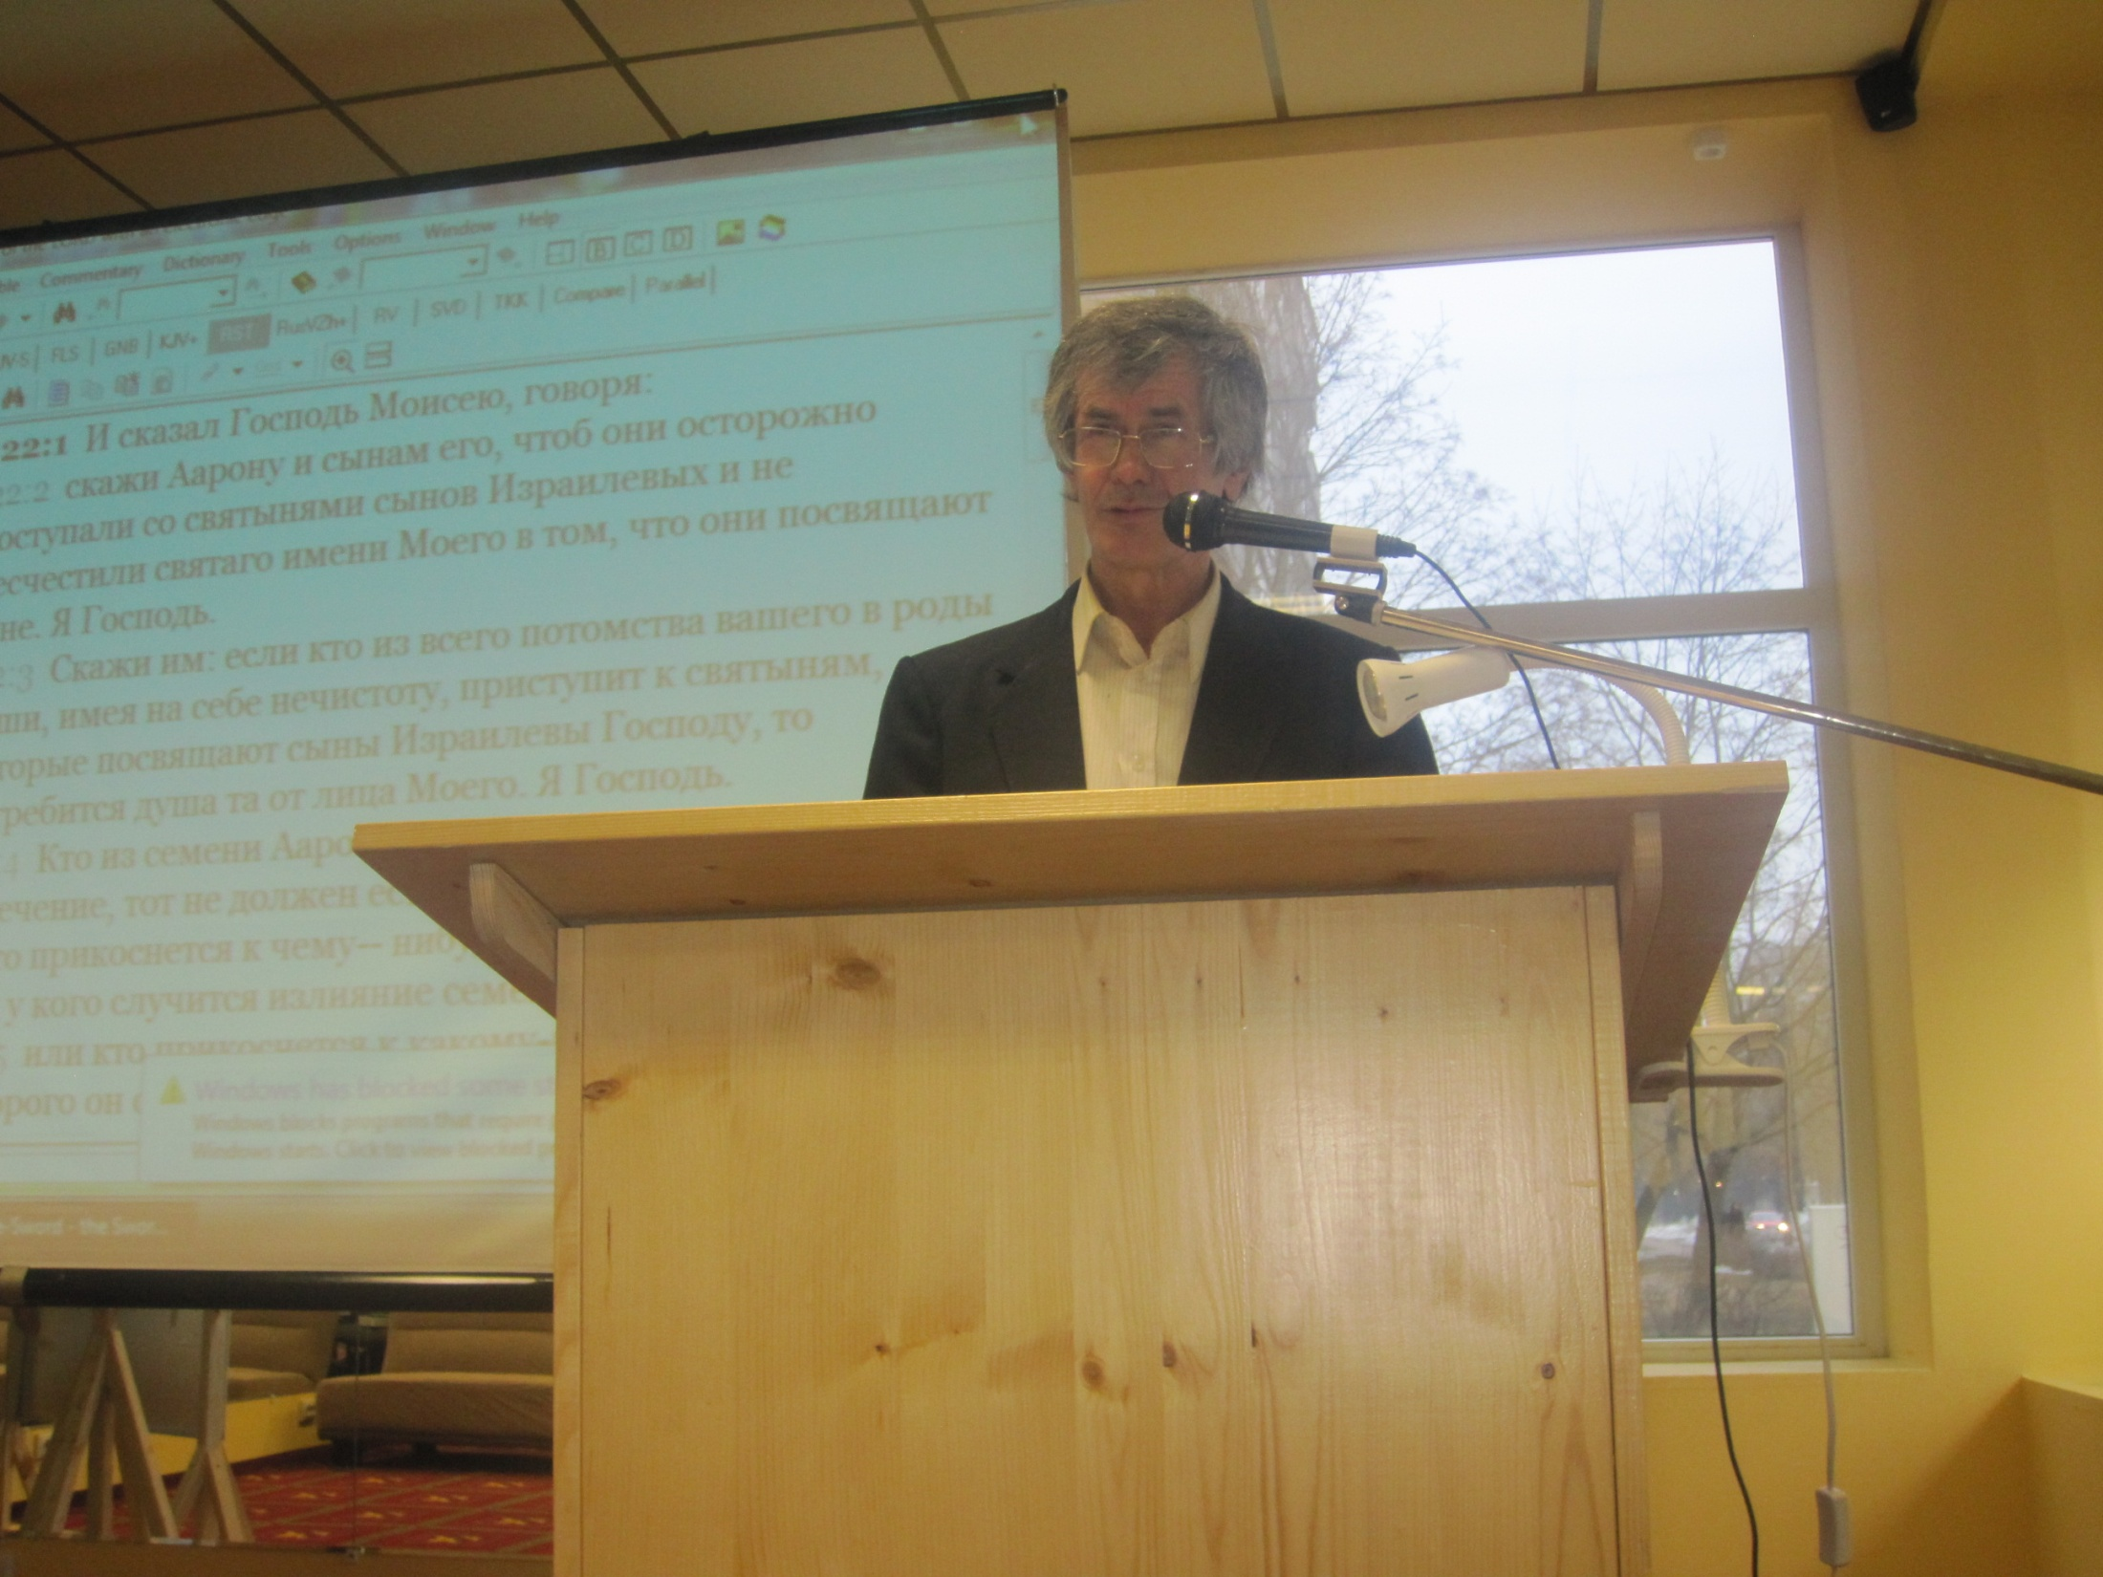
Notes:
Bro Vladimir here has become a teacher of the truth. His Jewish ancestry, fluency in Hebrew and Greek and a deep lifelong study of the scriptures, particularly the Books of Moses led him to baptism with us, having concluded that the teachings of the other churches simply did not add up to what God had taught him through the Bible.

Slide 39
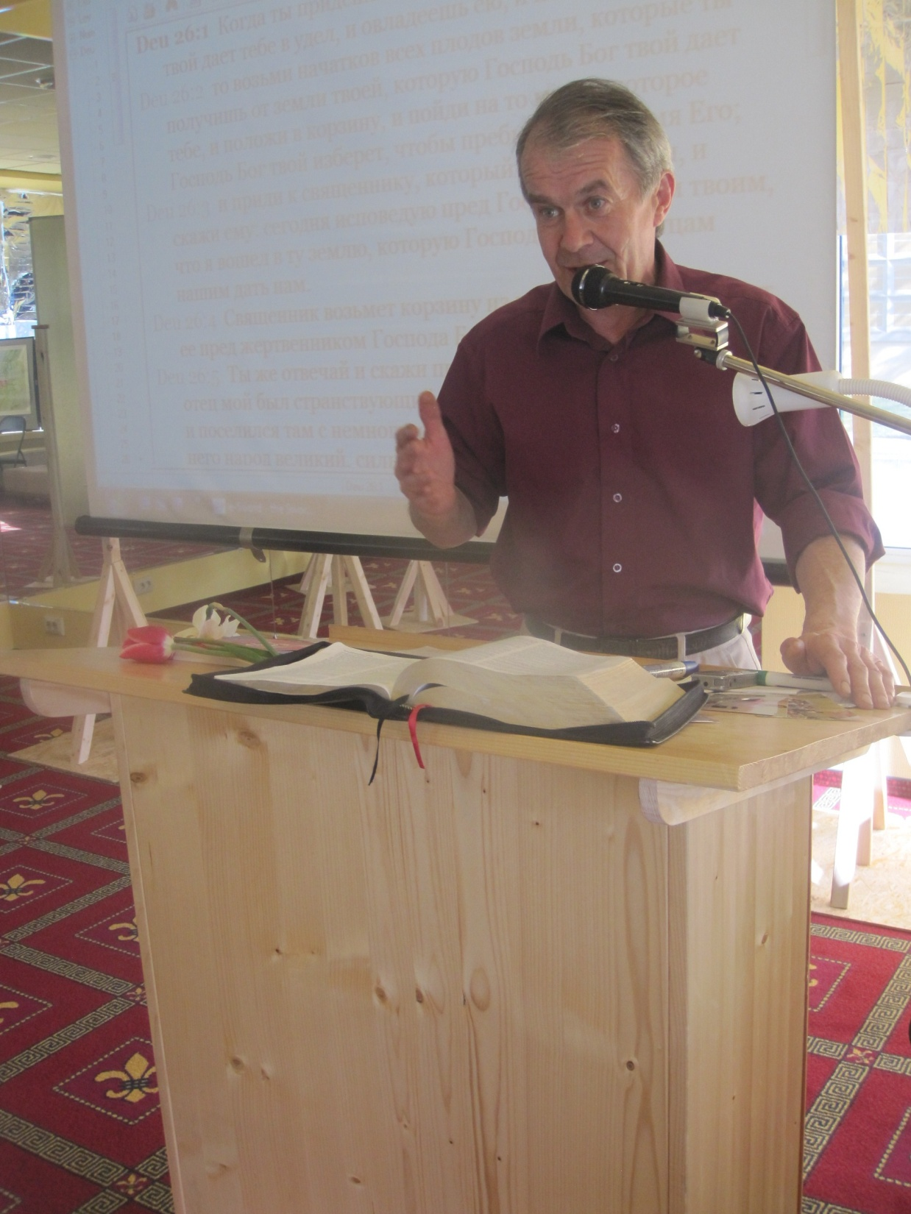
Notes:
The people who teach have remarkable backgrounds – here’s an ex KGB officer teaching about grace – his favourite subject .

Slide 40
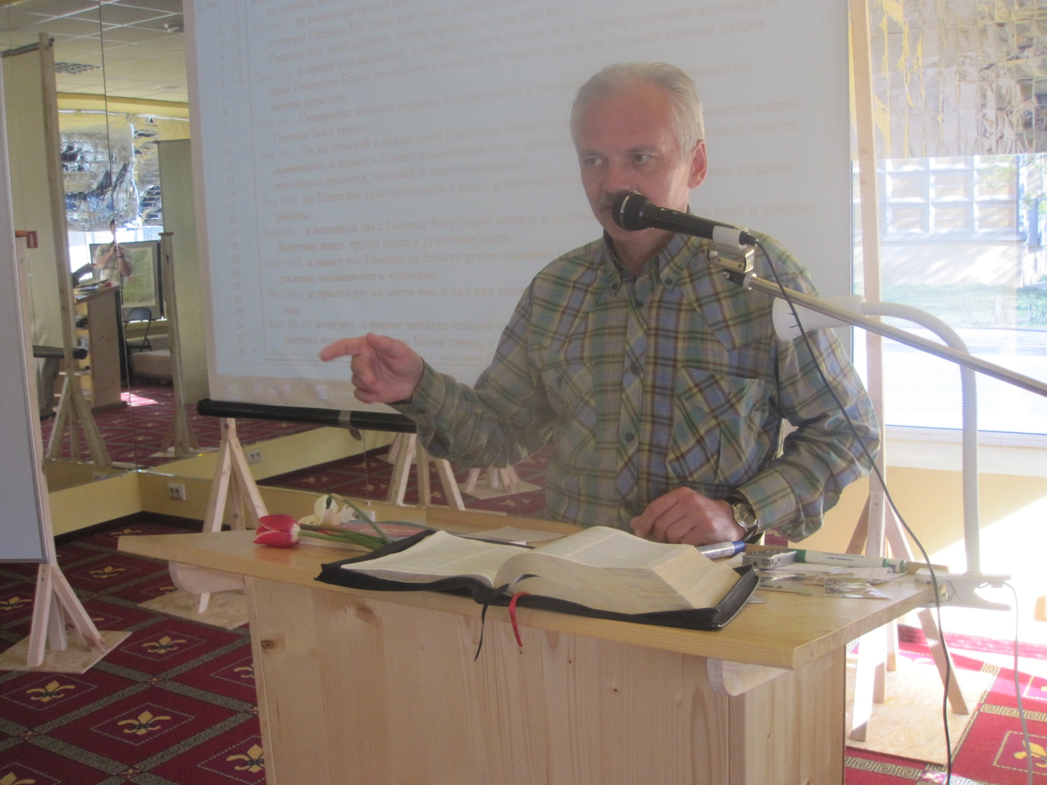
Notes:
And here’s Armands again – baptised a year ago, here leading a study on the book of Job.

Slide 41
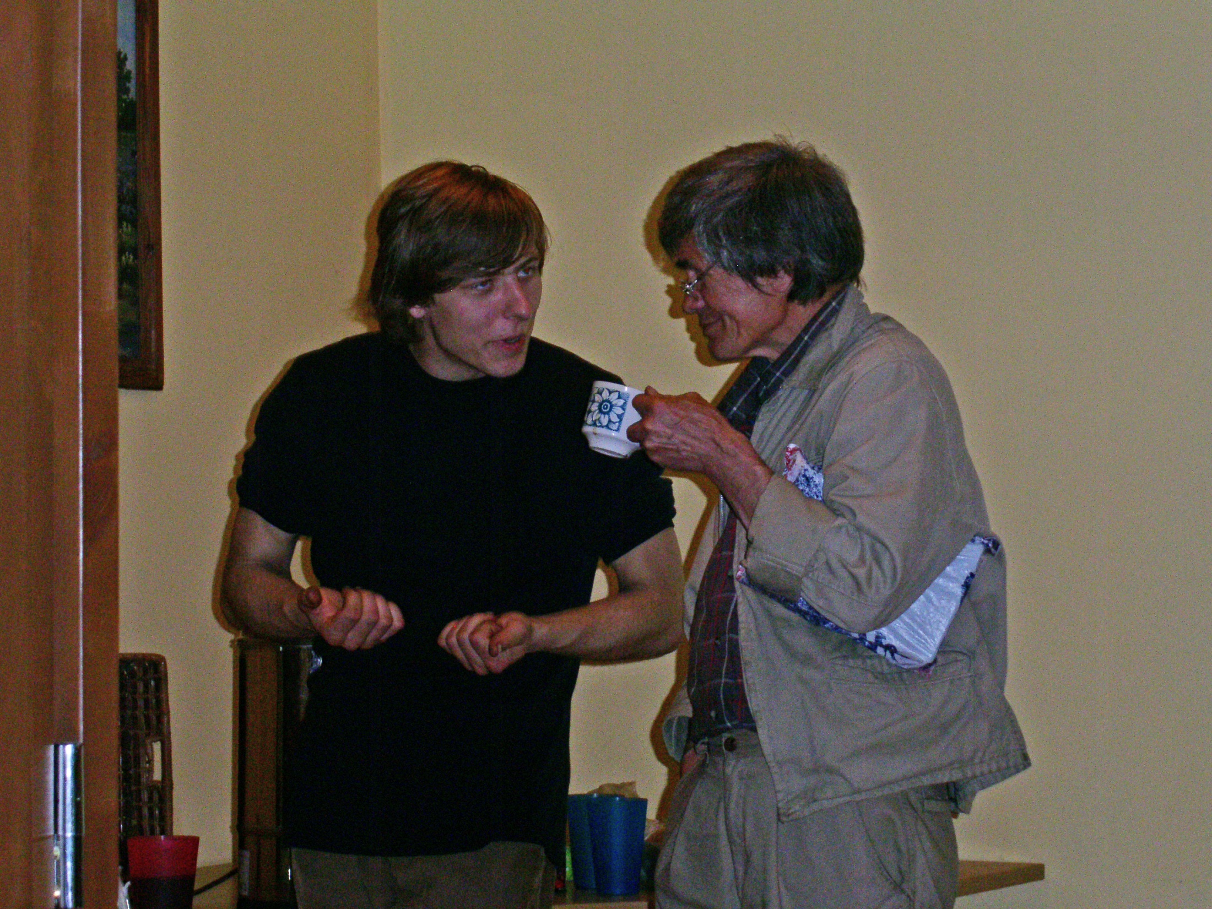
Notes:
Accommodation is provided for these two, Vladimir and Dainis. Vlad is almost blind and Dainis helps him, Vlad teaches him and they act as caretakers and odd job men for the ecclesia.

Slide 42
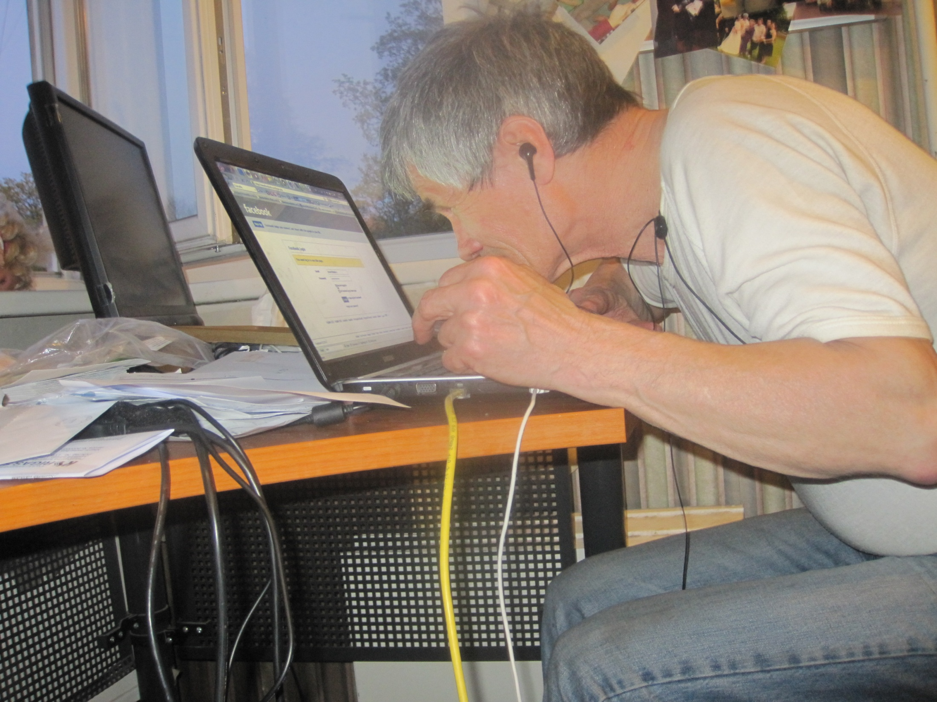
Notes:
Vlad has hundreds of pages of hand-written notes from his long studies of the Torah and he is desperately rushing to get this onto computer before he is finally blind.

Slide 43
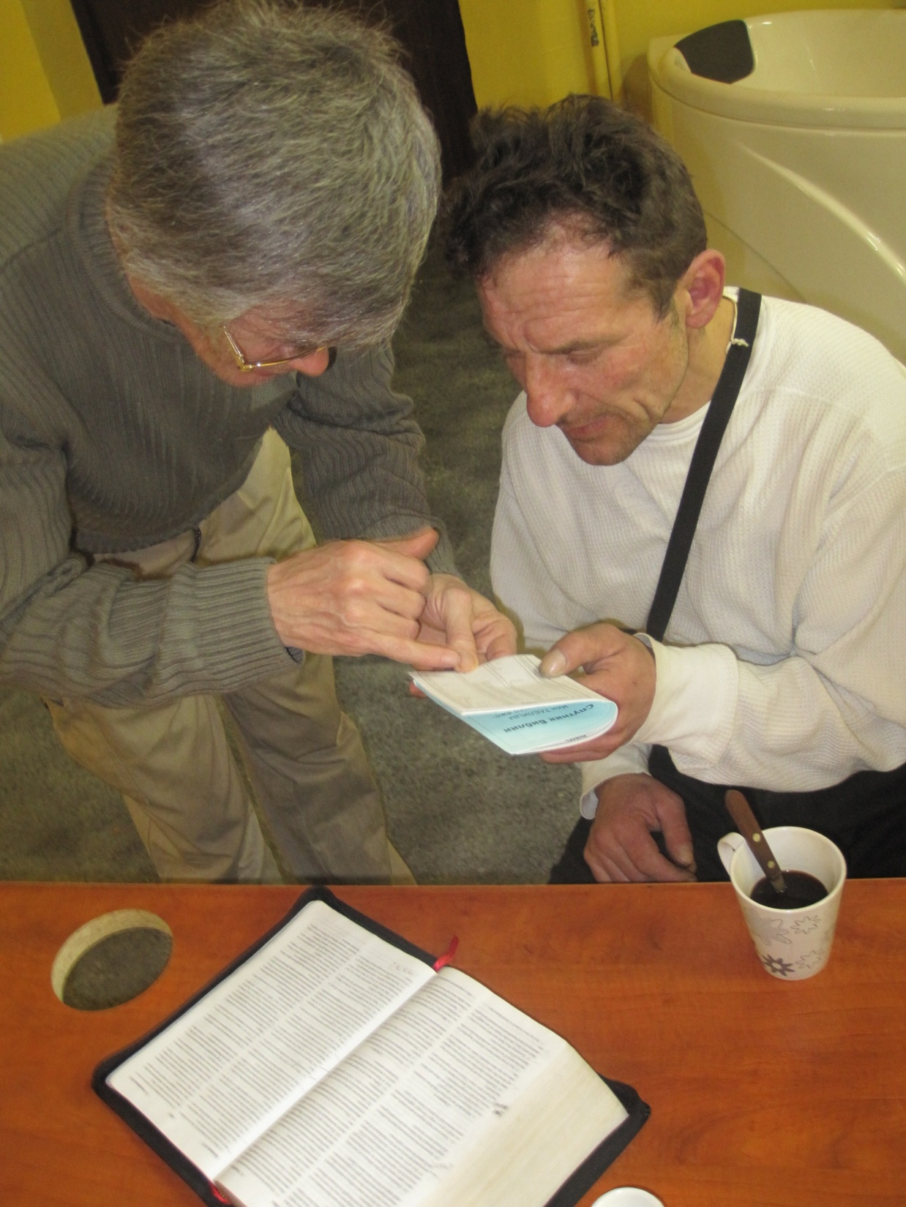
Notes:
Yet despite his poor sight, here he is teaching another brother how to use the Bible Companion.

Slide 44
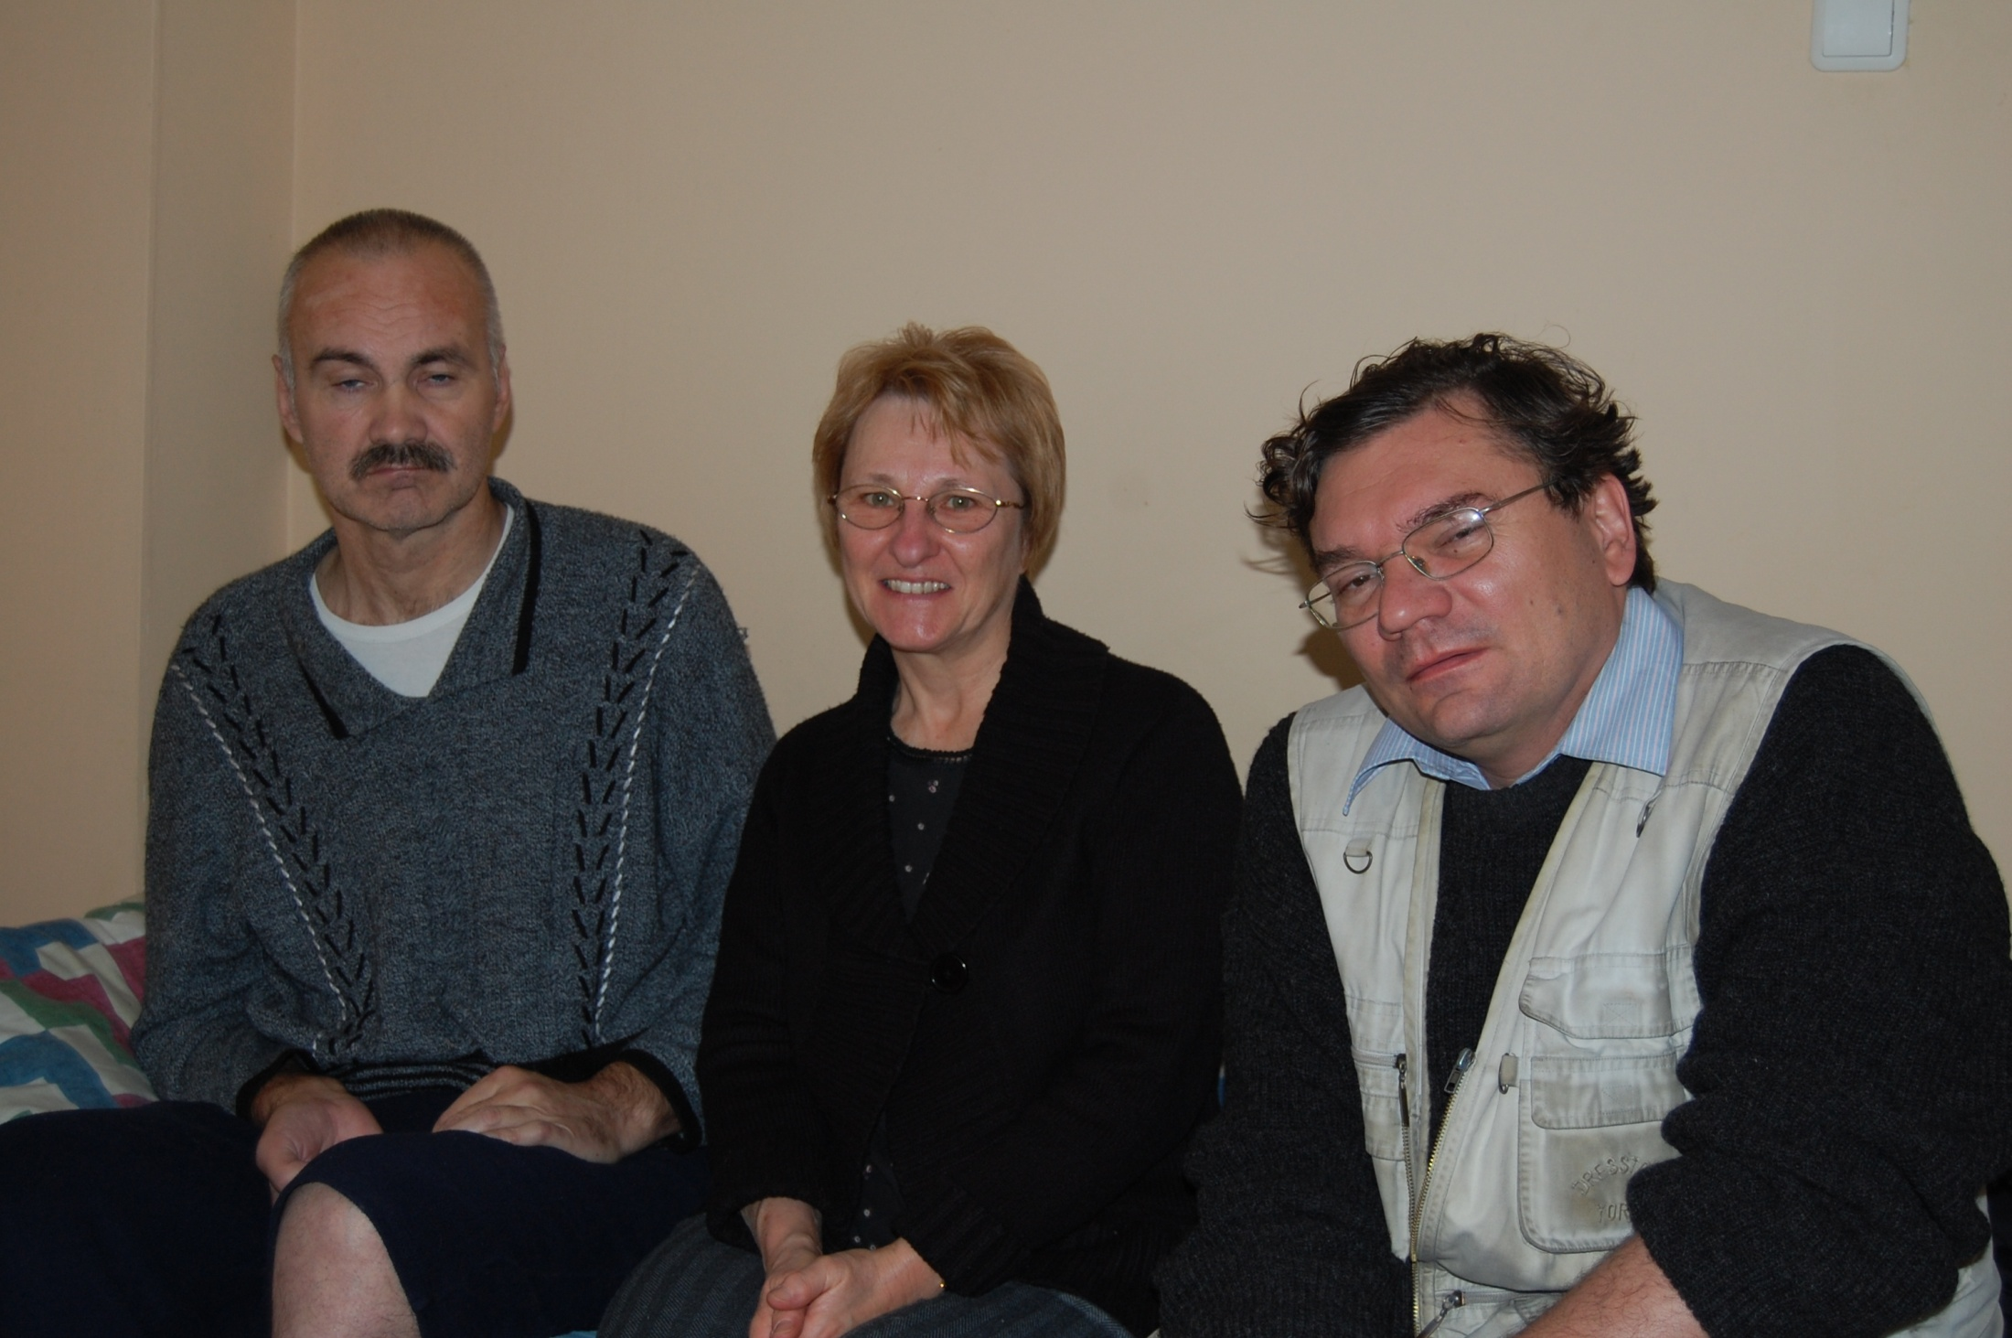
Notes:
Brother Viktor on the left had a stroke and was totally neglected by the hospital so sadly has permanent brain damage. Due to the intervention of Carelinks supporters and Duncan and Cindy – who incidentally is a doctor - his life was saved and he was found a home where he is receiving decent therapy. It costs about £10 a day.. The alternative doesn’t bear thinking about. There’s no free health care in practice in Latvia.

Slide 45
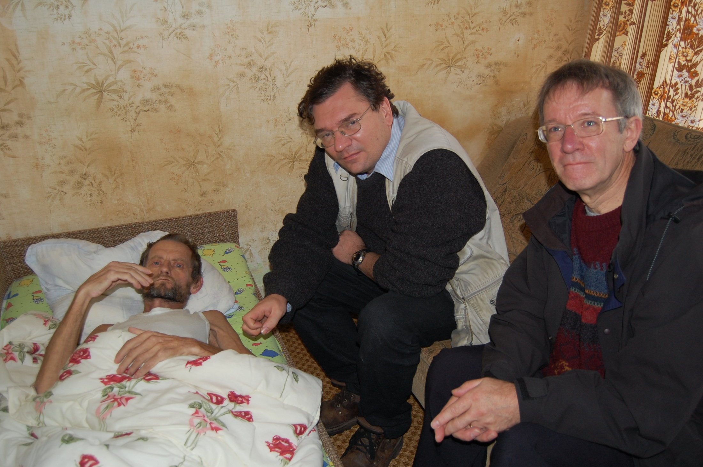
Notes:
Brother Valerij is dying of cancer – but not before he taught the truth to his boss and saw him baptised into Christ. Carelinks provided care at home for him at the end of his life. His ex-wife kindly cared for him, but it’s another drain on expenses for Carelinks.

Slide 46
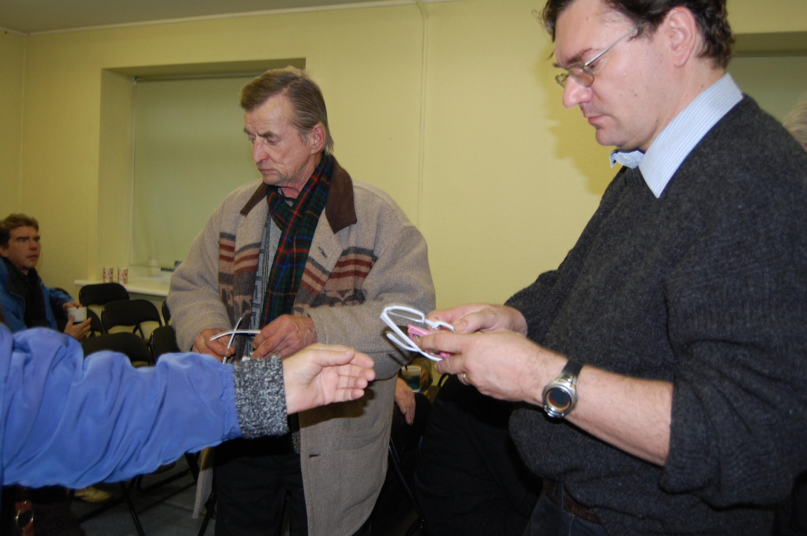
Notes:
Many cannot afford reading glasses. A kind donation from Maidenhead ecclesia enables them to read their Bibles.

Slide 47
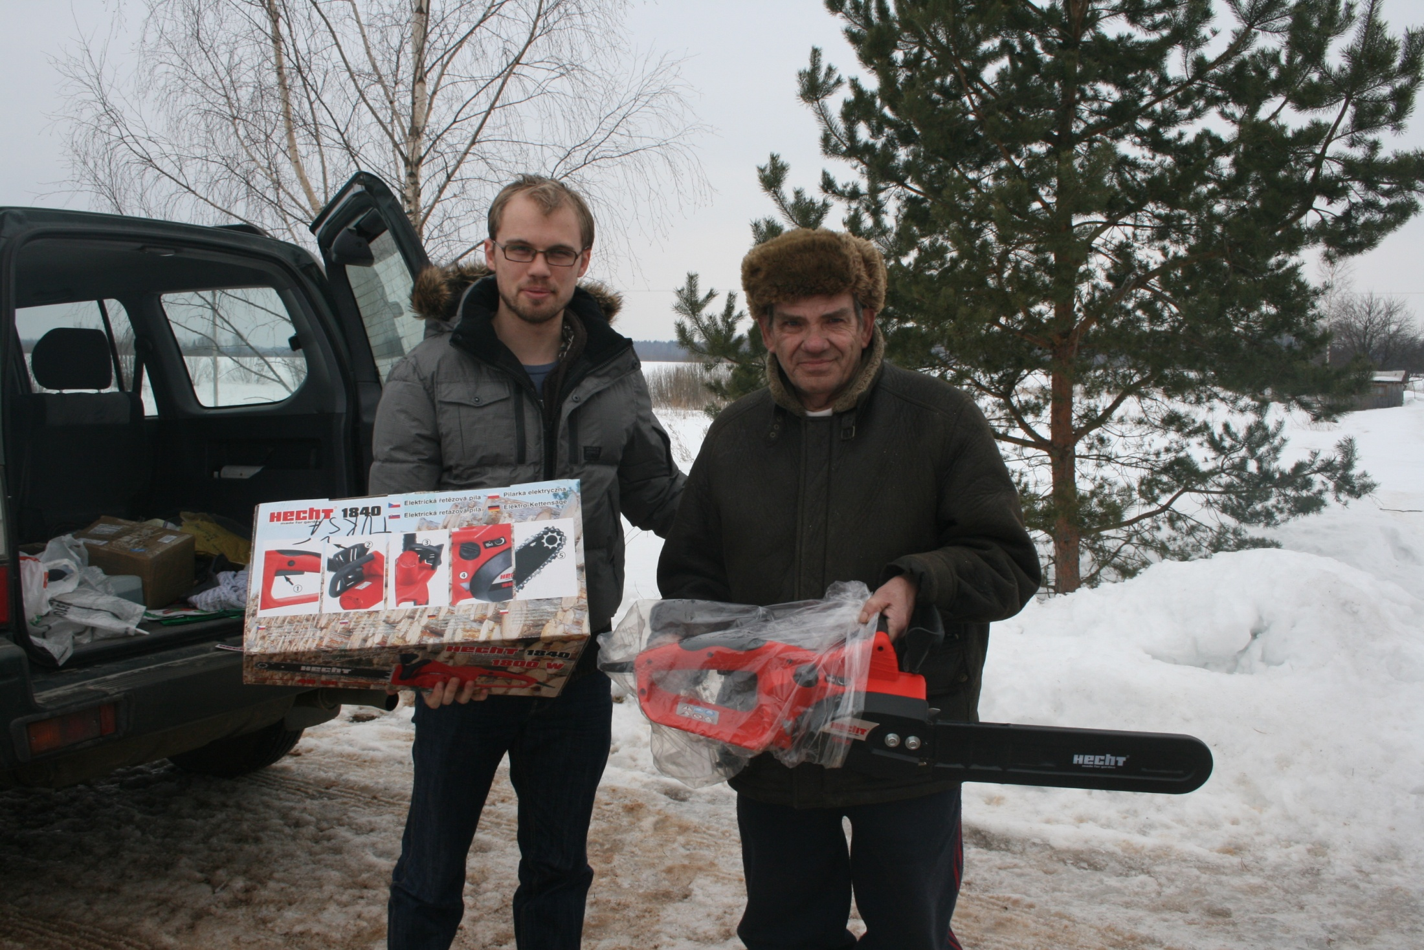
Notes:
The donation of a chain saw will enable this brother in the country to keep himself and his family warm in the -40 degrees common in winter.

Slide 48
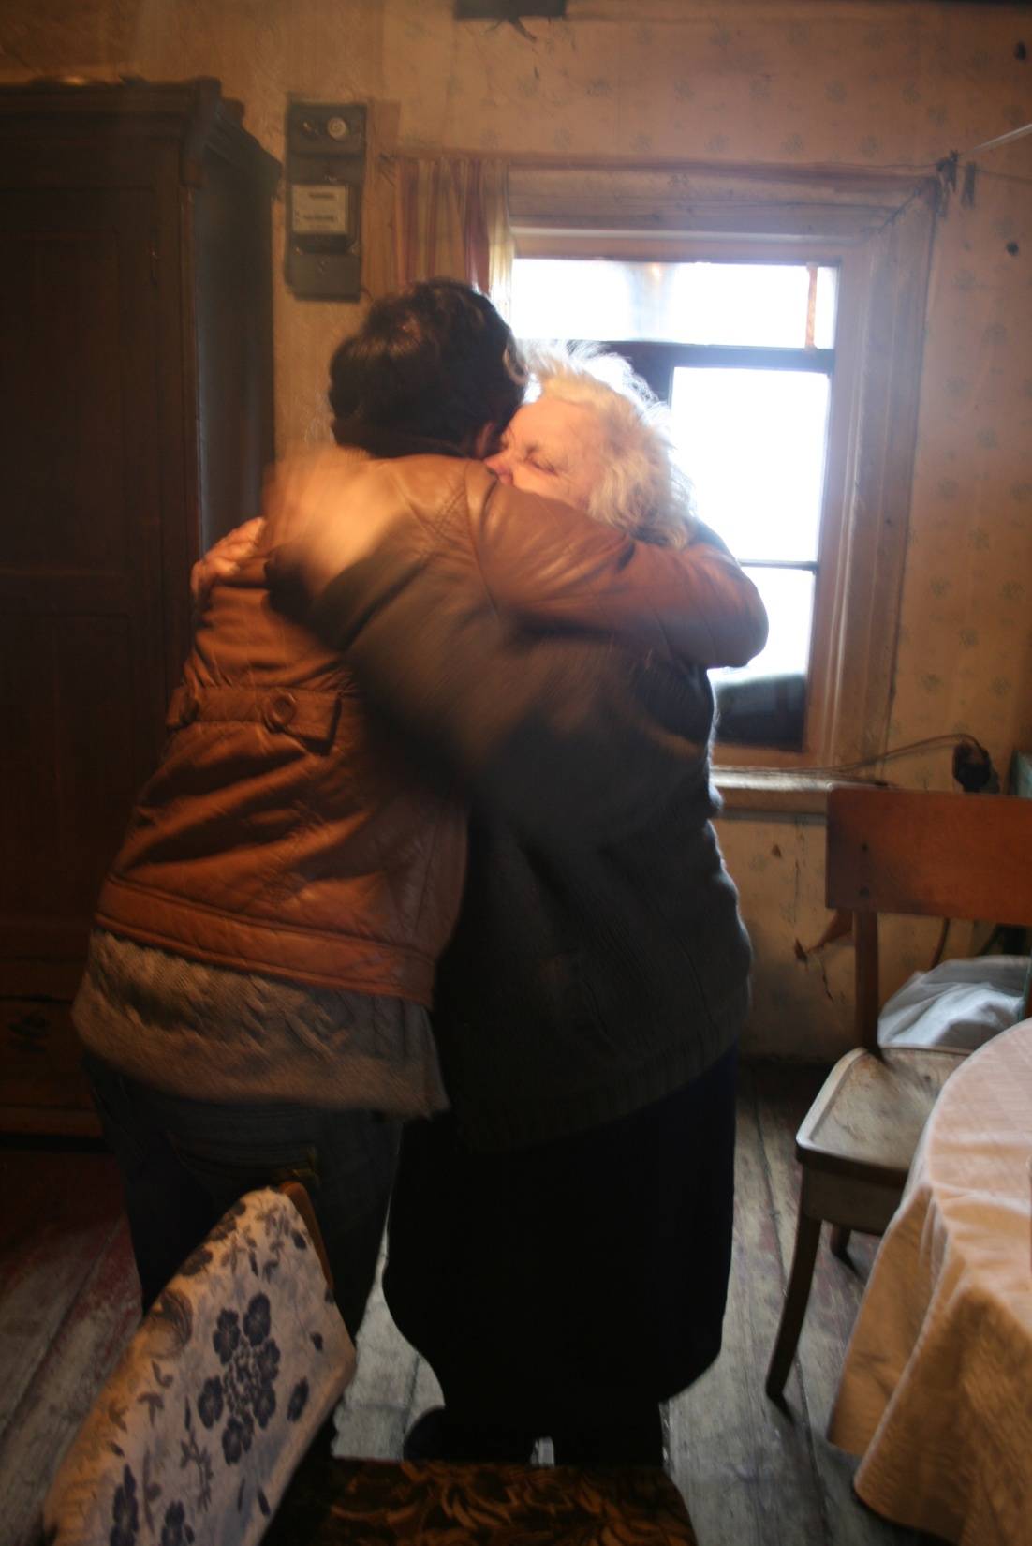
Notes:
And sometimes a delivery of logs will keep the icy cold away for a time.

Slide 49
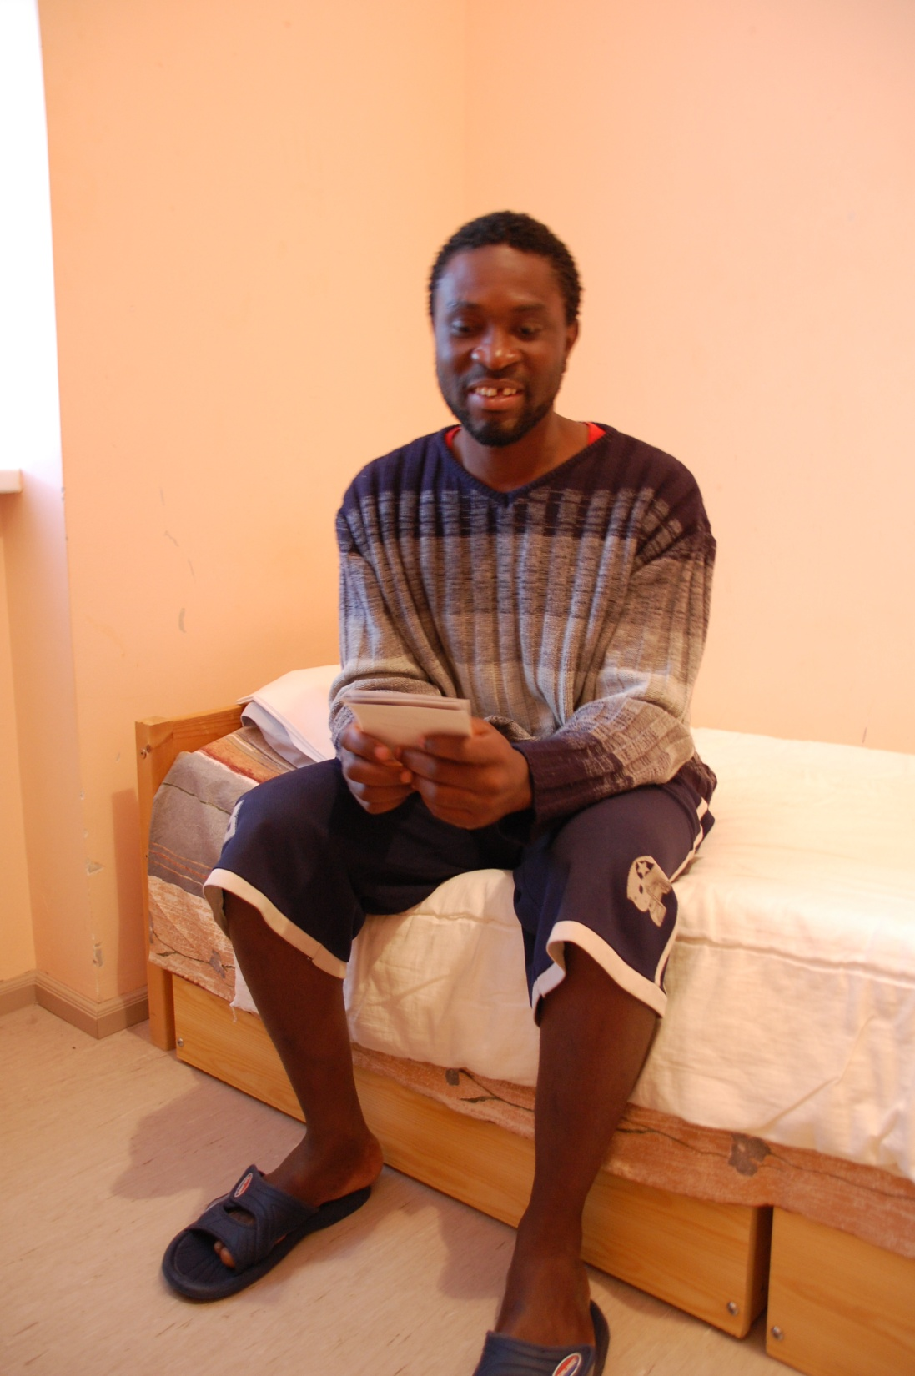
Notes:
The refugee centres for those seeking asylum have become a hotbed for preaching. Charles here had only been in this hostel for a few hours before he had found others and was actively preaching the truth to them. Many baptisms have followed.

Slide 50
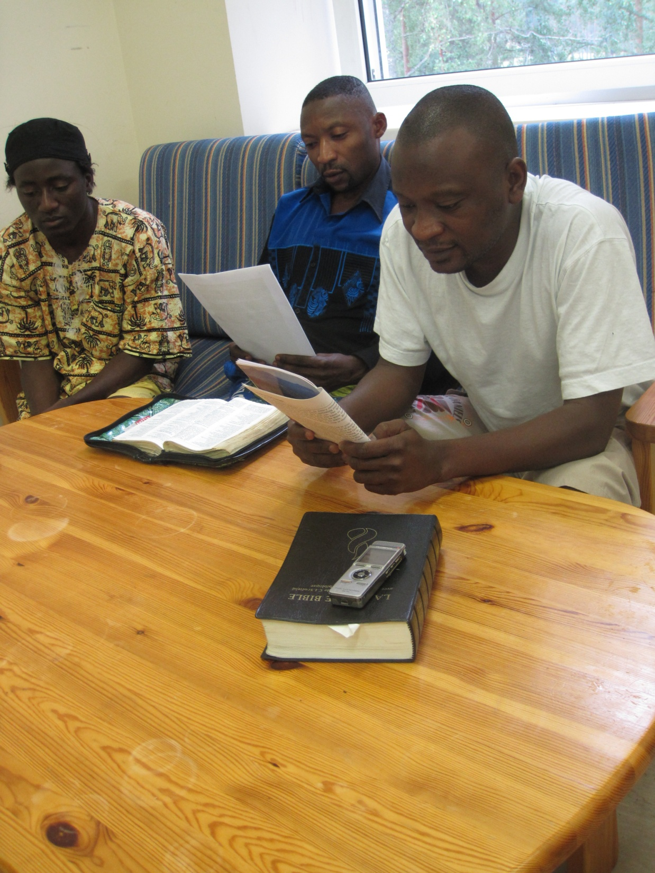
Notes:
The book Bible Basics is fortunately available in many languages – over 40 at the last count and it is a stated objective to get the Bible, the book Bible Basics and the Bible companion into as many languages as the Lord leads. These men are French speaking people from Congo, learning the truth in Latvia from an Englishman! – Typical!!

Slide 51


Slide 52

Notes:
In one centre for refugees – 12 people – 8 different nationalities!!
Some of them have been baptised, then returned to their own countries taking the truth with them. This has been a wonderful opportunity for preaching.

Slide 53

Notes:
And another international group – several from UK here to support the ecclesia, run a Bible Study weekend and undertaking a major decoration job. It was the occasion of the baptism of Robert on the left – a refugee from Sierra Leone, but now a stateless person in Latvia.

Slide 54

Notes:
The Iranian brethen have been particularly active with their fellow country men and women. Often using the internet, they target others who have fled from Iran for fear of persecution and then teach them the truth using Bible Basics until they are ready for baptism.

Slide 55

Notes:
Here are some Iranian sisters in Sweden.

Slide 56

Notes:
Notice the copy of Bible Basics that Duncan is holding in Farsi language. The sister in the middle is reading from the New European Version of the Bible in English. More about that later.

Slide 57

Notes:
And another Iranian contact in Germany.

Slide 58

Notes:
A typical enthusiastic study session between these two Iranian brethren.

Slide 59

Notes:
And another joyful baptism.

Slide 60

Notes:
A jump to Ukraine and a Bible School there. This teenage brother came from Moldova. He speaks good English but Carelinks have had to give his family assistance so he can avoid military service. Typically in Moldova they have a law allowing conscientious objection, but no framework within which to apply the law.

Slide 61

Notes:
Valeri here had travelled fro 3 days to spend a few hours with his bre and sis. Here he is shariung what he had found from the readings and from his experiences of life north of the Arctic Circle in Russia.

Slide 62

Notes:
Sister Ludmilla who preaches by advertising Bible Basics in her pet shop.

Slide 63

Notes:
About 50 attend the Bible School from many eastern bloc countries.

Slide 64

Notes:
This brother from Belaruse lives as a poor subsistence farmer. Notice the book he’s reading from which is one of dozens containing what can only be described as a personal Bible Commentary he is writing.

Slide 65

Notes:
And the fellowship is so important when you only see bre and sis at such a Bible School. Again support is needed to make this possible.

Slide 66


Slide 67


Slide 68


Slide 69

Notes:
Now a jump to Haiti. A brother was converted there and brought his whole congregation with him. Since the earthquake he has been giving practical help to this group and teaching them the truth. Here is a large group who were baptised in the spring.

Slide 70

Notes:
They have regular groups of over 50 coming together. And of course, following the disastrous earthquake and the failure of governments to give effective support, the ecclesia provides meals to all who come for the spiritual food as well.

Slide 71

Notes:
This is a group of African brothers in Naples. They use a sports hall to teach the truth, systematically going through Bible Basics for about 18 months before presenting new people for baptism.

Slide 72

Notes:
A group baptism in the Bay of Naples. These are English speaking, if anyone fancies a trip there.

Slide 73

Notes:
Some members in Kyrgystan. A country North of Afghanistan which is in political disarray. Our brothers and sisters there live in abject poverty and with great uncertainly.

Slide 74

Notes:
But the truth know no boundaries.

Slide 75

Notes:
And neither does their generosity – a meal provided out of all they have to offer.

Slide 76

Notes:
Notice the book – the Real Christ – here translated into Mandarin. There is a significant group in China who are keenly spreading the gospel message.

Slide 77

Notes:
This is a Bible School in China

Slide 78

Notes:
And now to Malawi. A man here was sent from Malawi to learn about fishery husbandry in Norway. He went home a baptised brother. Using Bible Basics, he showed his pastor the truth and a large group formed a new Christadelphian ecclesia there.

Slide 79

Notes:
I don’t expect the Malawi government expected this sort of catch in Lake Malawi!

Slide 80

Notes:
And so to the latest Carelinks project - the production of a version of the Bible free from copyright– the NEV – New European Version.
This is the New Testament of which several thousand have been distributed, mainly to Africa.

Slide 81

Notes:
An Iranian brother baptised last week with his copy. It includes a copy of the Bible Companion, extracts from Bible Basics and also footnotes showing our understanding of the gospel.

Slide 82

Notes:
Brother Peter has his copy of the Russian language New Testament,

Slide 83

Notes:
This is book coming to the end of its life - as the final proofreading is currently being undertaken on the whole Bible. It is going to cost about £40000 to produce 5000 copies and pay for the huge postage costs. Again, anyone interested in supporting this worldwide project is invited to join.
I have some Gift Aid forms if anyone would like one.

