Slide 1
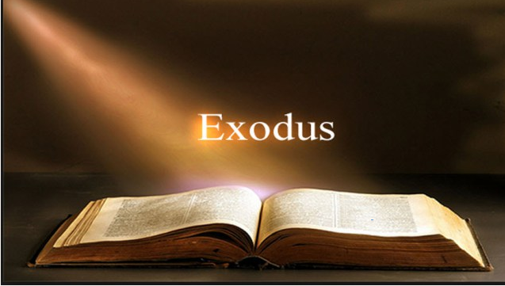

Slide 2
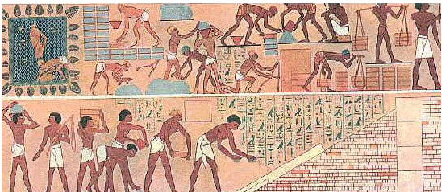
God’s people were slaves in Egypt.

Slide 3
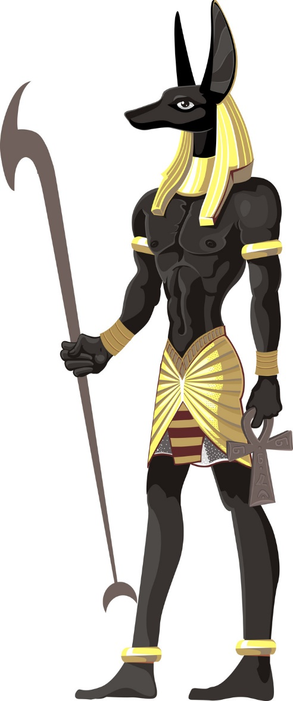

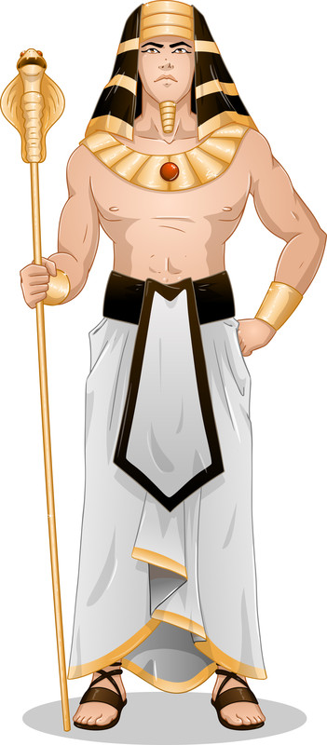
Pharaoh hates God’s people

Slide 4
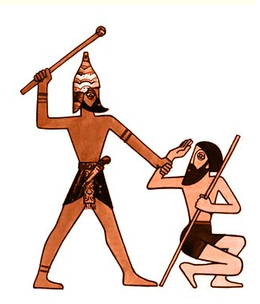


And orders that every first born child of the Hebrews be killed.
1

Slide 5
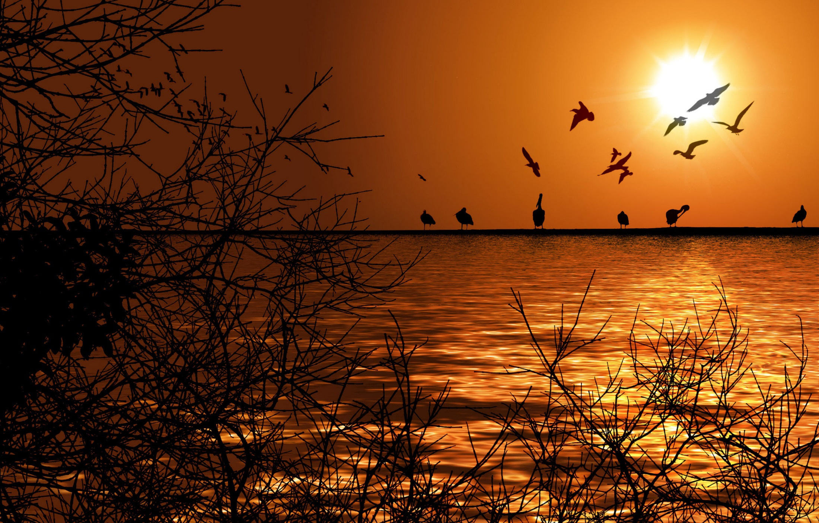
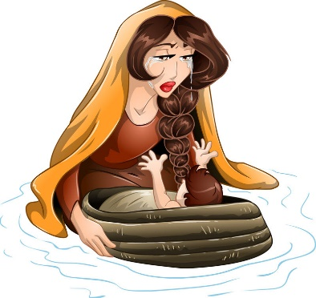
To Save Moses, his mother places him in a basket and puts him in the Nile River in hopes that he will be safe

Slide 6
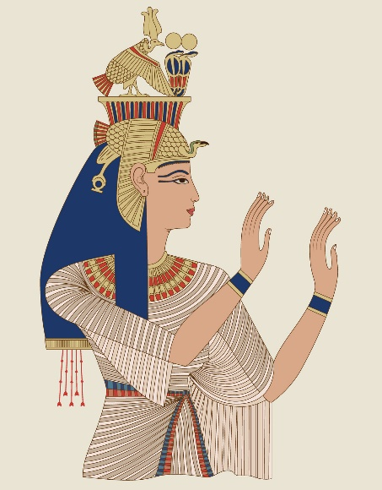
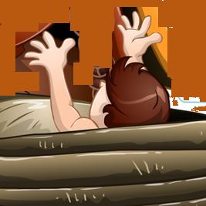
She watches as the Pharaoh’s Daughter rescues Moses from the river and takes him to be her son

Slide 7
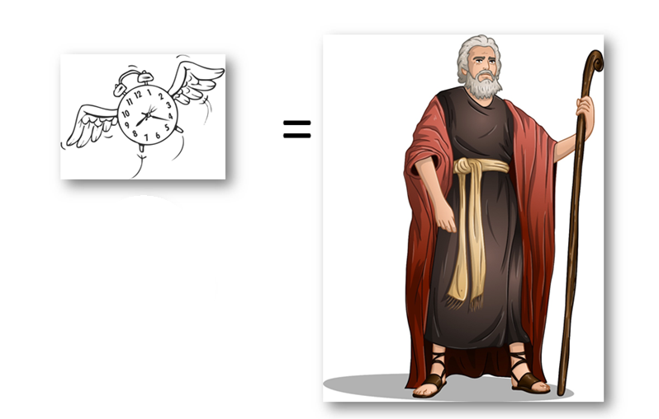

Slide 8
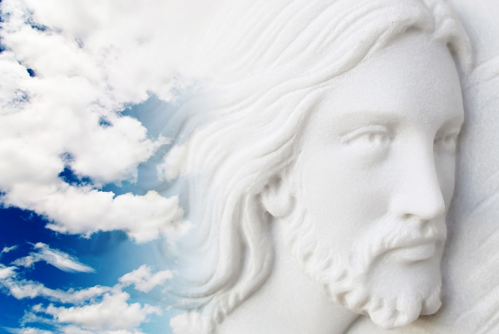
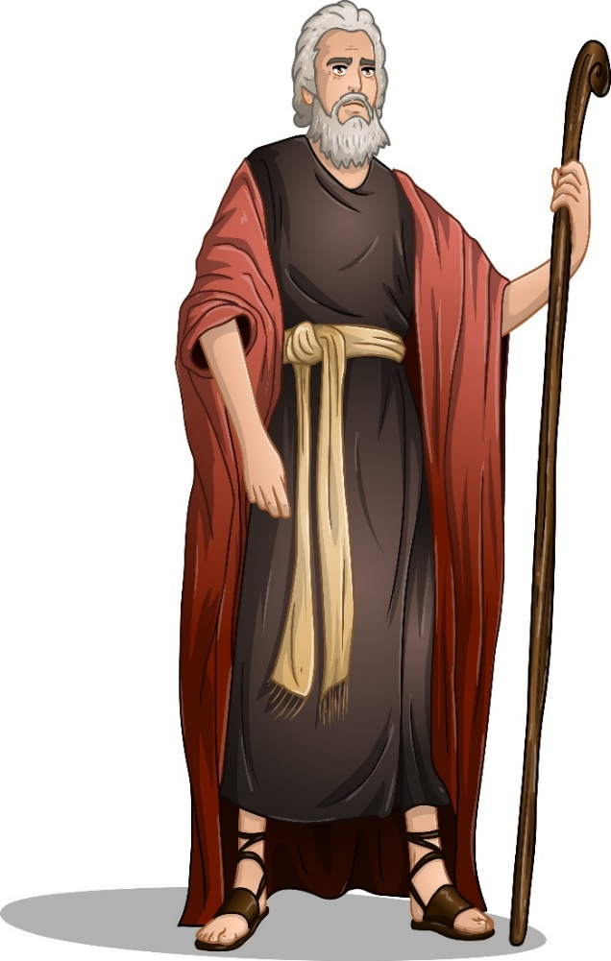
Lead my people out of bondage!
I will lead the people out of Egypt to the Promised Land

Slide 9
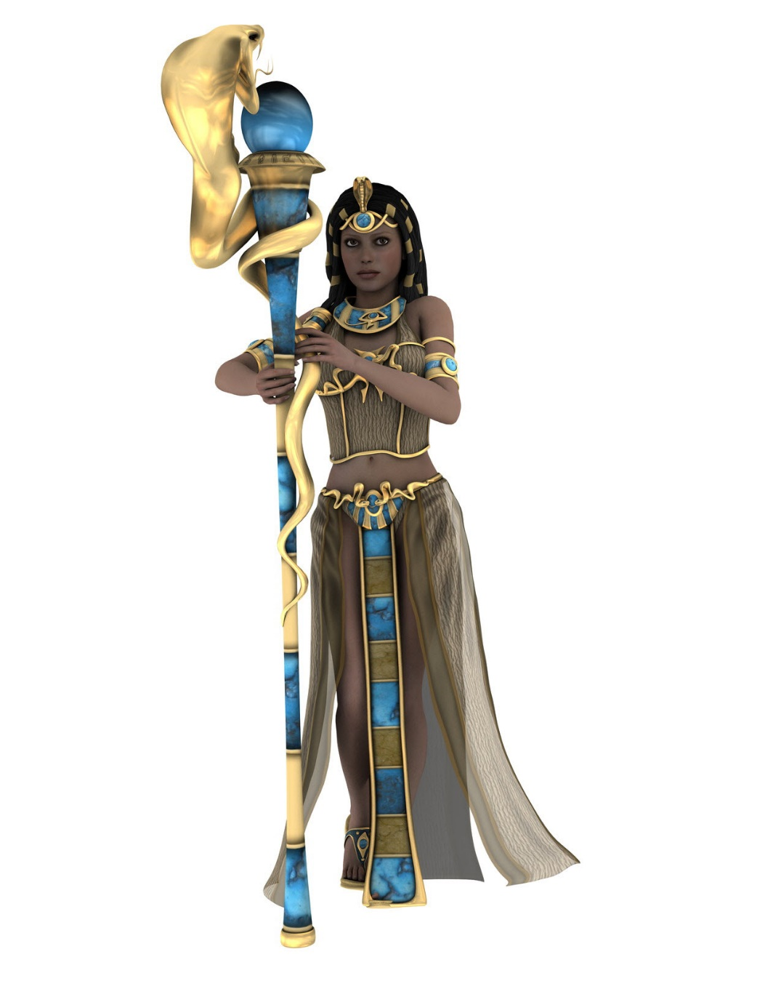


Moses goes to the Pharaoh and tells him to let God’s people go.
Let God’s people go!

Slide 10
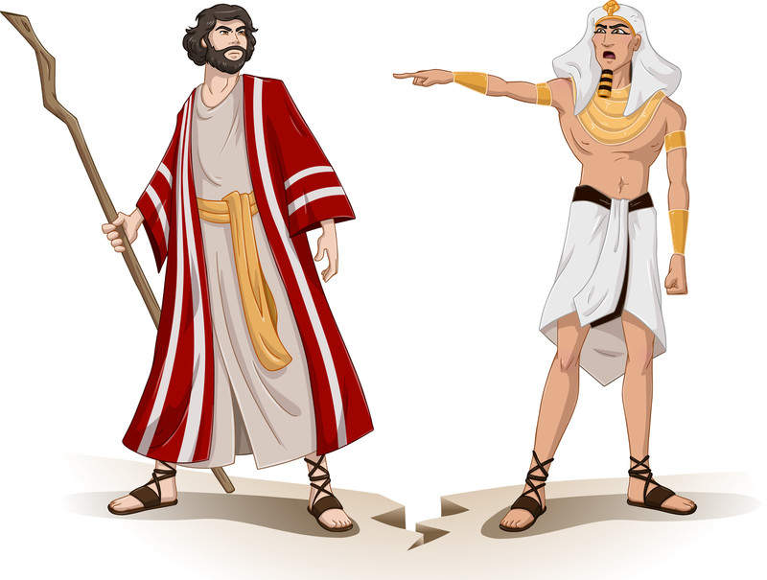

Slide 11
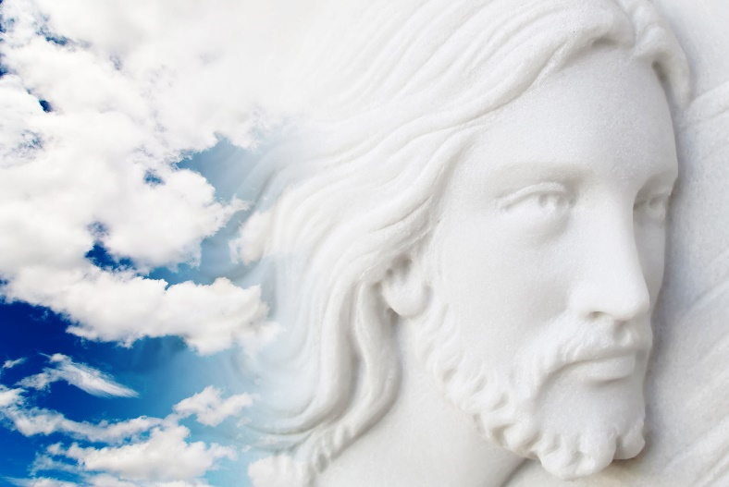

Turn the water to blood to prove to them that I am the only True God!

Slide 12

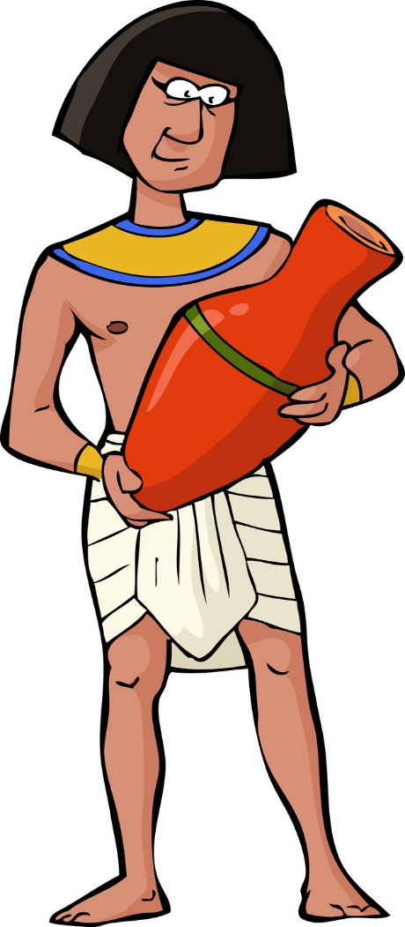
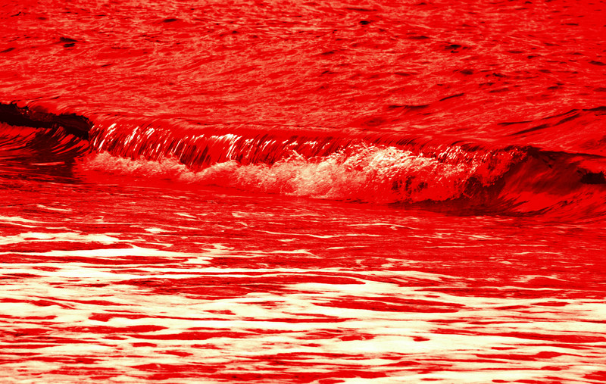
1) Turn the Nile River into Blood

Slide 14

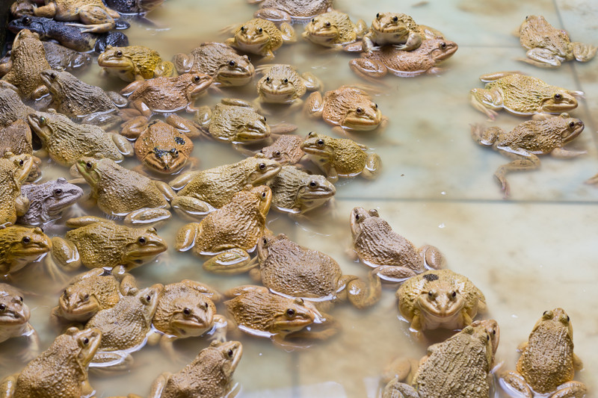
2) May Frogs take over the land

Slide 16

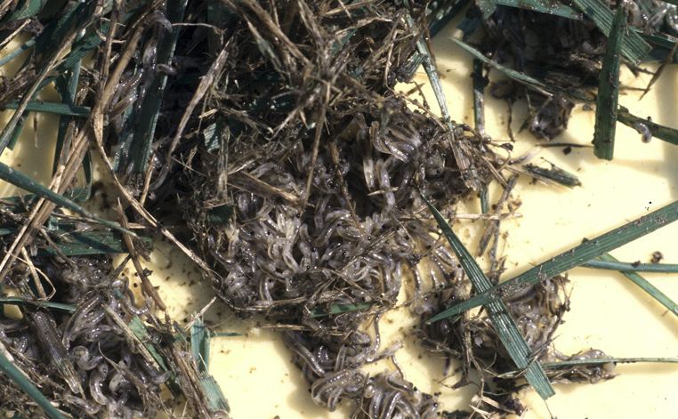
3) May you have Gnats and Lice upon you

Slide 18
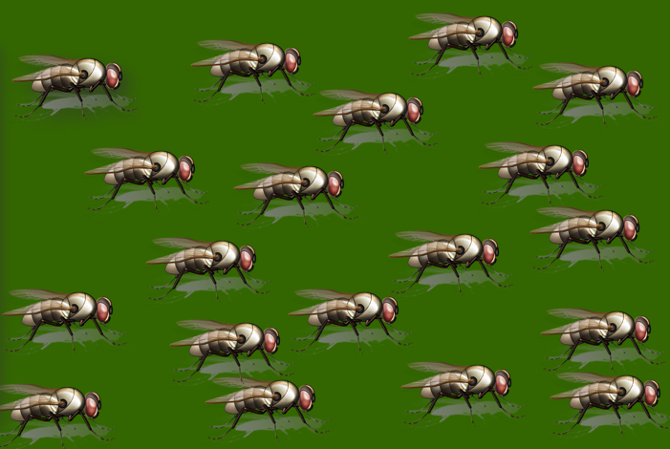

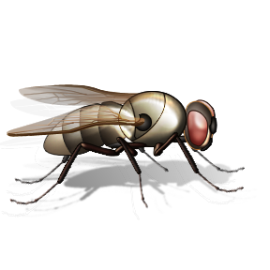
4) May flies dominate the land

Slide 20

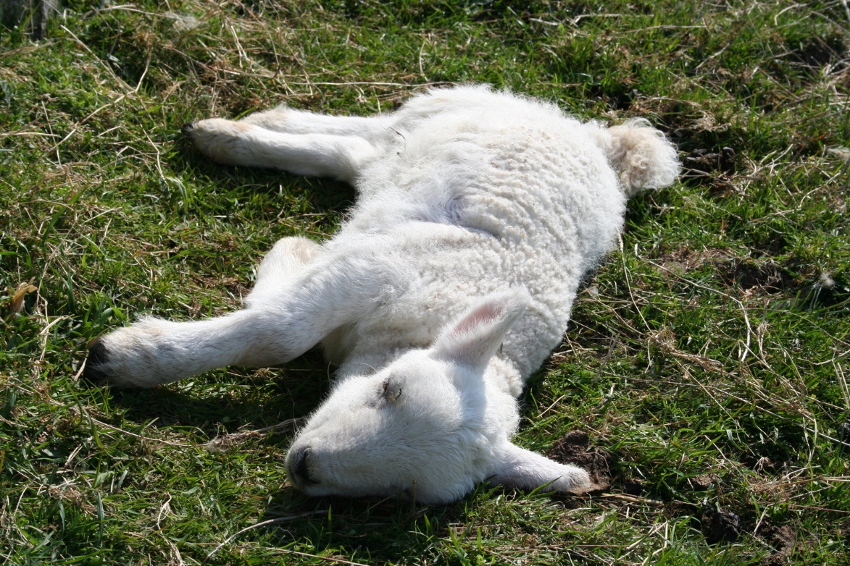
5) May all your livestock come down with disease

Slide 22

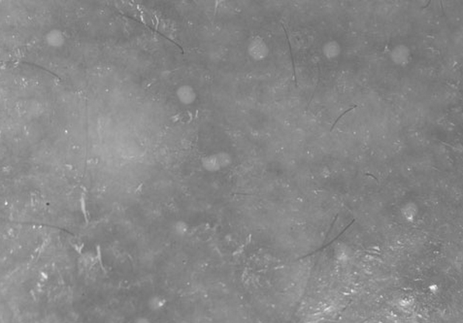
6) May all your people come down with boils

Slide 24
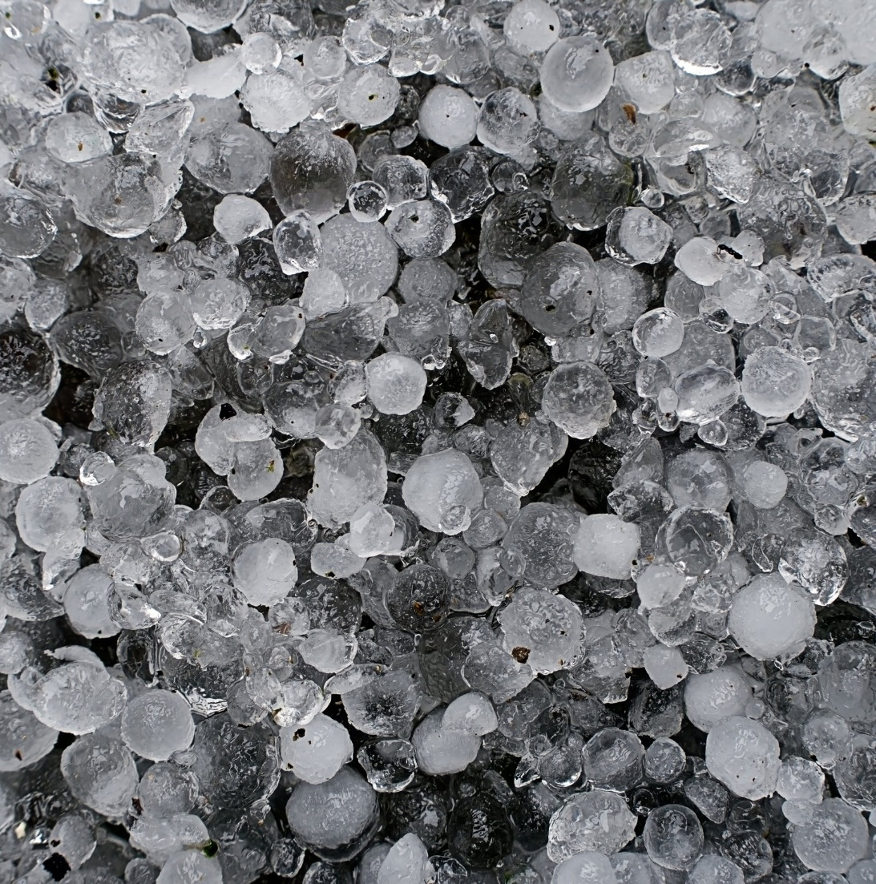
7) May hail and thunder rain down upon your land

Slide 26

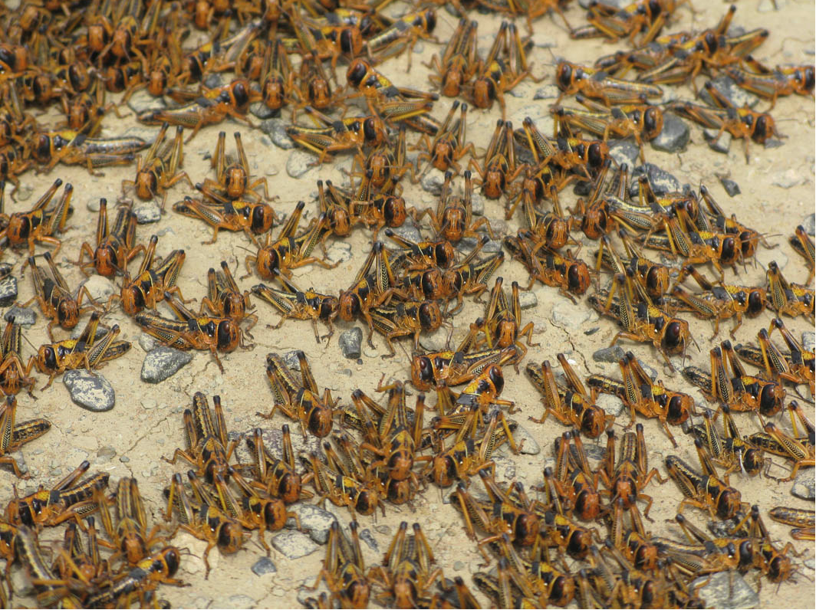
8) May locusts consume every crop and be everywhere

Slide 28
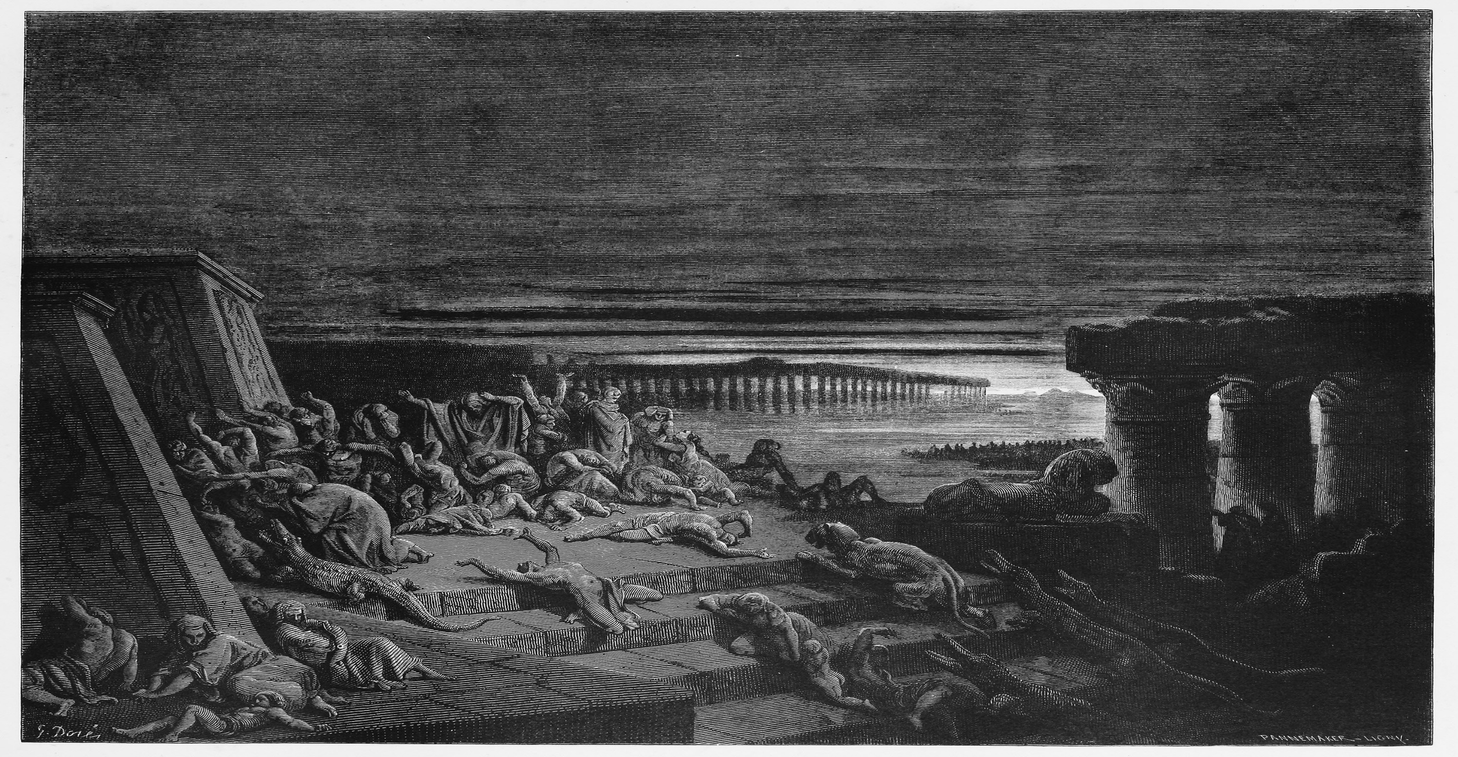
9) Then Darkness filled the land

Slide 30

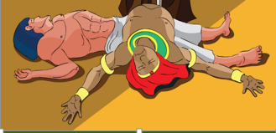
10) Then Pharaoh's First born child dies

Slide 31


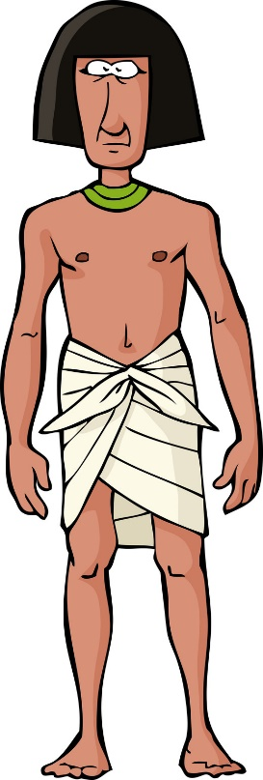
Take your people
and go!

Slide 32
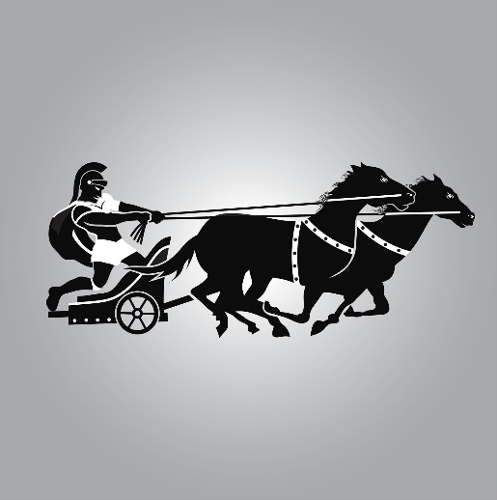
But Pharaoh changes his mind and goes after them
Take your people
and go!

Slide 33
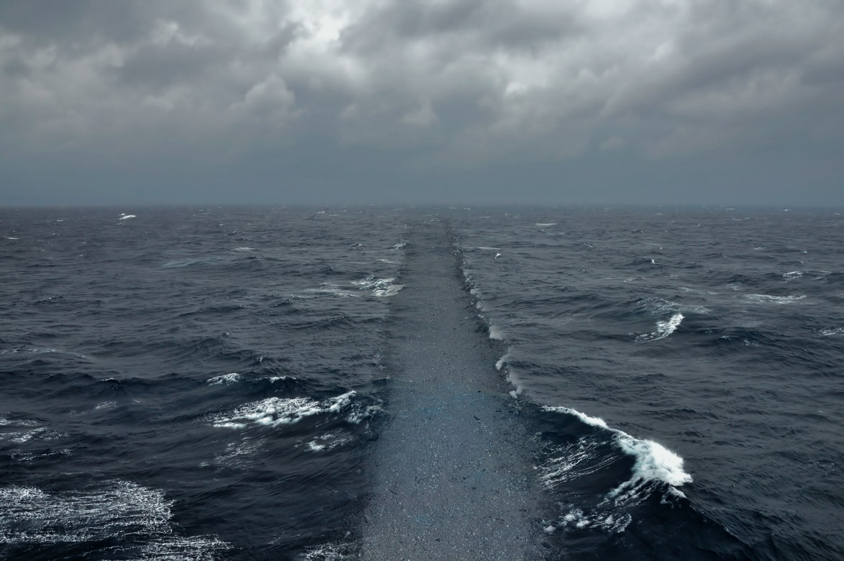

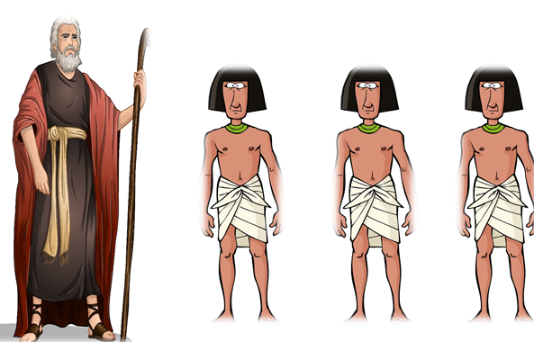




God helps Moses part the sea, then closes it when his people are safely across!

Slide 34
All of Pharaoh's men drowned along with their Chariots and horses that day

Slide 35
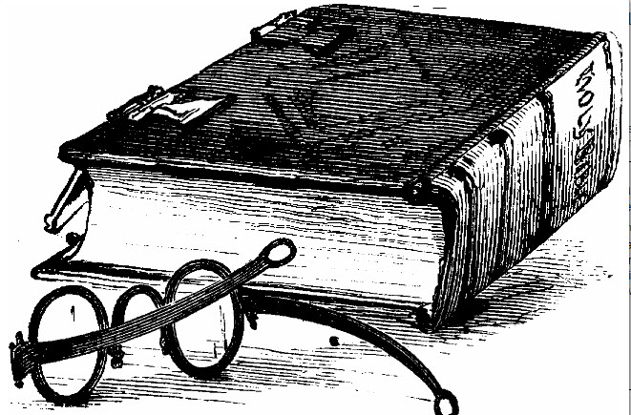
I’d like to thank CanStock for allowing me to purchase license rights to use these images.
canstockphoto.com

