Slide 1
Bible Basics Study 4: God And Death

Slide 2
www.biblebasicsonline.com www.carelinks.net Email: info@carelinks.net

Slide 3
4.1 The Nature Of Man

Slide 4
There is a refusal - albeit heavily masked - to take on board the fact that life is so short that all too soon the finality of death will be upon us. “For what is your life? It is even a vapour, that appears for a little time, and then vanishes away”. “We will surely die and become like water spilled on the ground, which cannot be gathered up again”. “Like grass which grows up; in the morning it flourishes and grows up; in the evening it is cut down and withers” (James 4:14; 2 Sam. 14:14; Ps. 90:5,6).
“So teach us to number our days, that we may gain a heart of wisdom.” (Ps. 90:12)

Slide 5
Contrary to God’s plain statement that man would “surely die” if he sinned (Gen. 2:17), the serpent asserted, “You will not surely die” (Gen. 3:4). This attempt to negate the finality and totality of death has become a characteristic of all false religions.

Slide 6
Man is dust
“The Lord God formed man of the dust of the ground...out of it (the ground) you (Adam) were taken; for dust you are, and to dust you shall return” (Gen. 2:7; 3:19). There is absolutely no hint here that man has any inherent immortality; there is no part of him that will live on after death.
“We are the clay” (Is. 64:8); “man is of the earth, made of dust;” (1 Cor. 15:47); man’s “foundation is in the dust” (Job 4:19); “and man would return to dust” (Job 34:14,15). Abraham admitted that he was “but dust and ashes” (Gen. 18:27). Immediately after disobeying God’s command in Eden, God “drove out the man...lest he put out his hand, and take also of the tree of life, and eat, and live for ever” (Gen. 3:24,22). If man had an immortal element within him naturally, this would have been unnecessary.

Slide 7
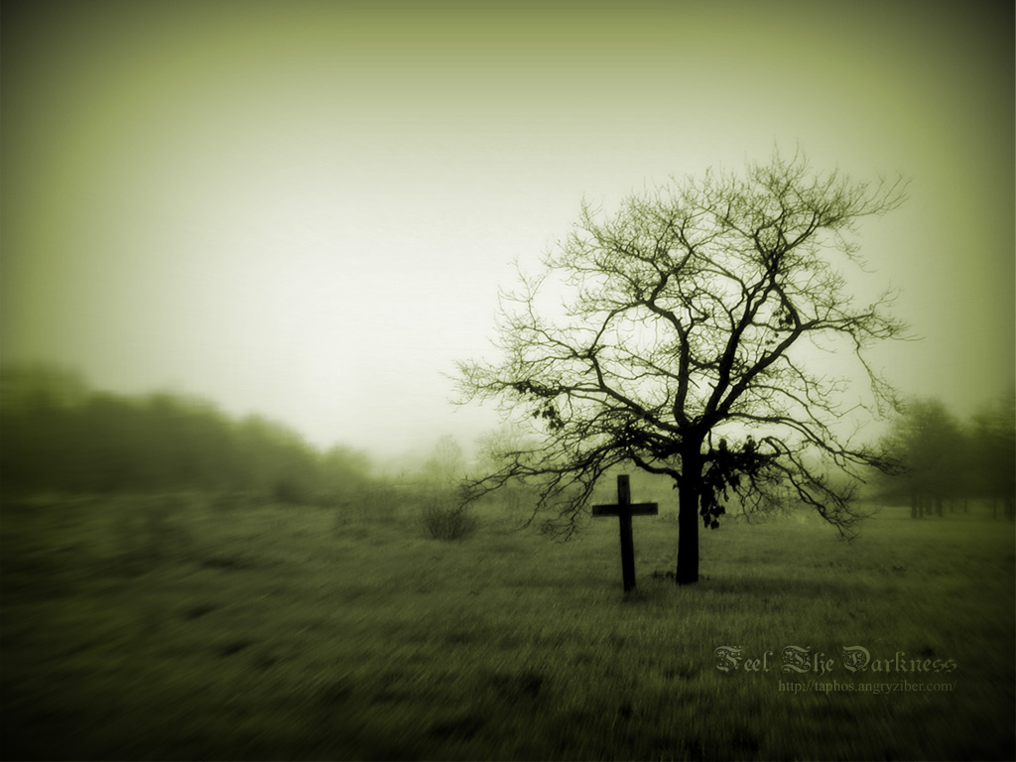
“By the sweat of your face you shall eat bread, till you return to the ground, for out of it you were taken; for you are dust, and to dust you shall return.”
Genesis 3:19

Slide 8
Conditional Immortality [1]
“Christ...has brought life and immortality to light through the gospel” (2 Tim. 1:10; 1Jn. 1:2). He is the “author” of “eternal salvation” (Heb. 2:10; 5:9 RVmg.).
“Unless you eat the flesh of the Son of man and drink his blood, you have no life in you (i.e. ‘inherent in you’). Whoever eats My flesh, and drinks My blood has eternal life, and I will raise him up at the last day” - to give him this “eternal life” (Jn. 6:53,54)
“God has given us (believers) eternal life, and this life is in His Son” (1 Jn. 5:11). There can be no hope of immortality for those not “in Christ”. Only through Christ has immortality been made possible; He is “the author of eternal salvation to all who obey him” (Heb. 5:9). Immortality for men was therefore originated through the work of Christ.

Slide 9
Conditional Immortality [2]
The true believer seeks for immortality, and will be rewarded for this by the gift of eternal life - something he does not naturally possess (Rom. 2:7; 6:23; Jn. 10:28). Our mortal body “must put on immortality” at the return of Christ (1 Cor. 15:53); thus immortality is something promised, not now possessed (1 Jn. 2:25).
If it should be that Christ did not rise from the dead, then those who have died in Him would perish (1 Cor. 15:18). It follows therefore that they did not have ‘immortal souls’ that went to reward in Heaven on death.
God alone has inherent immortality (1 Tim. 6:16).

Slide 10
4.2 The Soul

Slide 11
‘Nephesh’ and ‘Psuche’
The Hebrew and Greek words which are translated ‘soul’ in the Bible (‘Nephesh’ and ‘Psuche’ respectively) are also translated in the following ways:
Body, Breath, Creature, Heart, Mind, Person, Himself, Life
The ‘soul’ therefore refers to the person, body or self. The famous ‘Save Our Souls’ (S.O.S.) clearly means ‘Save us from death!’ The ‘soul’ is therefore ‘you’, or the summation of all the things that make up a person.

Slide 12
The creation of Adam
The animals which God created are called “living creatures...every living thing that moves” (Gen. 1:20,21). The Hebrew word translated “creatures” and “living thing” here is ‘nephesh’, which is also translated ‘being’; for example in Gen. 2:7: “...and man became a living being”. Thus man is a ‘soul’ or ‘living being’, just as the animals are ‘souls’ or ‘living beings’.

Slide 13
Man as an Animal in Death
“What happens to the sons of men also happens to beasts; one thing befalls them: (note the double emphasis): as one dies, so dies the other... man has no advantage over beasts...All (i.e. man and animals) go to one place (the grave); all are from the dust, and all return to dust” (Ecc. 3:19,20). The writer prayed that God would help men to appreciate this hard fact, “that (men) may see that they themselves are like beasts” (Ecc. 3:18).
The N.I.V. translation of Ecc. 3:18 says that God ‘tests’ man by making him see that he is just an animal; i.e. those who are humble enough to be His true people will realise the truth of this, but those who are not will fail this ‘test’.

Slide 14
The Soul Dies [1]
652 of the 754 times the Hebrew word nephesh occur, it is used about the soul or creature dying.
“The soul who sins shall die” (Ez. 18:4).
God can destroy the soul (Mt. 10:28). Other references to souls being destroyed are: Ez. 22:27 (people = nephesh); Prov. 6:32; Lev. 23:30 (person = nephesh).
All the “people” (nephesh) that were within the city of Hazor were killed by the sword (Josh. 11:11; cf. Josh. 10:30-39).
“...every living creature (psuche). died” (Rev. 16:3; cf. Ps. 78:50).

Slide 15
The Soul Dies [2]
“The blood of the lives (nephesh) of ... ” (Jer. 2:34).
“If a person (nephesh) sins in hearing ... an oath ...if he does not tell it...if he (nephesh) touches human uncleanness ...if a person (nephesh) swears, speaking thoughtlessly with his lips” (Lev. 5:1-4).

Slide 16
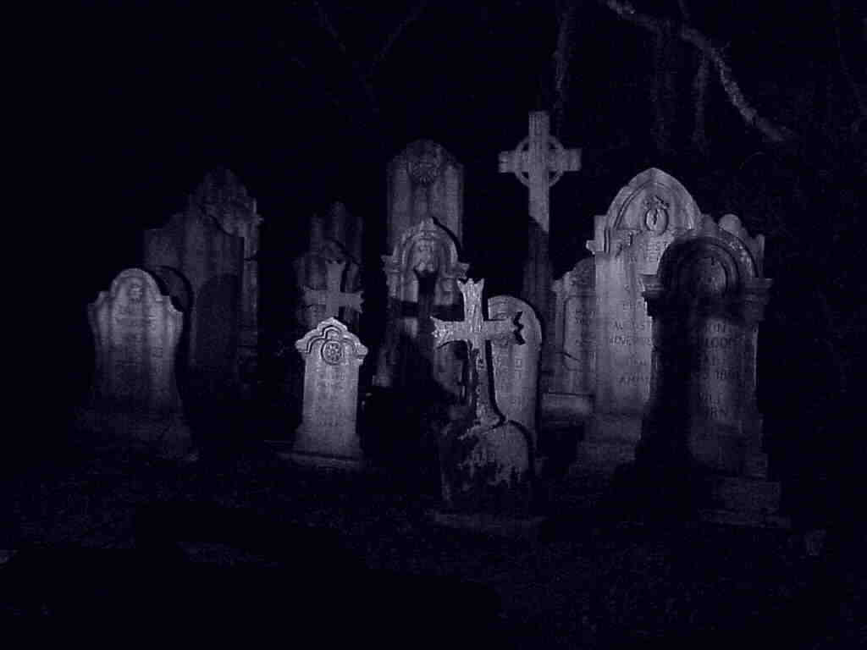
“The soul that sinneth, it shall die.”
Eze 18:20

Slide 17
4.3 The Spirit

Slide 18
The meaning of “spirit”
The Hebrew and Greek words for ‘spirit’ (‘Ruach’ and ‘Pneuma’ respectively) are also translated in the following ways.
Life, Spirit, Mind, Wind, Breath

Slide 19
Spirit as Life Force
“The body without the spirit is dead” (James 2:26). “God breathed into (Adam’s nostrils) the breath (spirit) of life; and man became a living being” (Gen. 2:7). Job speaks of “the breath of God” as being “in my nostrils” (Job 27:3 cf. Is. 2:22). The spirit of life within us is therefore given to us at birth, and remains as long as our body is alive.

Slide 20
The Spirit at Death [1]
When God’s spirit is withdrawn from anything, it immediately perishes - the spirit is the life force. If God “gather to Himself His spirit and His breath, all flesh would perish together, and man would return to dust. If you have understanding, hear this” (Job 34:14-16).

Slide 21
The Spirit at Death [2]
Ps. 146:3-5: “Do not put your trust in princes, nor in a son of man, in whom there is no help. His spirit departs, he returns to his earth (the dust from which we are made); in that very day his plans perish. Happy is he who has the God of Jacob for his help”.
At death, “the dust will return to the earth as it was, and the spirit will return to God who gave it” (Ecc. 12:7).

Slide 22
Man as an Animal in Death [1]
Men and animals have the same spirit, or life force, within them. “What happens to the sons of men also happens to beasts; one thing befalls them: as one dies, so dies the other. Surely, they all have one (i.e. the same) breath (spirit); man has no advantage over beasts” (Ecc. 3:19). There is no discernible difference between where the spirit of men and animals goes (Ecc. 3:21).

Slide 23
Man as an Animal in Death [2]
Both men and animals, who both had the spirit of life from God (Gen. 2:7; 7:15), were destroyed with the same death at the flood: “All flesh died that moved on the earth: birds and cattle and beasts and every creeping thing that creeps on the earth, and every man. All in whose nostrils was the breath of the spirit of life...died... all living things were destroyed” (Gen. 7:21-23).

Slide 24
4.4 Death Is Unconsciousness

Slide 25
Death is Unconsciousness [1]
“(Man’s) spirit (breath K.J.V.) departs, he returns to his earth; in that very day (moment) his plans perish” (Ps. 146:4).
“The dead know nothing...their love, their hatred, and their envy is now perished” (Ecc. 9:5,6). There is no “wisdom in the grave” (Ecc. 9:10) - no thinking and therefore no consciousness.
Job says that on death, he would be “as though he had not been” (Job 10:18-19); he saw death as the oblivion, unconsciousness and total lack of existence which we had before we were born.

Slide 26
Death is Unconsciousness [2]
Man dies as the animals do (Ecc. 3:19); if man consciously survives death somewhere, so must they, yet both Scripture and science are silent about this.
God “remembers that we are dust. As for man, his days are like grass; as a flower of the field, so he flourishs...it is gone, and its place remembers it no more” (Ps. 103:14-16).
Believers knew that after death they would be unable to praise and glorify God, seeing that death was a state of unconsciousness- e.g. Hezekiah (Is. 38:17-19) and David (Ps. 6:4,5; 30:9; 39:13; 115:17

Slide 27
Death as a Sleep
Job 3:11-17: Why didn’t I die from the womb? Why didn’t I give up the spirit when my mother bore me? … For now should I have lain down and been quiet. I should have slept, then I would have been at rest… There the wicked cease from troubling. There the weary are at rest.
Dan. 12:2,13 Many of those who sleep in the dust of the earth shall awake, some to everlasting life, and some to shame and everlasting contempt. .. But go you your way until the end; for you shall rest, and shall stand in your lot, at the end of the days.

Slide 28
False Ideas
1. That the reward for our lives is given at death in the form of our ‘immortal soul’ being assigned to a certain place.
2. That the separation between righteous and wicked occurs at death.
3. That the reward for the righteous is to go to heaven.
4. That if everyone has an ‘immortal soul’, then everyone must go to either heaven or hell.
5. That the wicked ‘souls’ will go to a place of punishment called hell.
6. An immortal soul.

Slide 30
"The Bible nowhere says that we go to heaven when we die, nor does it ever describe death in terms of going to heaven. In the Old Testament, you went to sheol when you died". John Robinson, Bishop of Woolwich, On Being The Church In The World (Harmondsworth, UK: Penguin, 1960) p. 156.

Slide 31
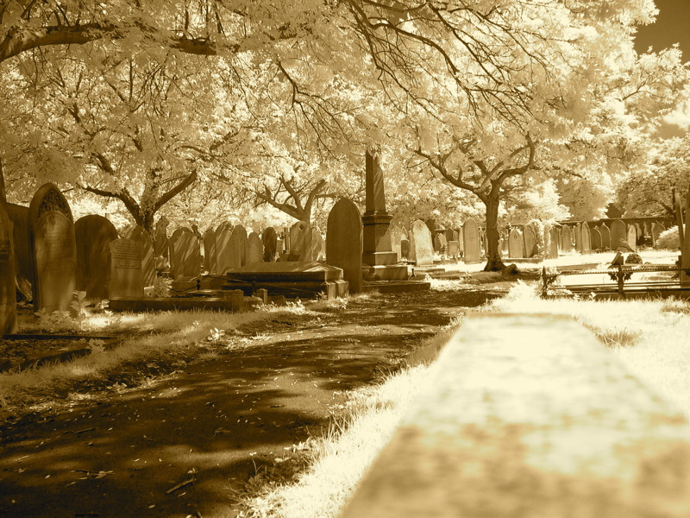
So is this
our only hope?
Death? Forever?
Notes:
.

Slide 32
4.5 The Resurrection

Slide 33
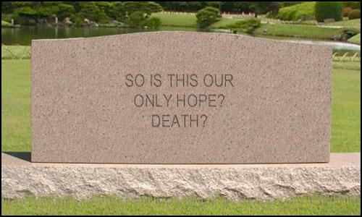
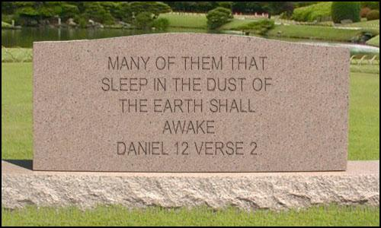

Slide 35
DIE TO SELF
BORN AGAIN
RAISED ANEW
LIVE FOR CHRIST
LIVE FOREVER
Notes:
So here is that chart again.
DIE TO SELF Col 3:3 For you have died, and your life is hidden with Christ in God.
Col 3:4 When Christ who is your life appears, then you also will appear with him in glory.
Col 3:5 Put to death therefore what is earthly in you: sexual immorality, impurity, passion, evil desire, and covetousness, which is idolatry.
BORN AGAIN
Joh 3:3 Jesus answered and said unto him, Verily, verily, I say unto thee, Except a man be born again, he cannot see the kingdom of God.
RAISED ANEW
Col 3:1 If then you have been raised with Christ, seek the things that are above, where Christ is, seated at the right hand of God.
Rom 6:6 Knowing this, that our old man is crucified with him, that the body of sin might be destroyed, that henceforth we should not serve sin.
LIVE FOR CHRIST
Rom 6:8 Now if we have died with Christ, we believe that we will also live with him.
LIVE FOREVER
Joh 3:16 "For God so loved the world, that he gave his only Son, that whoever believes in him should not perish but have eternal life.

Slide 36
Resurrection of the Body [1]
At his return, Christ “will transform our lowly body, that it may be conformed to his glorious body” (Phil. 3:20,21). Those who have died and decomposed to dust will “awake and sing” (Is. 26:19).
Through baptism we associate ourselves with Christ’s death and resurrection, showing our belief that we too will share the reward which he received through his resurrection (Rom. 6:3-5).

Slide 37
Resurrection of the Body [2]
Through sharing in his sufferings now, we will also share his reward: “carrying about (now) in the body the dying of the Lord Jesus, that the life of Jeus also may be manifested in our body” (2 Cor. 4:10).
“He who raised Christ from the dead will also give life to your mortal bodies through his Spirit” (Rom. 8:11). With this hope, we therefore wait for “the redemption of our body” (Rom. 8:23), through that body being immortalised.

Slide 38
“That blessed hope”

Slide 39
The Faithful Hope for Resurrection
“My redeemer lives, and...shall stand at last on the earth: and after my skin is destroyed, ... in my flesh (or bodily form) I shall see God, whom I shall see for myself, and my eyes shall behold, and not another. How my heart yearns within me!” (Job 19:25-27).
Isaiah’s hope was identical: “My dead body shall...arise” (Is. 26:19).
“Your brother will rise again…Martha said to him, I know that he will rise again in the resurrection at the last day” (Jn. 11:23,24).
“Everyone who has heard and learned from the Father...I will raise him up at the last day” (Jn. 6:44,45).

Slide 41
4.6 The Judgment

Slide 42
Judgment will Come
We will “stand before the judgment seat of Christ” (Rom. 14:10); we “must all have our lives laid open before the tribunal of Christ” (2 Cor. 5:10) to “receive what is due to him for his conduct in the body, good or bad.” (R.E.B.)
“At the end of the age. The angels will come forth, (and) separate the wicked from among the just” (Mt. 13:47-49).

Slide 43
The Separation of Good from Bad
“The Son of man comes in his glory, and all the holy angels with him, then he will sit on the throne of his glory (David’s throne in Jerusalem, Lk. 1:32,33). All the nations (i.e. people from all nations, cf. Mt. 28:19) will be gathered before him, and he will separate them one from another, as a shepherd divides his sheep from the goats. And he will set the sheep on his right hand, but the goats on the left. Then the King will say to those on his right hand, ‘Come, you blessed of my Father, inherit the Kingdom prepared for you ...’” (Mt. 25:31-34).

Slide 44
When Christ returns, then the gracious reward will be given - and not before
“When the chief Shepherd (Jesus) shall appears, you will receive the crown of glory” (1 Pet. 5:4 cf. 1:13).
“Jesus Christ...will judge the living and the dead at his appearing and his kingdom...the crown of righteousness, which the Lord, the righteous judge, will give to me on that day” (2 Tim. 4:1,8).
At Messiah’s return in the last days, “many of those who sleep in the dust of the earth ( cf. Gen. 3:19) shall awake, some to everlasting life, and some to shame” (Dan. 12:2).

Slide 45
When Christ comes in judgment, those “in the graves...will...come forth - those who have done good, to the resurrection of life, and those who have done evil, to the resurrection of condemnation” (Jn. 5:25-29).
“I (Jesus) am coming quickly, and my reward is with me, to give to every one according to his work.” (Rev. 22:12). We do not go to heaven to get the reward - Christ brings it from heaven to us.

Slide 46
Separation Between Good and Bad at the Judgment- Not at Death
Jonathan was righteous but Saul wicked, yet “in their death they were not divided” (2 Sam. 1:23).
Saul, Jonathan and Samuel all went to the same place at death (1 Sam. 28:19).
Righteous Abraham was “gathered to his people”, (or ancestors), on death; they were idolaters (Gen. 25:8; Josh. 24:2).
The spiritually wise and foolish experience the same death (Ecc. 2:15,16).

Slide 47
All the righteous will be rewarded together, at the same time.
“Come, you blessed of my Father, inherit the Kingdom prepared for you” (Mt. 25:34). Thus all the sheep inherit the Kingdom at the same time ( cf. 1 Cor. 15:51).
At “the harvest” of Christ’s return and judgment, all those who have laboured in the Gospel will “rejoice together” (Jn. 4:35,36 cf. Mt. 13:39).
“These all died in faith, not having received the promises” made to Abraham about salvation through entering God’s Kingdom (Heb. 11:8-12). It follows that at their death, these men did not, one by one, go off to heaven to receive a reward. The reason for this is given in vs. 39,40: They “did not receive the promise, God having provided something better for us, that they should not be made perfect apart from us”.

Slide 48
4.7 The Place Of Reward: Heaven Or Earth?

Slide 49
The ‘Lord’s Prayer’ asks for God’s Kingdom to come (i.e. praying for the return of Christ), whereby God’s desires will be done on earth as they are now done in heaven (Mt. 6:10). We are therefore praying for God’s Kingdom to come on the earth.
“Blessed are the meek, for they shall inherit the earth” (Mt. 5:5) - not ‘...for their souls shall go to heaven’.
“The meek shall inherit the earth...those who are blessed by him shall inherit the earth...The righteous shall inherit the land, and dwell in it for ever” (Ps. 37:11,22,29).

Slide 50
“David...is both dead and buried...David did not ascend into the heavens” (Acts 2:29,34).
Earth is the arena of God’s operations with mankind: “Heaven, even the heavens, are the Lord’s, but the earth He has given to the children of men” (Ps. 115:16).
Rev. 5:9,10: (Christ) has “made us kings and priests to our God; and we shall reign on the earth”.
The dominion of the Kingdom will be “under the whole heaven”, and will fill “the whole earth” (Dan. 7:27; 2:35 cf. v. 44).

Slide 51
4.8 Responsibility To God

Slide 52
Knowledge of God’s Word Makes us Responsible to Judgment
“He who rejects Me, and does not receive My words, has that which judges him - the word that I have spoken will judge him in the last day” (Jn. 12:48).
“As many as have sinned without (knowing God’s) law, will also perish without law, and as many as have sinned in the law (i.e. knowing it), will be judged by the law” (Rom. 2:12).
In God’s sight “sin is not imputed when there is no law”; “by the law is the knowledge of sin” (Rom. 5:13; Rom. 3:20).

Slide 53
Jn. 15:22 shows that knowledge of the Word brings responsibility: “If I (Jesus) had not come and spoken to them, they have no sin, but now they have no excuse for their sin”.
“Therefore everyone who has heard and learned from the Father...I (Christ) will raise him up at the last day” (Jn. 6:44,45).
“Whoever will not hear (i.e. obey) my words…I will require it of him” (Dt. 18:19).

Slide 54
“That servant who knew his master’s will, and did not prepare himself or do according to his will, shall be beaten with many stripes. But he who did not know, yet committed things worthy of stripes, shall be beaten with few. (e.g. by remaining dead). For everyone to whom much is given, from him much will be required; and to whom much has been committed, of him they will ask the more” (Lk. 12:47,48) - so how much more God?
“Therefore, to him who knows to do good and does not do it, to him it is sin” (James 4:17).

Slide 55
Israel’s special responsibility to God was on account of His revelations to them concerning Himself (Am. 3:2). “Therefore I will punish you for all your iniquities ...” “and you shall all bow down to the slaughter; because, when I called, you did not answer; when I spoke, you did not hear, but did evil” (Is. 65:12).

Slide 56
Not all who have ever lived will be raised
The people of the ancient nation of Babylon “will ... sleep a perpetual sleep and not awake” after their death because they were ignorant of the true God (Jer. 51:39; Is. 43:17).
Isaiah encouraged himself: “O Lord our (Israel’s) God, other masters besides You have had dominion over us (e.g. the Philistines and Babylonians)...They are dead, they will not live (again); they are deceased, they will not rise...all their memory to perish” (Is. 26:13,14). Note the triple emphasis here on their not being raised: “will not live (again)...will not rise...all their memory to perish”. By contrast, Israel had the prospect of resurrection on account of their knowledge of the true God: “Your (Israel’s) dead shall live; together with my dead body they shall arise” (Is. 26:19).

Slide 57
4.9 Hell

Slide 58
The meaning of sheol
The original Hebrew word ‘sheol’, translated ‘hell’, means ‘a covered place’. ‘Hell’ is the anglicised version of ‘sheol’; thus when we read of ‘hell’ we are not reading a word which has been fully translated. A ‘helmet’ is literally a ‘hell-met’, meaning a covering for the head. Biblically, this ‘covered place’, or ‘hell’, is the grave.

Slide 59
Jonah in “Hell”
“Jonah prayed unto the Lord his God from the fish’s belly. And he said: ‘I cried...to the Lord...out of the belly of Sheol (hell) I cried” (Jonah 2:1,2). This parallels “the belly of Sheol” with that of the fish. The fish’s belly was truly a ‘covered place’, which is the fundamental meaning of the word ‘sheol’. Obviously, it was not a place of fire, and Jonah came out of “the belly of Sheol” when the fish vomited him out. This pointed forward to the resurrection of Christ from ‘hell’ (the grave) - see Mt. 12:40.

Slide 60
Sheol is translated ‘grave’
“Let the wicked...be silent in the grave” (sheol [Ps. 31:17]) - they will not be screaming in agony.
“God will redeem my soul from the power of the grave” (sheol [Ps. 49:15]) - i.e. David’s soul or body would be raised from the grave, or ‘hell’.
Hos. 13:14: “I will ransom them (God’s people) from the power of the grave (sheol); I will redeem them from death”. This is quoted in 1 Cor. 15:55 and applied to the resurrection at Christ’s return.

Slide 61
The righteous are resurrected out of sheol
1 Sam. 2:6: “The Lord kills and makes alive (through resurrection); he brings down to the grave (sheol), and brings up”.
Jesus, whose “soul was not left in Hades (hell), nor did his flesh see corruption” (Acts 2:31) because he was raised. Note the parallel between Christ’s ‘soul’ and his ‘flesh’ or body. That his body “was not left in Hades” implies that it was there for a period, i.e. the three days in which his body was in the grave. That Christ went to ‘hell’ should be proof enough that it is not just a place where the wicked go.

Slide 62
Both good and bad people go to ‘hell’, i.e. the grave.
Jesus “made his grave with the wicked” (Is. 53:9).
Jacob said that he would “go down into the grave (hell)...mourning” for his son Joseph (Gen. 37:35).

Slide 63
Hell is not a Place of Eternal Torment
. God has no pleasure in punishing wicked people (Ez. 18:23,32; 33:11 cf. 2 Pet. 3:9).
“Like sheep they are laid in the grave (hell); death shall feed on them” (Ps. 49:14)
Despite Christ’s soul, or body, being in hell for three days, it did not suffer corruption (Acts 2:31). This would have been impossible if hell were a place of fire.

Slide 64
Ezekiel 33
Ez. 32:26-30 gives a picture of the mighty warriors of the nations around, lying in their graves: “the mighty who are fallen (in battle)...who have gone down to hell with their weapons of war; they have laid their swords under their heads...they shall lie...with those who go down to the Pit”. This refers to the custom of burying warriors with their weapons, and resting the head of the corpse upon its sword. Yet this is a description of “hell” - the grave. These mighty men lying still in hell (i.e. their graves), hardly supports the idea that hell is a place of fire. Physical things (e.g. swords) go to the same “hell”

Slide 65
“Eternal fire” not literal; it symbolizes God’s anger and complete destruction
Sodom was punished with “eternal fire” (Jude v. 7)
“Then I will kindle a fire in its gates, and it shall devour the palaces of Jerusalem, and it shall not be quenched” (Jer. 17:27).
God punished the land of Idumea with fire that would “not be quenched night nor day; its smoke shall ascend for ever. From generation to generation it shall lie waste...the owl and the raven shall dwell in it...thorns shall come up in its palaces” (Is. 34:9-15).

Slide 66
Gehenna
In the New Testament there are two Greek words translated ‘hell’. ‘Hades’ is the equivalent of the Hebrew ‘sheol’, the grave. ‘Gehenna’ is the name of the rubbish tip which was just outside Jerusalem, where the refuse from the city was burnt.

Slide 67
‘Gehenna’ is the Aramaic equivalent of the Hebrew ‘Ge-ben-Hinnon’. This was located near Jerusalem (Josh. 15:8), and at the time of Christ it was the city rubbish dump. Dead bodies of criminals were thrown onto the fires which were always burning there, so that Gehenna became symbolic of total destruction and rejection.

Slide 68
Ever-smoking rubbish dump near Antananarivo, Madagascar

Slide 69
The rejected at the judgment seat at Christ’s return will go “to hell (i.e. Gehenna), into the fire that shall never be quenched ... where their worm does not die” (Mk. 9:43,44). The reference to “where their worm does not die”, is evidently part of this same idiom for total destruction - it is inconceivable that there could be literal worms which will never die.

Slide 70
“The wages of sin is death” (Rom. 6:23), which is unconsciousness. The punishment for sin is not eternal torture in literal fire.

Slide 71
www.biblebasicsonline.com www.carelinks.net Email: info@carelinks.net

Slide 72
Study 4: Questions
1. What happens when we die?
a) The soul goes to heaven
b) We become totally unconscious and our bodies return to the dust
c) The soul is stored somewhere until judgment
d) Wicked souls go to hell and the good ones to Heaven
2. What is the soul?
a) An immortal part of our being
b) A word meaning ‘body, person, creature’
c) Exactly the same as the spirit
d) Something which goes to heaven or hell after death
3. What is the spirit of man?
4. Briefly describe the nature of man.
5. List two Bible verses which prove that death is a state of unconsciousness.
6. What do you know about the judgment seat of Christ?
7. Who will be raised and judged?
8. What is hell?
9. What is Gehenna?

